Slide 1
Open Records and Open Meetings Laws
Lexie Bergstrom
Staff Attorney
North Dakota School Boards Association

Slide 2
Disclaimer
This presentation is not intended as legal advice.
The information and commentary provided in this presentation and any comments or materials provided are for educational purposes only and should not be considered legal advice.
Please consult with you school board’s attorney for legal counsel as needed.

Slide 3
Open Records & Open Meetings
Primary Sources
ND Constitution Article 11
N.D.C.C. Chapter 44-04
N.D.C.C. Chapter 15.1
Secondary Sources
North Dakota Attorney General Opinions
North Dakota Supreme Court Cases

Slide 4
Open Records

Slide 5
Open Records Basics
What is subject to open record laws?
All records
In the possession of a public entity
Regarding public business
N.D.C.C. § 44-04-17.1(16)

Slide 6
Open Records Basics
What is a Record?
Recorded information of any kind, regardless of the physical form or characteristics by which the information is stored, recorded, or reproduced…
N.D.C.C. § 44-04-17.1(16)
What is Public Business?
All matters that relate or may foreseeably relate in any way to…the performance of the public entity’s governmental functions, including any matter over which the public entity has supervision, control, jurisdiction, or advisory power; or…the public entity’s use of public funds.
N.D.C.C. § 44-04-17.1(12)

Slide 7
Examples of Records that are Generally Open
Personnel file, including:
Job performance
Evaluations
Business-related emails
Records on personal devices, including:
Cell phones (email, messages, photos)
Computers (email, documents, etc.)
Contracts with a public entity, including:
Prices
costs

Slide 8
Open Records Basics
There must be a law that specifically says the record is protected.
The law will typically say the record is:
“not subject to Article XI of the North Dakota Constitution,”
“not an open record,”
“exempt,” or
“confidential.”

Slide 9
Open Records Basics
Exempt
Confidential
May be released.
Public entity has discretion-needs entity action.
May be called a “closed” record.
Not against the law to release an exempt record.
Cannot be released.
Public entity has no discretion.
Can only be released pursuant to a statute.
Class C felony to knowingly release confidential records.
N.D.C.C. § 44-04-17.1(5) and N.D.C.C. § 44-04-17.1(3)

Slide 10
Exempt
Public employee personal information, including
Month/day of birth;
Home address;
Personal phone numbers;
Photograph;
DMV and employee ID numbers;
Payroll deduction information;
Dependent/emergency contact information;
Any credit, debit, or electronic fund transfer card number;
Any account number at a bank or other financial institution;
Type of leave taken, and leave applied for but not yet taken.
Internal investigation complaints-for no more than 75 days from the date of the Complaint
Confidential
Social Security Numbers;
Computer passwords;
Employee use of employee assistance programs; and
CHRI checks performed by BCI

Slide 11
More Record Examples
Trade secret, proprietary, commercial, and financial information is confidential “if it is of a privileged nature.” N.D.C.C. § 44-04-18.4(1).
Economic development records and information may be exempt. N.D.C.C. § 44-04-18.4(5).
Bids received by a public entity in response to an invitation for bids by the public entity are exempt until all of the bids have been received and opened by the public entity. N.D.C.C. § 44-04-18.4(6)(a).
Proposals received by a public entity in response to a request for proposals are exempt records until a notice of intent to award is issued. N.D.C.C. § 44-04-18.4(6)(b)
Records included with any bid or proposal naming and generally describing the entity submitting the proposal are open. N.D.C.C. § 44-04-18.4(6)(C).

Slide 12
More Record Examples, Cont.
2021 Open Record Legislative Changes:
Medical records, or a record containing medical information, in possession of a public entity are exempt. N.D.C.C. § 44-04-18.32.
Active litigation records. Records obtained, compiled, or prepared by a public entity or the attorney representing a public entity for the purpose of litigation, unless the records already have been filed publicly or the litigation is completed are exempt. N.D.C.C. § 44-04-19.1(12).
Applications. Applications and any records related to the applications which contain information that could reasonably be used to identify an applicant are exempt. Finalists’ information remains open. N.D.C.C. § 44-04-18.27

Slide 13
Responding to Record Requests
Every person has the right to inspect or make a request for a public record.
Generally, an entity cannot make a requester fill out a form.
Although you cannot require the initial request in writing either, you can request written (reasonable) clarification.
Exception- if you need to verify identity to release an otherwise confidential or exempt record.
A requester DOES NOT have to give their name or reason for the request.
Exception- to verify identity for confidential or exempt records.
You only have to provide one copy of the record, once.
N.D.C.C. § 44-04-18

Slide 14
Responding to Record Requests
You must provide RECORDS- not opinions or explanations.
A request for information is not a request for records.
Requests should reasonably identify the record.
Can clarify; do not intimidate.
Can suggest.
You only have to provide records you have in your possession.
However, you cannot contract with a third party to “hold” your records and then claim not in your “possession”.
NDCC § 44-04-18

Slide 15
Responding to Record Requests
You do not have to create new records or put in a new format
Exceptions:
If the requester asks for a paper copy and you only have an electronic copy, you must provide a paper copy, but you can charge in accordance with N.D.C.C. § 44-04-18(2).
Text messages- you are not required to provide access to the device.
You must give a legal reason for any denial of records.
Including if records do not exist.
Review and redact for confidential information.
N.D.C.C. § 44-04-18.10
Communicate with the requester- give estimate of time, costs, etc.
N.D.C.C. § 44-04-18

Slide 16
Responding to Record Requests
You may allow an individual to utilize the individual's own personal devices for duplication of records. If allowed, you shall establish reasonable procedures to protect the integrity of the records as long as the procedures are not used to prevent access to the records.
If records are available on the internet, you can refer the requestor to the website.
However, if the requestor does not have internet access or a computer, you will need to provide a paper copy of the record.
Can charge in compliance with N.D.C.C. § 44-04-18

Slide 17
Reasonable Time
Several factors are used to determine appropriate length of any delay, including:
Need to consult with attorney if reasonable doubt exists on whether the record is open;
Excising confidential information;
Bulk of request and volume of documents reviewed;
Accessibility of documents; and
Office staff and availability, workload, balancing of other responsibilities.
If there will be a delay-communicate that to the requester.

Slide 18
Basics of Charging
May charge up to 25¢ per copy of a size no more than 8x14.
May charge actual costs of postage, maps, color photos.
Locating records-first hour free, thereafter $25/hour.
Redacting confidential information- first hour free, thereafter $25/hour
No charge to forward electronic copies unless it takes IT longer than one hour to produce, thereafter can charge actual cost of IT resources.
May require payment before locating, redacting, making, or mailing the copy.
5 or more requests from the same requestor within 7 days-may treat as one request when computing time to locate/excise records.
Access is (usually) free!
N.D.C.C. § 44-04-18(2)

Slide 19
Template for Public Entity Use When Responding to an Open Records Request

Slide 20
Quiz- True or False?
A record of an employee’s job performance in their personnel file is generally open.
- True
You can deny a request for records because the requestor is not part of the school district.
- False
A public entity can decide whether to give an exempt record to a requestor at its discretion.
-True

Slide 21
Open Meetings

Slide 22
Open Meetings Basics
What is a meeting?
A quorum of
A governing body
Of a public entity
Discussing public business
N.D.C.C. § 44-01-17.1(9)
What is a quorum?
One-half or more of the members of the governing body, or any smaller number if sufficient for a governing body to transact business on behalf of the public entity.
N.D.C.C. § 44-04-17.1(15)

Slide 23
Reminder
A meeting can happen:
By conference call;
On very short notice;
Over video conference; or
At a restaurant.
Anywhere a quorum is present.

Slide 24
Open Meeting Exceptions
Chance or social gatherings where no public business is considered or discussed.
Emergency operations during a disaster or emergency declared under section 37-17.1-10 or an equivalent ordinance if a quorum of the members of the governing body are present but are not discussing public business as the full governing body or as a task force or working group.
Attendance at meetings of national, regional, or state associations.
Training seminars where no public business is discussed.
Delegation to one person- one person is not a committee.
N.D.C.C. § 44-04-17.1(9)(b)

Slide 25
Committees
Definition of Meetings includes Committees.
Committee: two or more people acting collectively pursuant to authority delegated to that group by the governing body.
Includes delegation of any public business, including information gathering.
Applies even if the public business being discussed was not delegated to the committee by the governing body, so long as it relates to the business of the public entity.
Key questions:
Did the governing body delegate any sort of authority?
Is the committee doing something the governing body could do itself?

Slide 26
Reminder
It does not matter…
If the committee does not have final authority;
If the committee is just “brainstorming” or “fact-finding”;
If the committee is only intended to recommend something to the governing body;
If the subject being discussed is not a subject within the authority delegated to the committee.
…a quorum of a committee is still a meeting.

Slide 27
Two Kinds of Meetings
Regular Meetings
Set by filing yearly schedule.
Must still create agenda for each meeting.
May discuss items not on the agenda at the meeting.
Agenda should contain all topics known at the time the agenda is drafted, but may contain some boilerplate or catch-all items (i.e. “Committee Reports”).
Special Meetings
Can only discuss the items on the published agenda.
Agenda must be specific (no “catch-all” entries such as “old business”).
N.D.C.C. § 44-04-20

Slide 28
Access to Public Meetings
If a meeting is held in-person, meeting room must be accessible to, and the size of the room must accommodate, the number of persons reasonably expected to attend the meeting.
If the meeting is held by electronic means, the electronic capacity must accommodate the number of persons reasonably expected to attend the meeting remotely.
N.D.C.C. § 44-04-19(2)

Slide 29
2023 Legislative Change
At the request of a resident of the school district, a school district shall record the school district's regular or special meeting, archive the recording, and make the recording available to the public.
A request must be submitted to the school district no later than seven days prior to the meeting.
A school district shall publish on its website a link to the recording of a board meeting. The recording must be available on the school districts' website for no fewer than three months from seven days after the meeting.
If a school district provides a livestream of a regular or special meeting of the board, the school district shall notify the public of the location of the link to access the livestream.
N. D.C.C. § 15.1-09-30

Slide 30
Providing Notice
When should the Notice be provided?
Notice should be posted “at the same time as such governing body’s members are notified.”
Remember: When governing body receives the agenda, the public should see the agenda.
If it’s a special meeting, and the members know the date of the meeting, but no agenda has been prepared?
Post notice of date at the same time members know of the date.
Once agenda is prepared, it should also be posted at the required locations.
N.D.C.C. § 44-04-20(4) & (6)

Slide 31
Notice Requirements
What must the Notice say?
Time, date, and location of the meeting;
Topics to be discussed;
Notice of any executive session.
If a meeting is held electronically, no longer have to make a speakerphone or monitor available in a physical location. Now, the information necessary to join the meeting must be in the notice.
*The public should be able to read the notice and understand what the governing body is planning to discuss. Do not be vague.
N.D.C.C. § 44-04-20(2)

Slide 32
Providing Notice
Where must the Notice go?
Posted at the main office, and
Location of the meeting on the day of the meeting;
Appropriate central location: County Auditor OR posted on public entity’s website;
Given to anyone who has requested it.
Special meetings-notification must be given to official newspaper. (Committee meetings are probably special meetings)
Reminder: This does not mean it needs to be published.
N.D.C.C. § 44-04-20(3), (4), (6)

Slide 33
Meeting Minutes
Minutes must contain:
Names of members attending;
Date and time meeting was called to order and adjourned;
List of topics discussed;
Description of each motion made and whether it was seconded (and by whom);
Results of every vote taken; and
The vote of each member on every roll call vote (required for all nonprocedural votes).
N.D.C.C. § 44-04-21(2)

Slide 34
Common Meeting Violations
Using emails or other communication methods where a quorum is involved to discuss public business.
Permissible
To provide information for members to review before a meeting;
Ministerial matters, e.g., to set a meeting date.
Violations
Hitting “reply all” to a permissible communication to hold a discussion or provide an opinion
A member sharing thoughts, ideas, or opinions to a quorum of a public entity or a committee, even if no one responds.

Slide 35
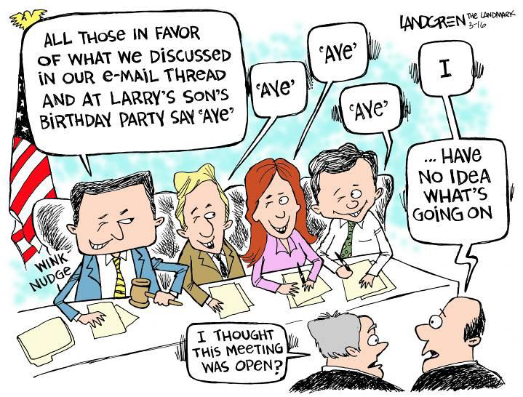
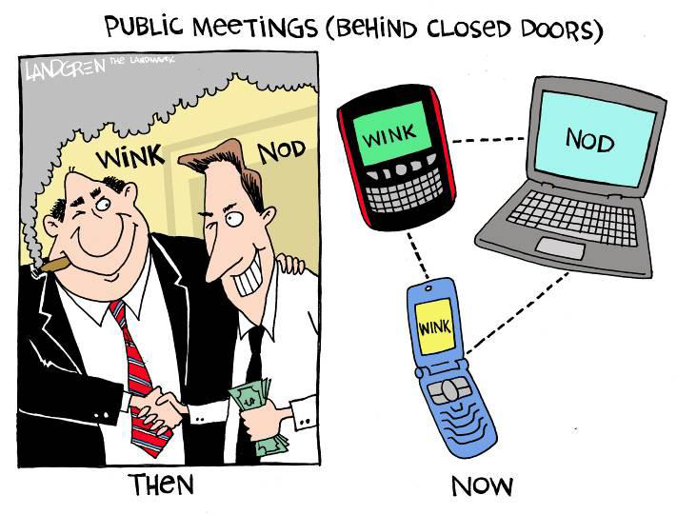
Common Meeting Violations
Straw polling (no matter who does the polling)
Calling members prior to the meeting and polling their votes.
Serial meetings
A series of smaller gatherings, where public business is discussed, which collectively constitute a quorum.

Slide 36
Quiz
True or False: Meeting minutes must contain the vote of each member of the governing body on every recorded roll call vote.
- True
For a special meeting, notice must be provided:
At least two days prior to the meeting.
At least two hours prior to the meeting.
Once an agenda for the meeting is prepared.
At the same time members know of the date.
Every notice must include:
Date of the meeting
Time of the meeting
Topics to be considered
Location of the meeting (including an electronic address)

Slide 37
Executive Session N.D.C.C. § 44-04-19.2

Slide 38
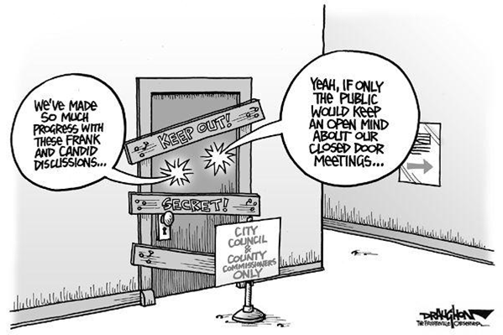
Executive Sessions
Must be specifically authorized by law
Most common reasons:
Discussing exempt/confidential records;
Attorney consultation; and
Negotiation strategy.
Most common violation:
Closing meeting to discuss personnel matters!
Contractual terms and negotiation strategy may be discussed in executive session, but personnel issues cannot.

Slide 39
Executive Session Basics
Attorney consultation- 2 ways
1. Advice regarding and in anticipation of reasonably predictable or pending litigation or adversarial administrative proceedings OR
2. To receive attorney's advice and guidance on the legal risks, strengths, and weaknesses of an action of a public entity, which, if held in public, would have an adverse fiscal effect.
Remember: Just because attorney is sitting in does not automatically make it an attorney consultation!
N.D.C.C. § 44-04-19.1(5)

Slide 40
Reminder
“All other discussions beyond the attorney’s advice and guidance must be made in the open, unless otherwise provided by law.”

Slide 41
Executive Session Basics
Negotiation strategy
Must relate to strategy or provide instructions to an attorney or other negotiator,
Regarding a pending claim, litigation, adversarial administrative proceedings, or contracts,
Which currently being negotiated or for which negotiation is reasonably likely to occur in the immediate future,
AND must have adverse fiscal effect if the discussion would be held in public.
N.D.C.C. § 44-04-19.1(9)

Slide 42
Common School Board Executive Sessions
Board meetings concerning the nonrenewal, dismissal for cause, or suspension of a teacher, principal, superintendent, or director may be closed to the public.
See generally, N.D.C.C. chapters 15.1-14 and 15.1-15
Student Records
N.D.C.C. 15-10-17(7) protects student records at state higher education institutions, but there is not a similar statute for records of elementary and secondary school students.
Instead, look to FERPA which protects “education records” which include student discipline records and teacher journals, but does not include directory information.

Slide 43
How to Hold and Executive Session
Convene in open meeting;
Announce in open meeting the topics to be discussed and legal authority;
Note: To discuss confidential information- no motion necessary. To discuss exempt/closed information- motion to enter executive session.
Record the session (keep for 6 months);
Note time of executive session and who attended in minutes;
Only discuss topics in announcement;
(usually) final action in open meeting.
N.D.C.C. § 44-04-19.2

Slide 44
Violations

Slide 45
Violation Basics
Any interested person may request and attorney general’s opinion to review: 1) a written denial of a request for records or 2) a denial of access to a meeting.
Request must be made within 30 days of alleged records violation. Meetings without notice must be within 90 days of alleged violation.
If the attorney general issues a written opinion concluding that a violation has occurred, the public entity has seven days to correct any other violation.
If the public entity fails to take the required action within the seven-day period and the person requesting the opinion prevails in a civil action the person must be awarded costs, disbursements, and reasonably attorney’s fees in the action and on appeal.
Attorney General can mandate training for violations of law.
N.D.C.C. § 44-04-21.1

Slide 46
Violations – Civil Penalties
Violations may be subject of civil action.
Action must be commenced within 60 days of the date the person knew or should have known of the violation or 30 days from issuance of AG opinion – whichever is later.
Court may award $1,000 or actual damages for intentional or knowing violations – whichever is greater.
N.D.C.C. § 44-04-21.2

Slide 47
Violations – Criminal Penalties
Attorney General can refer a public servant to the state’s attorney for multiple violations.
A public servant who knowing violates the law is guilty of a class A misdemeanor.
N.D.C.C. § 44-04-21.3

Slide 48
Quiz
True or false: All discussions an with attorney during a school board meeting require the board to enter executive session.
- False
If the attorney general issues a written opinion concluding that a violation has occurred, the public entity has how long to correct the violation?
7 days
21 days
30 days
90 days
True or false: An executive session would be proper to discuss an unfavorable employee evaluation.
- False

Slide 49
Case Study 1
N.D.A.G. 2023-O-04
Date issued: September 28, 2023
Issued to: City of Fargo
Conclusion: Fargo ran afoul of the open records laws by not providing requested records within a reasonable time and failing to give the requester an explanation for the nearly 4-week delay.
COMMUNICATION IS IMPERATIVE!
Explaining the reason for the delay may have mitigated the situation, encouraged him to narrow his request, or perhaps altogether avoided his request for an opinion.
No further corrective measures were required.
2023-O-04.pdf (nd.gov)
Must prove the records or explain why the records are not being provided within a reasonable time. (NDCC 44-04-18(2)(8))
The open records law is violated when a person’s right to review a copy of a record that is not exempt or confidential is denied or unreasonably delayed. (NDCC 44-04-18(3)(8))
A delay may be reasonable if the request was for a large number of records, where closed or confidential information had to be excised, or where other responsibilities of the public entity demanded immediate attention.
Not expected to be on hand, but response is expected within a matter of hours or days and not weeks

Slide 50
Case Study 2
N.D.A.G. 2022-O-10
Date Issued: September 29, 2022
Issued to: Lewis & Clark Public School Board
Conclusion: The Lewis & Clark Public School failed to provide notice of its October 27, 2021, special meeting in substantial compliance with NDCC 44-04-20
An email list was created for future personnel so no further action was required.
2022-O-10.pdf (nd.gov)
Notice must be given before all meetings of a public entity to anyone requesting such information
The board believed it had a duty to provide notice and a schedule of regular board meetings to anyone who requested the information.
The Superintendent provided personal notice of the November 8, 2021, regular meeting by informing the citizen of the date, time, and location of the next regular meeting via text on October 22, 2021.

Slide 51
Case Study 3
N.D.A.G. 2022-O-13
Date issued: September 29, 2022
Issued to: Minot Public School District No. 1
Conclusion: Superintendent’s Reintegration Committee is not subject to open meetings law because it does not meet the statutory definition of a governing body.
MPS did not have to provide notice of the committee meetings to the public and did not have to post or file meeting notices
2022-O-13.pdf (nd.gov)
“Governing body” includes any group of persons, regardless of membership, acting collectively pursuant to authority delegated to that group by the governing body.
Superintendents’ Cabinets are not subject to open meetings law when they are not created by school board rule and are not delegated any authority by the school board.
Cabinets not “active collectively pursuant to authority delegated to them by the governing body.

Slide 52
Case Study 4
N.D.A.G. 2022-O-05
Date issued: May 19, 2022
Issued to: North Dakota Board of Chiropractic Examiners
Conclusion: the Board properly withheld from the doctors the executive session recording of discussions of protected records.
2022-O-05 (nd.gov)
The purpose of an executive session is not only to protect the records being discussed, but also to protect the consideration or discussion of those closed or confidential records.
Three ways an executive session recording may be released
Dr. C’s request was for the recorded discussion, not of his records as he argued.
The protection of the discussion cannot be waived by him.

Slide 53
References & Resources
North Dakota Constitution Article XI General Provisions
North Dakota Century Code Chapter 44-04
Attorney General’s website https://attorneygeneral.nd.gov/
Open Records & Meetings Laws
Manuals & Guides
Open Records Guide
Template for Responding to an Open Records Request
Open Meetings Guide
Sample Form for Closing Executive Sessions
Sample Meeting Notice
Notice Checklist

Slide 54
Questions?

