Slide 1
Asset Management, Investing and Bonding 2023
Presented By
Patty VerDouw

Slide 2
Background:
Employed by the ND School Board Association as Policy Services Assistant
Business Manager at Edgeley School for 12 Years
15 Years With Deere & Company
Licensed Insurance Agent – Licensed in All Lines of Insurance
Attended Valley City State and Dickinson State College
Raised in Edgeley, ND
Oldest of 7 Children
Mother of 33-Year Old Twin Boys

Slide 3

Let’s Jump into the Abyss!

Slide 4
What are we Going to Cover?
Banking & Investing Terminology
NDCC Title 21, NDCC 57-15-16, and NDCC 57-19 as it Applies to Schools
Borrowing Practices
  Bonds
Reporting to the Board on Banking & Investments
Types of Investments
Forecasting
Selection Process for Banks Under Law
Etc., Etc., Etc.

Slide 5

PLEASE NOTE:
This presentation will follow NDCC and each slide will reference the Code, Chapter, Verse where appropriate.
If you see this, there is more information on this subject in the Tool Box.
If a slide is this color, be prepared to be tested on the information.
NDCC 21-01.1

Slide 6

Definitions:
Bond Basics
In finance, a bond is a debt in which the District owes the holders of the debt (Bonding Company) and is obligated to repay the principal and interest at a later date – Termed Maturity.
Other stipulations may also be attached to the bond issue, such as the obligation of the District to provide certain information to the bond holder, or limitations on the behavior of the District.

Slide 7
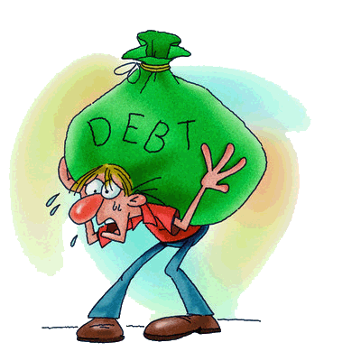
Definitions:
Bonds are generally issued for a fixed term longer than 10 years and are categorized as “Long Term Debt”.
New debt between 1 year and 10 years is categorized as a “Note”.
New debt of less than 1 year is categorized as a “Bill”.

Slide 8
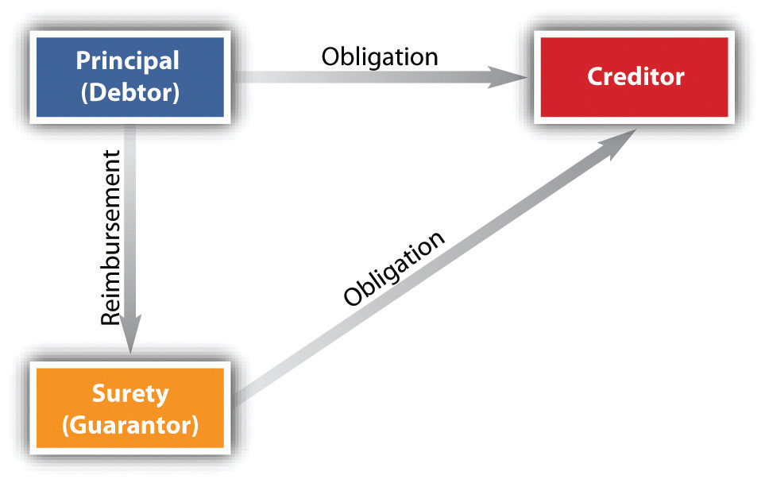
Definitions:
Bond: A bond is simply a loan, but in the form of a security.
Security refers to a debt instrument, such as a governmental bond, corporate bond, certificates of deposits, municipal bonds, or preferred stock that can be bought or sold between two parties (bonding company/lender & the District) and has terms defined for the amount borrowed, interest rate, and maturity date.
Bonds are issued by corporations, non-profits, the federal government, state and local governments.
In the case of a bond issued by a District, the District receives a loan from a private lender that is secured by the districts ability to generate income through taxation.
The District than owes principal and interest to the private lender.

Slide 9

Definitions:
District bonds play an important role in financing numerous types of capital and infrastructure projects such as renovation of existing buildings, construction of new buildings, etc.
There are generally two types of bonds:
Revenue Bonds,
and
General Obligation Bonds

Slide 10
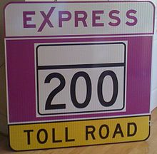
Definitions:
Revenue Bonds are bonds, whose payback provisions are tied to a specific revenue stream, such as fees.
Example: Bonds being issued to fund student loans. Interest revenue from the student loans are the only source of payback of the bonds.

Slide 11
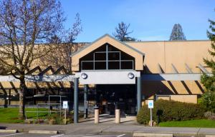
Definitions:
General Obligation bonds are backed by the full faith, credit and taxing power of the District and are considered public debt.
General Obligation Bonds have a wider backing (full taxing power), they generally carry lower interest rates than revenue bonds as they are considered lower risk.
Example: Issuing bonds to construct a new middle school. Payback is through tax levies.
General Obligation Bonds are One
Method that School Districts Use
To Finance Projects.

Slide 12
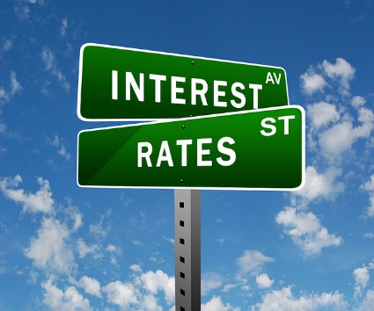

Definitions:
Accrued Interest
Interest accrued (added) on a bond or other fixed income security since the last interest payment was made.
When the bond is sold, the District pays the market price plus accrued interest to the bond company.
Accrued Interest is calculated by multiplying the interest rate (coupon rate) by the annualized number of days that have elapsed since the last payment.

Slide 13
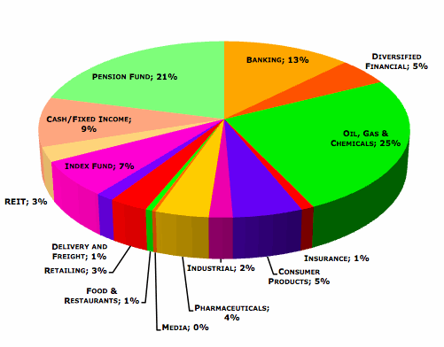
Definitions:
Asset Allocation
Revenue and investments are spread across various types of accounts (Checking, Savings Accounts, Certificates of Deposits, Bonds, etc.). Asset allocation does not assure or guarantee better performance.
Average Annual Total Returns
The annualized return for an investment, as measured over various time periods such as one, three, and ten years.

Slide 14

Definitions:
Bond
A long-term debt security that obligates the District to pay the face value amount on a specified future date. Issued primarily by governments and corporations. Also called fixed income securities, the District typically agrees to pay a specified interest rate at regular intervals until the bond’s maturity date (Due Date).

Slide 15
Definitions:
Bond Counsel
An attorney (or firm) retained by the District to give a legal opinion that the District is authorized to issue proposed securities (bonds), has met all the legal requirements, and that the interest will be exempt from federal income tax.
The opinion may also address matters such as state or local tax exemption and enforceability of certain security provisions.
Typically, Bond Counsel may prepare, or review, and advise the District regarding authorizing, resolutions, bond contracts, official statements, validation, proceedings, and litigation.

Slide 16
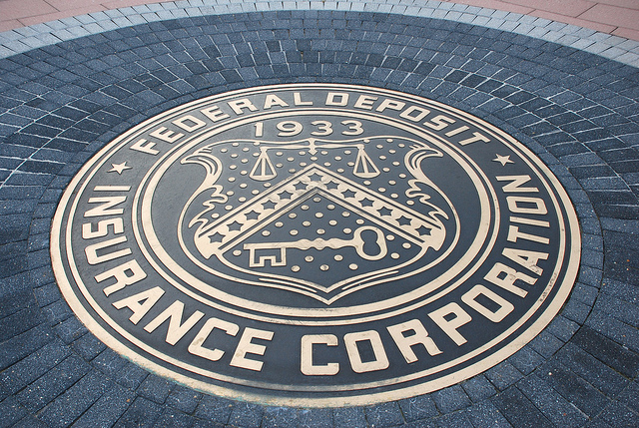
Definitions:
Certificate of Deposit
A debt instrument issued by a bank or credit union. The District agrees to leave an agreed-upon amount of money on deposit for a specified period of time in return for a rate of interest that is generally higher than that available with a savings account.
CDs are FDIC insured up to $250,000.
For more information on FDIC Coverage, go to: https://www.fdic.gov/deposit/covered/

Slide 17

Definitions:
Certificate of Indebtedness
A short-term agreement on the part of a political subdivision (School District) to pay a stated sum on or before a specific date, along with interest.
Simply put, it is an IOU that the District gives to a lender pledging proceeds from taxes already levied.
Unlike a bond, a Certificate of Indebtedness does not need to be voter approved.

Slide 18

Definitions:
Coupon Rate
The interest rate on a debt security (borrowed money that the District promises to repay at a certain time and with a certain rate of interest). It is usually expressed as a percentage of the face value of the bond or note.
Executory Contract
A contract which has not yet been fully performed (executed).
In other words – it is a contract under which both sides still have important performance remaining, but the contract has been fully performed by one party but not by the other.

Slide 19

Definitions:
Face Value
The value of a bond or note that appears on the face of the certificate or instrument. Face value is ordinarily the amount the issuing institution promises to pay at maturity.
Also referred to as Par Value.

Slide 20

Definitions:
Federal Deposit Insurance Corporation (FDIC)
Federal agency that insures deposits of member banks for up to $250,000 per depositor.
https://www.fdic.gov/deposit/covered/

Slide 21
Definitions:
National Credit Union Administration
Federal agency that insures deposits of member banks for up to $250,000 per depositor.
Your savings federally insured to at least $250,000
and backed by the full faith and credit of the United States Government
NCUA
National Credit Union Administration, a U.S. Government Agency
Visit this website for more information: www.NCUA.gov

Slide 22

Definitions:
Government Bond
Bonds issued by the U. S. Government, typically regarded as the highest-grade securities issued with the least amount of default risk. The major types include:
Treasury Bills
Savings Bonds
Treasury Notes
Treasury Bonds

Slide 23

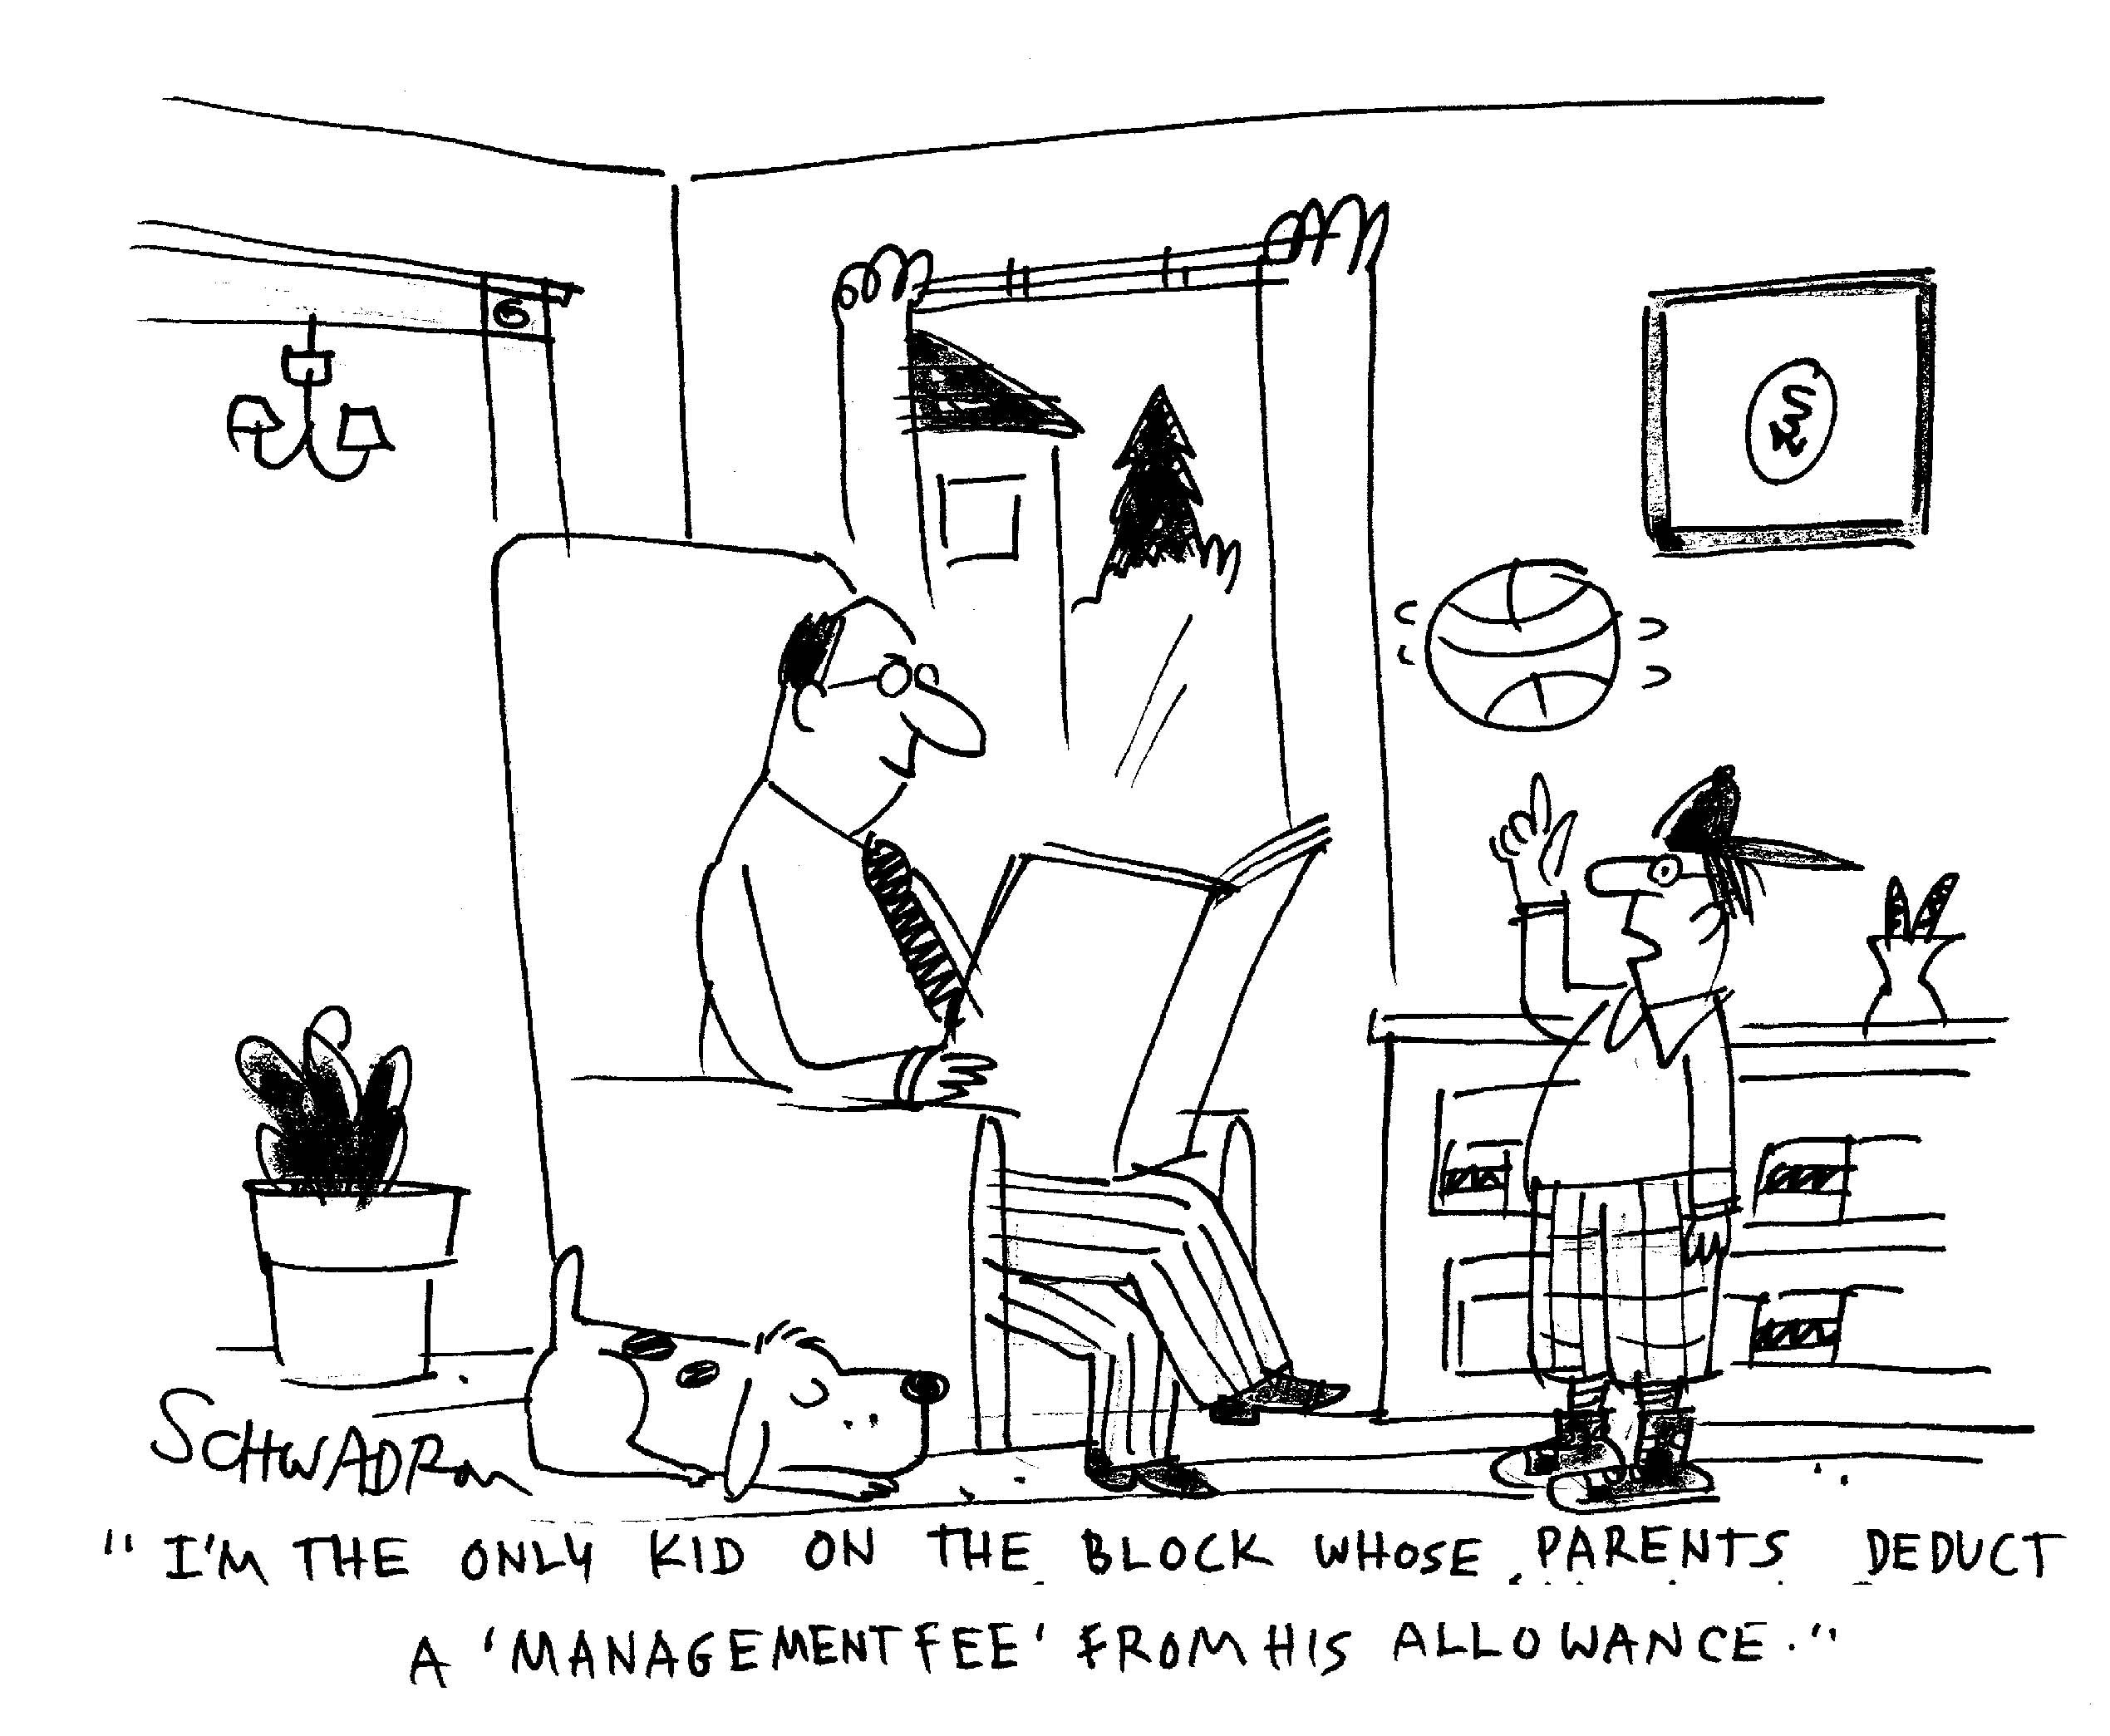
Definitions:
Interest
Money paid regularly, at a particular rate for the use of money lent, or for delaying the repayment of a debt.
Management Fee
A charge paid to a company/bank
for servicing the bond payments.

Slide 24

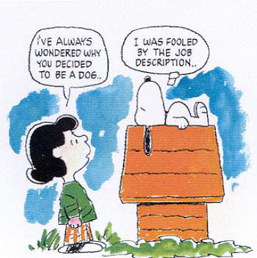
Definitions:
Liquidity
The ability to easily convert investments into cash.
Custodian of Funds
This is YOU! You’re custodian of all District funds.

Slide 25
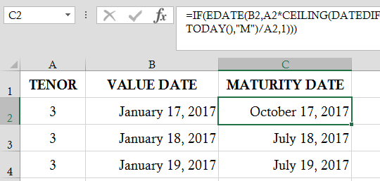
Definitions:
Maturity Date
The date on which the face value (principal amount) and last interest payment of a debt security (such as a bill, note, bond or CD) become due and payable.
The maturity date is the date when the bond’s principal and final interest payment are to be paid.

Slide 26

Definitions:
Money Market Account
Many banks offer a Money Market Account for Districts. It is a repository for their Interim Funds, operating funds, savings, or used for ACH deposits that come from State, Federal and Local sources.
Typically, a Money Market Account is an interest-bearing checking/savings account that may offer a higher interest rate than a regular savings account. The major difference from checking accounts is that money market deposit accounts are typically limited to six withdrawals or transfers per month.

Slide 27
Definitions:
ND Public Finance Authority
The Authority offers Certificates of Indebtedness to schools for short-term needs (generally less than 1 year). The maximum amount a District may borrow is limited to 5% of the prior year’s ending budget plus the maximum cumulative monthly deficit.
Under the School Construction Financing Program (SCF), the Authority makes loans to Districts for financing projects through District issued General Obligation Bonds under NDCC 21-03. Financing is available in any dollar amount, subject to credit requirements, and certain program requirements.
For more information on ND Public Finance Authority School Financing go to: http://www.nd.gov/pfa/school.html

Slide 28

Definitions:
ND Public Finance Authority
The interest rates payable by a District are market rates, which are set through a competitive bid process when the Authority issues and sells its program bonds to fund a loan.
The interest rates paid by the Authority on its program bonds are the same rates a School District will pay on its bonds sold to the Authority for the loan.
In other words – there is no mark up of interest to the District by the Authority.

Slide 29
Definitions:
Principal
It is the basic amount invested exclusive of earnings.
In other words – The amount of the loan minus interest and fees.
Securities and Exchange Commission (SEC)
A federal regulatory agency created by the Securities and Exchange Act of 1934 to protect investors from fraud within the securities market.
More information can be found at: https://www.sec.gov/

Slide 30
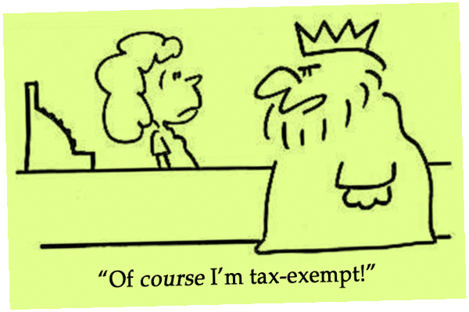
Definitions:
Tax Exempt
An investment that is NOT subject to taxation at the FEDERAL level. Such investments may be subject to state, local or the federal alternative minimum tax.

Slide 31
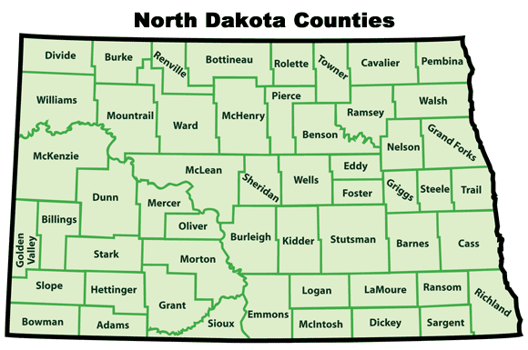
Definitions:
Taxing District
NDCC defines a taxing district as any county, city, School District, township, park district, water conservation and flood control district, Garrison Diversion Conservancy District, county park district, joint county park district or irrigation district in the state.
Yield (%)
The rate of return, usually a dividend or interest payment, on an investment, expressed as a percentage of market price.
NDCC 21-01-01

Slide 32

NDCC 57-15
BUILDING FUND for
SCHOOL DISTRICTS

Slide 33
Tax Levy for Building Fund
The Board levies taxes annually for the Building Fund. The maximum tax levy allowed for the Building Fund is 20 mills.
A Building Fund must be approved by 60% of the District patrons. Once established, it remains in place without a time limit.
A Building Fund can be discontinued upon completion of all payments due, and cancellation of all bonds.
The levy can be discontinued at the discretion of the Board or petition of 20% of the qualified voters that voted in the last election, AND upon a favorable vote of 60% of the qualified voters.
NDCC 57-15-16

Slide 34
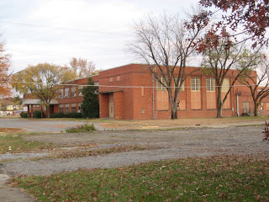
Creating the Building Fund
The Board may create the Building Fund by appropriating and budgeting for an amount not in excess of 20% of the current annual appropriation for all other purposes combined.
This does not include appropriations to pay interest and principal of any of the bonded debt and can not be in excess of the limitations prescribed by law.
NDCC 57-15-16

Slide 35

Maintaining the Building Fund Levy
Any District executing a contract, or lease with the State Board of Public School Education, OR issues General Obligation Bonds which requires the contract, lease, or bond issue to maintain the levy, shall immediately file a certified copy of the contract, lease or bond issue the County Auditor.
The County Auditor is required to register the contract, lease, or bond issue as prescribed in NDCC 21-03-23. (We’ll cover this later)
NDCC 57-15-16

Slide 36
Maintaining the Building Fund Levy
Once registered, the District may not discontinue levy.
The levy must automatically be included in tax levy of the District from year to year by the County Auditor, until a sufficient sum of money have been collected to pay for the retirement of all obligations of the District for:
State Board of Public School Education
Pay the custodian (the Business Manager) of the bond sinking fund all amounts due, or to become due on the bonds
NDCC 57-15-16

Slide 37

Maintaining the Building Fund Levy
When the Board is levying taxes for the Building Fund, it shall:
Specify on the ballot the number of mills to be levied
The Board May, at its discretion, submit a specific plan for which the Building Fund will be used
  The Plan shall designate the general area to be served by use of the Building Fund
    The area to be served described in the plan, doesn’t need to be described on the Building Fund ballot.
NDCC 57-15-16

Slide 38
Disposition of the Building Fund
All revenue accruing for the Building Fund must be placed in a separate fund (Building Fund) and must:
      Be deposited, held or invested in the same manner as the sinking funds of the District; or
      Be used for the purchase of shares or securities of federal/state-chartered savings & loan associations, within the limits of federal insurance.
    The Building Fund is sometimes referred to as Capital Projects Fund by some Districts, however NDCC says it should be referred to as the
    Building Fund.
NDCC 57-15-17

Slide 39
Disposition of the Building Fund
Money in the Building Fund may ONLY be used for:
  The construction of District buildings & facilities;
  The renovation, repair, or expansion of District buildings & facilities;
  The improvement of District buildings, facilities, & real property;
  The leasing of buildings & facilities;
  The payment of rentals upon contracts with the State Board of Public School Education;
  The payment of rentals of contracts with municipalities for career & technical education facilities financed per NDCC 40-57; and
  The payment of principal, premiums, and interest on bonds issued in accordance with subsection 7 of NDCC 21-03-07.
NDCC 57-15-17

Slide 40

Disposition of the Building Fund
The custodian of the funds (You) may pay out the funds only upon the order of the Board.
The check for payment must be signed by the Board President and the Business Manager.
  The check must record on its face the purpose for which payment is made.
NDCC 57-15-17(1)(c)

Slide 41
Disposition of the Building Fund
Any money remaining in the Building Fund after the completion of payments for any building project that has cost 75% or more of the amount in the Building Fund at the time of letting contracts, must be returned to the General Fund of the District, upon the order of the Board.
The Board may pay into the General Fund any moneys that have remained in the Building Fund for 10 years or more.
  The Board may include this amount as part of its cash on hand in making up its budget for the next fiscal year.
  In determining what amounts have remained in the fund for 10 years or more, all payments that have been made from the Building Fund for building purposes must be considered as having been paid from the funds first acquired.
NDCC 57-15-17

Slide 42

Disposition of the Building Fund
If collection from taxes for the current budget and other income are insufficient to meet the requirement for the general operating expenses, the Board may transfer unobligated funds from the Building Fund into the General Fund, provided the District has issued Certificates of Indebtedness equal to 50% of the outstanding uncollected General Fund property tax.
The Board may not transfer funds from the Building Fund into the General Fund for more than two years.
NDCC 57-15-17

Slide 43
TITLE 21 - GOVERNMENTAL FINANCE
Payment & Registration of Warrants
NDCC Chapter 21-01

Slide 44

Definitions:
Warrant
“An order issued by the School Board to the Business Manager of the School District, that the Check to be drawn that when signed by the Business Manager, in an appropriate place, becomes a check on the School District Bank or Credit Union. No Check issued by the District may be delivered or mailed to the payee or payee’s agent or representative until the Check has been signed by the Business Manager and entered on the books of the District as a check drawn on a bank depository.”
Should you have a signature stamp for yourself as Business Manager?
NDCC 21-01-01

Slide 45

Warrant – Order of Payment
Any check issued by the District must be paid in order of its presentation for payment.
(First in first out.)
NDCC 21-01-02

Slide 46

Maximum Amount of Checks or Indebtedness – Violation of Provisions – Liability – Penalty
No checks of the District may be issued in excess of the amount of cash in the hands of the Business Manager exclusive of funds for payment of bonds.
In other words, you can’t issue checks if there is insufficient fund balances to cover the check for the General Fund, Special Reserve Fund, Building Fund, Hot Lunch, Or Activity Fund.
NDCC 21-01-03

Slide 47

Maximum Amount of Checks or Indebtedness – Violation of Provisions – Liability – Penalty
No indebtedness may occur, and no expenditures authorized in excess of the unencumbered uncollected taxes which have been levied during the current year plus the unencumbered uncollected taxes of the four preceding years.
NDCC 21-01-03

Slide 48

Maximum Amount of Checks or Indebtedness – Violation of Provisions – Liability – Penalty
Any check issued, contract entered into, or purported indebtedness incurred, in violation of NDCC is null and void.
NDCC 21-01-03

Slide 49
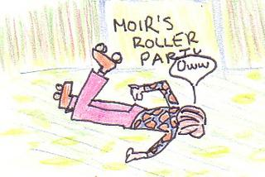
Maximum Amount of Checks or Indebtedness – Violation of Provisions – Liability – Penalty
Any Business Manager willfully executing or participating in the execution of any check, or contract, or attempting to incur any indebtedness of any School District in violation of NDCC is guilty of a CLASS A MISDEMEANOR.
The Business Manager would be PERSONALLY liable for the payment of the check or contract to the holder.
Orange Jumpsuit?
NDCC 21-01-03

Slide 50


Maximum Amount of Checks or Indebtedness – Violation of Provisions – Liability – Penalty
A violation of NDCC is a CLASS A MISDEMEANOR.
A Class A Misdemeanor is damage committed recklessly. If committed intentionally, the charge carries a potential sentence of up to 1 year in jail, a $3,000 fine or BOTH.
NDCC 21-01-03

Slide 51

Checks for Current Expenses
If a School District is unable to sell its Certificates of Indebtedness (written promise to repay a debt), it can issue checks in payment of current expenses in excess of cash on hand as long as:
It is not in excess of 85% of taxes levied for the current fiscal year BUT uncollected and not encumbered, PLUS
50% of the uncollected and not encumbered taxes of the last 4 years, AND
Funds derived from the collection of taxes for the current year and such preceding years that have been put in a special fund for the payment of checks issued against such taxes.
NDCC 21-01-04

Slide 52

Checks for Current Expenses
If checks are issued in excess of these limitations, the checks possess no validity against the District, BUT the officials that knowingly and willingly issuing the checks are PERSONALLY liable for the payment of them.
This means YOU and anyone else
with you!
NDCC 21-01-04

Slide 53

Checks for Salaries and Official Publications –
Payable ½ in Cash Prior to Other Checks
If a District does not have sufficient funds to pay salaries and wages to employees – including fees for publication of Board notices and minutes, in full – for a period of 6 months, the Board by Resolution, may authorize the issuance checks for one-half of these salaries, wages, and publication fees.
The balance would be registered and paid as other checks are registered and paid.
NDCC 21-01-05

Slide 54

Checks for Salaries and Official Publications –
Payable ½ in Cash Prior to Other Checks
This relieves the Business Manager of liability to other check holders because of payment of salaries and publication fees.
Responsibility
NDCC 21-01-05

Slide 55
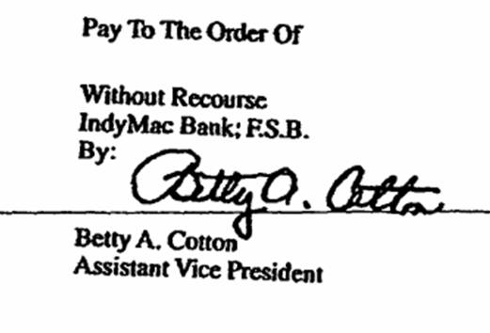
Registration of Checks – Rate of Interest
Whenever the law authorizes a District to issue checks in excess of cash available, the NDCC authorizes the Business Manager to do the following when a check is presented for payment, and not paid for want of funds, they should endorse the check as follows:
Presented for payment on ________, and not paid for want of funds.
NDCC 21-01-06

Slide 56
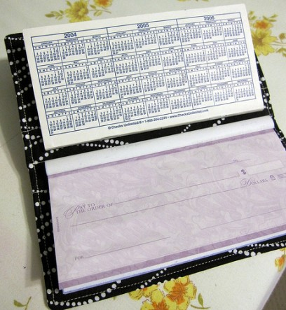
Registration of Checks – Rate of Interest
The Business Manager should enter these types of checks in the check register, by order presented.
The Board (which has authorized the issuance of checks in excess of cash on hand) shall determine the rate of interest which these checks MUST bear.
NDCC limits interest rates to 8% per annum from the date of registration for counties and cities. It doesn’t limit Districts specifically in law.
NDCC 21-01-06

Slide 57
Check Register – Who Keeps it – In What Form
The Business Manager of every District shall keep a check register, which MUST show in columns appropriately arranged:
Check #
Order of registration
Date written
Amount of the check
Fund that dollars were dispersed from
Date of presentation
Name and address registered person or additional assignees
Date payment was made
Amount of interest paid
Date the check was mailed
Check # | Order # | Date Written | Amount of Check | Fund | Date Presented | Name of Person | Address of Person | Additional Assignees? | Date of Payment | Amount of Interest | Total Paid | Date Check Mailed
11354 | 1 | 4/25/18 | $2,015.00 | GF | 6/1/18 | Joe Blow | PO Box 2, Mandan | No | 10/1/18 | $50.00 | $2,065.00 | 10/1/18
3086 | 2 | 5/1/18 | 10,245.00 | Bldg | 5/6/18 | Big Contractor | Big Ft Trl, Mandan | No | 11/3/18 | $406.43 | $10,111.00 | 11/3/18
NDCC 21-01-07

Slide 58

Business Manager to Notify Holder to Present Check – Order of Payment
Once the Business Manager has deposited funds sufficient to cover checks that had been unpaid due to lack of funds, they shall immediately notify the next registered person or entity by mail.
The notice should state that unless the check is presented for payment on or before the date specified in the notice, any interest will cease after that date.
All registered checks must be paid in the order of their registration.
NDCC 21-01-08

Slide 59
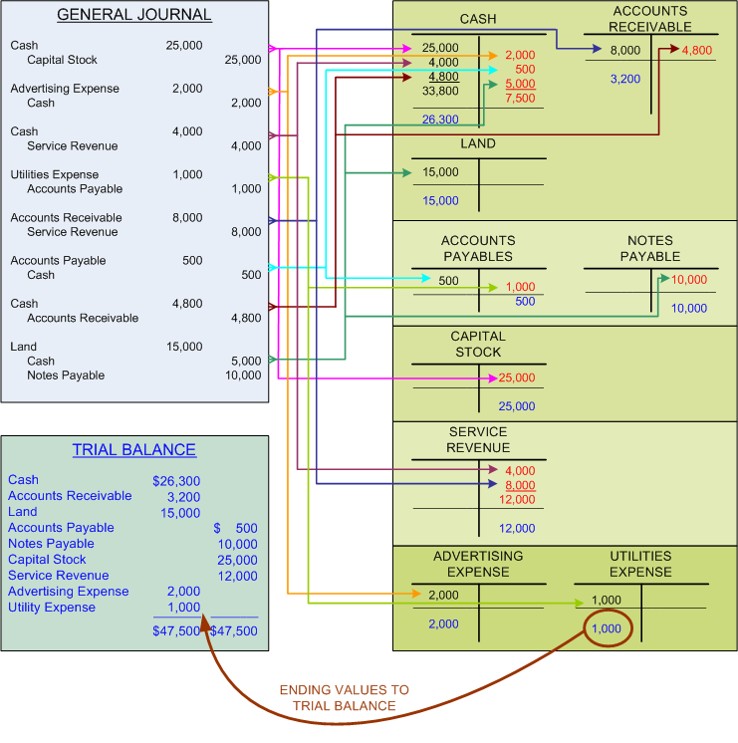
Cashbook and Register to be Reconciled Daily and Closed Annually – Penalty for Failure
As money is received, the Business Manager shall reconcile the cashbook and register on a daily basis and carry the amounts forward.
At the close of each year, if there is still insufficient money to pay all the checks registered, the Business Manager should close the register for that year and shall carry forward the excess to the next year.
NDCC 21-01-09

Slide 60

Cashbook and Register to be Reconciled Daily and Closed Annually – Penalty for Failure
Any Business Manager that fails to regularly enter the cash received and reconcile the cashbook from day to day – for the space of 3 days – shall forfeit for each offense the sum of $100.
This penalty would be recovered in a civil action on the District’s surety bond (covering the Business Manager) by any person holding a check drawn on the District’ account by the Business
Manager.
NDCC 21-01-09

Slide 61

Cashbook and Register Open to Inspection
The cashbook and register of the District must be open at all times to the inspection of any person in whose name any check is registered and unpaid.
NDCC 21-01-10

Slide 62

Failure to Register Checks –
Liability of the Business Manager
Any Business Manager that fails to register checks in the order of their presentation, or to pay the check in order of registration, is LIABLE on the Business Manager’s surety bond to each and every person that has payment of a check postponed in the sum of $300, to be recovered in civil action.
NDCC 21-01-11

Slide 63
TITLE 21 - GOVERNMENTAL FINANCE
Certificates of Indebtedness
NDCC Chapter 21-02

Slide 64

Certificates of Indebtedness - Definitions
Political Subdivision
A local governmental unit created by statute or by the Constitution of ND for local governmental or other public purposes.
In other words, a School District would be a political subdivision or local governmental unit.
NDCC 21-02-01

Slide 65
Certificates of Indebtedness - Definitions:
Revenues
In NDCC, revenues can mean any of the following:
Uncollected taxes
Amounts to be received from a distribution of federal moneys, including currently existing Bureau of Indian Affairs contracts
Amounts to be received from a distribution of money from a state appropriation, or a state statutory or constitutional provision
Amounts to be received from a grant or loan of state or federal funds
Amounts to be received from the issuance and sale of bonds by the District
NDCC 21-02-01

Slide 66
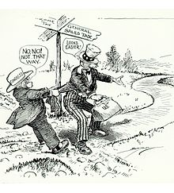
Certificate of Indebtedness - Definitions:
Uncollected Taxes
NDCC defines uncollected taxes as taxes for the year during which a Certificate of Indebtedness is issued AND the preceding 4 years that have been levied but from which moneys has not come into the District from tax payments or by satisfaction of tax liens.
Tax levies dedicated to the payment of principal and interest on outstanding evidences of indebtedness – such as bonds - are excluded.
NDCC 21-02-01

Slide 67
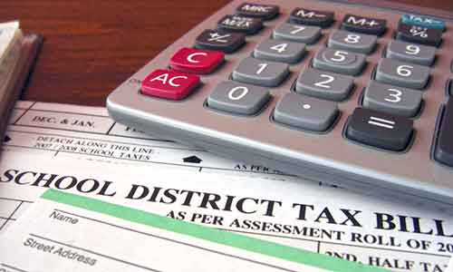
Certificates of Indebtedness – By Whom Issued – Term – Interest – General Obligation
Districts may borrow against revenues through the issuance of Certificates of Indebtedness.
A Certificate of Indebtedness is an agreement by the District to pay a stated sum on or before a specified date PLUS interest.
The average annual net interest rate can not exceed 12% if sold privately.
NDCC 21-02-02

Slide 68

Certificates of Indebtedness –
General Obligation
There is no interest rate ceiling on a certificate sold at a public sale or to the State of ND or any of its agencies or instrumentalities.
The certificate must be signed on behalf of the District by the President of the Board, the Business Manager, and must be payable from revenues.
NDCC 21-02-02

Slide 69
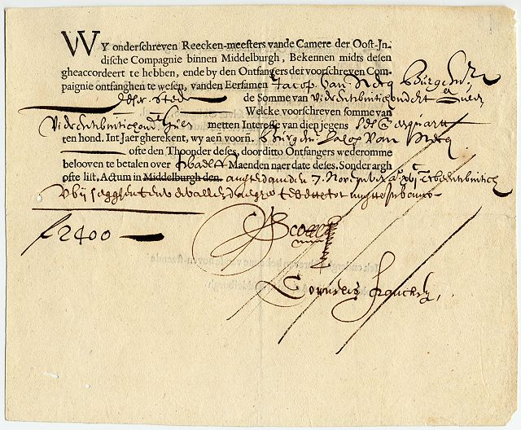
Certificates of Indebtedness –
General Obligation
A Certificate of Indebtedness issued against revenues that consist of levied and uncollected taxes is a General Obligation of the District to the extent of the levied and uncollected taxes.
NDCC 21-02-02

Slide 70
Certificates of County Auditor
A tax is levied when it has been voted on by School Board and certified to the County Auditor.
A Certificate of Indebtedness issued against revenues that consist of levied and uncollected taxes must be certified by the County Auditor.
The Auditor must certify that levied and uncollected taxes have been levied lawfully in the present year, plus uncollected taxes of the 4 preceding years.
An auditor that willfully signs a false certificate is guilty of a Class A Misdemeanor.
NDCC 21-02-02

Slide 71
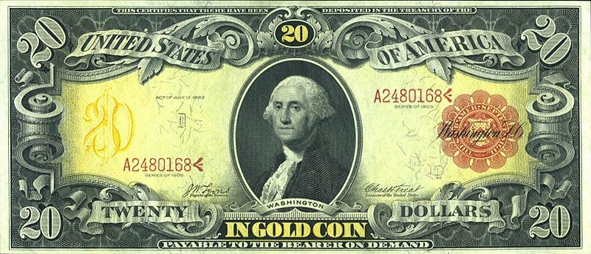
Record of Certificates of Indebtedness Issued Against Levied and Uncollected Taxes
The County Auditor shall keep a record of each Certificate of Indebtedness by (District) and certify it.
If a Certificate of Indebtedness has been paid in full by a District, the District must provide the County Auditor a Certificate of Redemption - (This stops the further collections of taxes for that levy).
This also must be recorded by the County Auditor.
NDCC 21-02-05

Slide 72
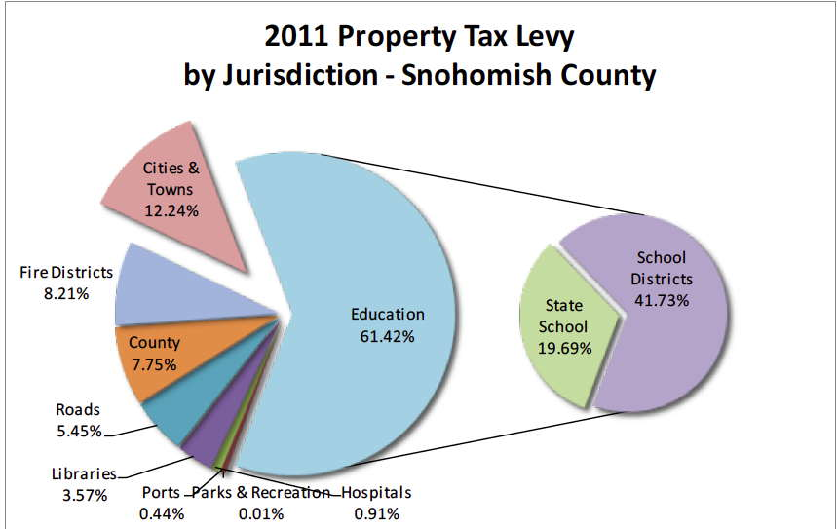
Certifying Amount of Uncollected Taxes
The County Auditor shall certify the amount of uncollected taxes remaining on the tax lists to the Business Managers for the Districts by July 10th of each year.
The County Auditor shall also certify to the Business Manager at this time, the amount of cash collections apportioned for each month to the District and the amount derived from levies of each tax year.
NDCC 21-02-06

Slide 73
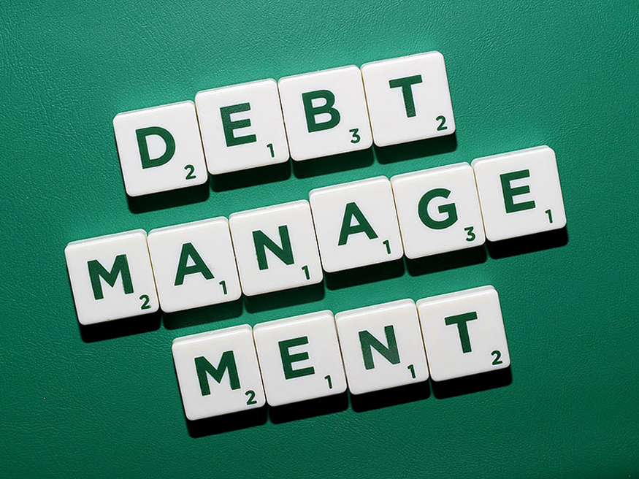
Authorizing Resolution – Sinking Fund
If a District issues a Certificate of Indebtedness, the District – by a vote of the Board – shall establish a SINKING FUND for the retirement of the debt including interest on its due date.
The Board Resolution must also provide for the regular accumulation of money in the Sinking Fund from the revenues pledged to the payment of the debt (tax levies).
When there is sufficient money in the Sinking Fund to pay principal and interest owing on the maturity date of the debt, NO ADDITIONAL REVENUES MAY BE CREDITED TO THE FUND!
NDCC 21-02-07

Slide 74

Percentage of Current Taxes Used to Pay Delinquent Certificates of Indebtedness
If the District has not collected enough funds to retire outstanding Certificates of Indebtedness issued against uncollected taxes within 2 months after their due date, there must be set aside monthly from current tax collections (exclusive of tax levies dedicated to the payment of outstanding indebtedness) not less than 10% of the amount of the collections until the past due certificates have been paid.
NDCC 21-02-08

Slide 75
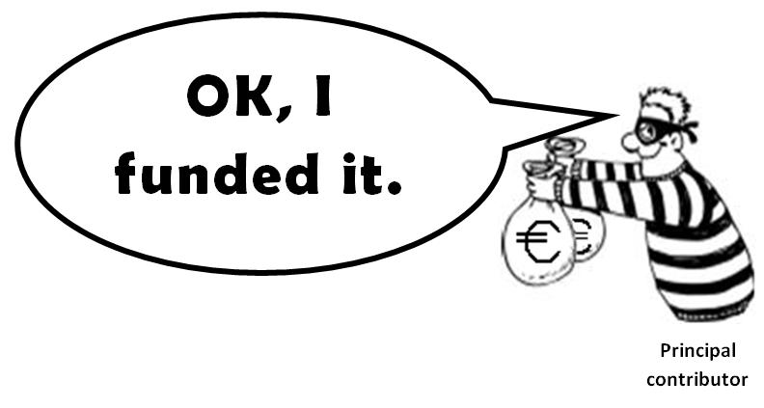
Advertising for Bids – When Required – Procedure Similar to Bond Sales
If the School Board decides to borrow upon Certificates of Indebtedness, it shall follow the same procedures and is subject to the same penalties as relating to sale of bonds outlined in NDCC 21-03.
NDCC 21-02-11

Slide 76

Presumption of Validity
Certificates of Indebtedness are presumed to be fully authorized and issued under the laws of ND.
Any person or governmental unit is barred from questioning the authorization, sale, execution, issuance or delivery by the District.
NDCC 21-02-14

Slide 77
Certificate of Indebtedness Exempt From State Taxation – Review for Exemption From Federal Taxation
Payments of principal and interest on a Certificate of Indebtedness issued under ND law are exempt from all taxes, EXCEPT inheritance, estate and transfer taxes, imposed by the state, any county, or city, or any other political subdivision.
However, a District shall review federal tax laws and regulations to determine the tax-exempt status of interest payments prior to the issuance and sale of the certificate on a purported federally tax-exempt basis.
NDCC 21-02-15

Slide 78
Certificate of Indebtedness Exempt From State Taxation – Review for Exemption From Federal Taxation
In other words – HIRE/CONSULT A TAX ATTORNEY or BOND ATTORNEY!
NDCC 21-02-15

Slide 79
TITLE 21 - GOVERNMENTAL FINANCE
Evidence of Indebtedness Proceedings –
Judicial Review
NDCC Chapter 21-02.1

Slide 80

Petition by a District for Court to Examine and Approve Evidence of Indebtedness Proceedings – Contents of Petition
Any District may file a petition in District Court– either before or after issuance or payment of the (Certificate of Indebtedness or bond) asking for examination, approval, and confirmation from the court.
The petition must state the facts and confirm that the petitioner is a (school district) of the state.
NDCC 21-02.1-02

Slide 81

Hearing of Petition – Notice of Filing and Hearing
The Court fixes the time of the hearing. Notice of the hearing must be published in the official newspaper of the County for two consecutive weeks by the Clerk of Court.
The hearing must be held not less than 15 days nor more than 60 days after the last publication.
NDCC 21-02.1-03

Slide 82


Powers of the Court Upon Trial –
Amendment of Petition
The Court shall conduct the hearing as in the case of a trial of a civil action without a jury.
The Court shall permit the petition to be amended so it conforms to the evidence and facts presented at the hearing.
The Court shall prepare its findings of fact and conclusions of law and shall order that the decree of the court be entered.
NDCC 21-02.1-04-06

Slide 83

10 Minute
BREAK

Slide 84
TITLE 21 - GOVERNMENTAL FINANCE
BONDS
NDCC Chapter 21-03

Slide 85
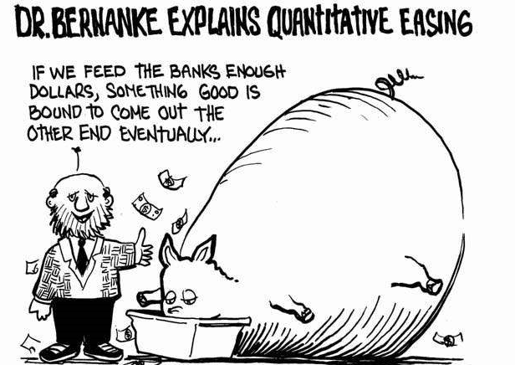
Definitions Used in NDCC for Bonds
Governing Body
A School Board of any School District.
Initial Resolution
Any resolution that is adopted by the Board that authorizes the District to borrow money or issue bonds.
Municipality
Is a county, city, township, Public School District, park district, recreation service district, or rural fire protection district empowered to borrow money and issue written obligations to repay the same out of public funds or revenue.
NDCC 21-03.1

Slide 86

Definitions Used in NDCC for Bonds
Population of Municipality
Is its population according to the last officially published US or state census – whichever was taken latest.
Recorded
Means the Business Manager keeps a “full and correct” written record of every step or proceeding that takes place in the course of authorizing and issuing bonds including affirmative and negative votes cast by the electors.
Value of Taxable Property or the Assessed Valuation
Means the assessed value of all taxable property in the District that is empowered to levy taxes.
NDCC 21-03-01

Slide 87

Grant of Power to Borrow –
General Limitations of Indebtedness
If the District borrows money or issues bonds, THE FUNDS CAN ONLY BE USED THE FOR PURPOSE SPECIFIED and must follow procedures outlined in NDCC.
No District may incur debt in any manner or for any purpose in an amount which, with all other outstanding debt of the District exceeds 5% of the assessed value of taxable property, EXCEPT:
NDCC 21-03-04

Slide 88

Grant of Power to Borrow –
General Limitations of Indebtedness
A School District, by a majority vote of the qualified voters in a general or special election, may increase the debt limit 5% beyond the 5% set for municipalities.
NDCC 21-03-04, 1

Slide 89
Purposes & Specific Limitations of Bond Issues
Districts are empowered to borrow money and to issue bonds. Bonds may be issued:
By any Public School District to purchase, erect, enlarge and improve school buildings and teacherages (acquire sites/accommodations provided for a teacher by a school).
To acquire sites for playgrounds
To furnish and equip facilities with heat, light and ventilation or other necessary apparatus
To pay advance rentals to the State Construction Fund
To purchase school bus equipment that meet the standards set by the State Superintendent of Schools.
NDCC 21-03-06, 4

Slide 90

Purposes and Specific Limitations of Bond Issues
If your District has a community or junior college or off-campus educational center which has an enrollment of 1,000 or more students, upon motion of the Board, for capital construction purposes. That would include:
Construction and equipping of new buildings
Repairing, or renovating, and equipping existing buildings
NDCC 21-03-06, 4.1

Slide 91
In this case, the Board may levy a tax not exceeding 2 mills on the taxable valuation of the District for paying principal and interest on the bond.
This mill levy is in addition to any other mill limitations provided by law.
The total principal amount of bonds under this section can not exceed $700,000 and any debt incurred by the District must be within the limits established by law.
Bonds issued under this subsection must never become a general obligation of the state.
NDCC 21-03-06, 4.1

Slide 92
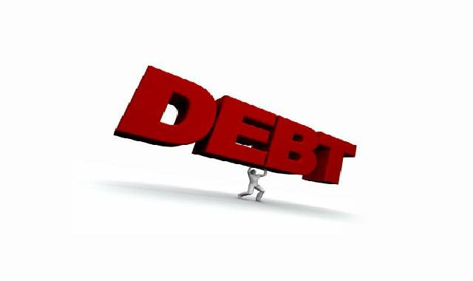
Purposes and Specific Limitations of Bond Issues
Districts are empowered to borrow money and to issue bonds. Bonds may be issued:
To pay any final judgment obtained against the District if the Board does not deem it advisable to pay the judgment out of current revenues.
If this type of bond can NOT be sold in accordance with NDCC, they may be issued to the judgment creditor in payment of the judgment.
NDCC 21-03-06, 7a

Slide 93

Purposes and Specific Limitations of Bond Issues
To provide necessary funds for the payment of principal and interest of bonds which are due or about to become due, but the District does not have sufficient funds, but only:
To the extent of the deficit;
Or to refund outstanding bonds of the District which are called for redemption and prepayment in accordance with their terms.
Or by consent of the holder within 6 months from the date of refunding bonds
When in the judgement of the Board, the best interest of the District will be served through reduction of interest costs or the extension of maturities.
NDCC 21-03-06, 7b

Slide 94

Purposes and Specific Limitations of Bond Issues
Bonds may be issued:
To refund outstanding bonds not yet due, or becoming due, or subject to redemption and prepayment within 6 months - If in the judgment of the Board, the best interests of the District will be served to reduce the costs, or the extension/adjustment of maturities versus the resources available for their payment.
NDCC 21-03-06, 7c

Slide 95
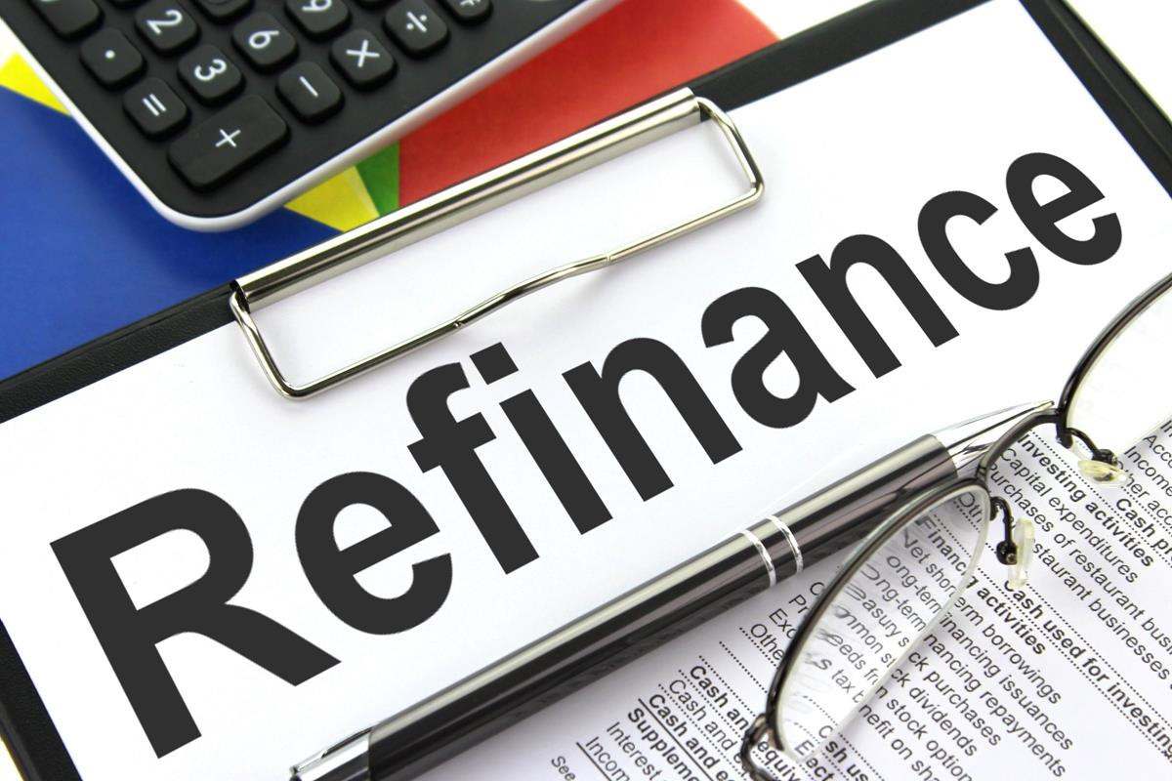

IN OTHER WORDS,
You can Refinance Bonds to reduce interest, shorten or lengthen term, change bonding companies, etc.
A bond that retires another bond before the first bond matures is called a Refunding Bond. These bonds are almost always issued at a lower interest rate than the original bond, ensuring significant reduction in interest expenses.
NDCC 21-03-06, 7c

Slide 96

Purposes and Specific Limitations of Bond Issues
There are requirements to do this:
The proceeds of the Refunding Bonds, are held in escrow until the maturity date.
The securities purchased with the escrow funds must be limited to purchasing General Obligations of the United States.
NDCC 21-03-06, 7c

Slide 97

The principal and interest payments are guaranteed by US government agencies such as:
Banks for cooperatives
Federal Home Loan Banks
Federal Intermediate Credit Banks
Federal Land Banks
Federal National Mortgage Association
Securities must be purchased simultaneously with the delivery of the refunding bonds.
NDCC 21-03-06, 7c

Slide 98

Purposes and Specific Limitations of Bond Issues
Money on hand in the Sinking Fund maintained for payment of outstanding bonds that are not immediately needed for payments or other available funds, can be deposited in the escrow fund and invested in the same manner as the proceeds of the refunding bonds.
NDCC 21-03-06, 7c

Slide 99
School District Voter Approval of Building Authority or Other Indirect Funding Methods –
Building Construction Project Approval
A School Board CAN NOT enter an agreement pursuant to IRS ruling 63-20 under which payments of any kind would be required by the District to any building authority or other entity that incurs debt in connection with acquisition, improvements or construction of any property or structure that total $4,000,000 or more unless it has been approved by a vote of a majority of the qualified electors of the District if the agreement is for acquisitions, improvements or construction for which a special or regular District election would be required if the District undertook the projects through issuance of bonds.
NDCC 21-03-06.1

Slide 100
School District Voter Approval of Building Authority or Other Indirect Funding Methods –
Building Construction Project Approval
The District can not enter into any agreements for payments or other obligation regarding construction, purchase, repair, improvement, modernization or renovation of any building to by used by the District without approval of the Superintendent of Public Instruction (provided in NDCC 15.1-36-01) if the School District undertook the project itself.
NDCC 21-03-06.1

Slide 101

Election Required - Exceptions
No District may issue bonds without being authorized to do so by a vote equal to 60% of all the qualified voters EXCEPT:
NDCC 21-03-07

Slide 102

Election Required - Exceptions
The School Board may also by resolution adopted by 2/3 vote, dedicate the tax levies as authorized by NDCC 15.1-09-47 (Fargo), 15.1-09-49 (Fargo) or 57-15-16 (Tax Levy for Building Fund in School Districts) and issue General Obligation Bonds to be paid by these dedicated levies.
It can be used for the purchase, construction, reconstruction or repair of school buildings or improvement of a project.
It can also be used for the construction or improvement of a project under NDCC 15.1-36-02 or 15.1-36-08. (School construction)
NDCC 21-03-07

Slide 103

Election Required - Exceptions
The Initial Resolution authorizing tax levy dedication and General Obligation Bonds must be published in the official newspaper of the District.
Any owner of taxable property within the District may file with the Business Manager a protest against the adoption of the resolution within 60 days.
Protests must be in writing and must describe the property that is the subject of the protest.
NDCC 21-03-07

Slide 104

Election Required - Exceptions
If the Board finds the owner of the taxable property has an assessed valuation equal to 5% or more of the assessed valuation of all taxable property within the District when it was last finally equalized, all further proceedings under the initial resolution are barred.
NDCC 21-03-07

Slide 105
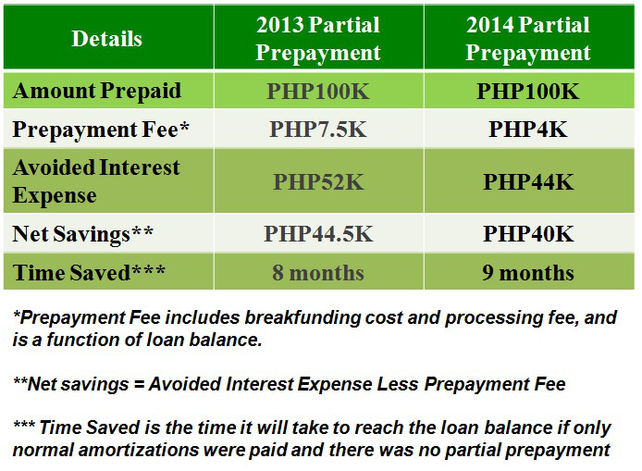
Election Required - Exceptions
There are also provisions under NDCC 21-03-07, 9 & 10 that allow for election exceptions due to disaster, executive order, or by proclamation of the Governor under NDCC 37-17.1.
Or if a District wants to dedicate a tax levy to provide funds to prepay outstanding special assessments in accordance with the provisions of Title 40 against property owned by the District.
NDCC 21-03-07(9)(10)

Slide 106

Maximum Interest Rate, Maturity & Denominations
No bonds may bear interest rates and be sold privately at a price resulting in an average net interest cost higher than 12% per annum.
There is no interest rate ceiling on those bonds sold at public sale or to the State of ND or any of its agencies or instrumentalities.
The bonds can not run for a period longer than 20 years.
In other words, 20 years or less
NDCC 21-03-08

Slide 107

Maximum Interest Rate, Maturity & Denominations
The bonds may not bear a date earlier than the date of the election authorizing their issuance, or the date of the Initial Resolution of the Board if no election was required.
NDCC 21-03-08

Slide 108
Initial Resolution - Form
If you want to issue a bond, your 1st step is to adopt an INITIAL RESOLUTION. The resolution must state:
The maximum amount of the bond
The purpose for which the bond is being issued
The assessed valuation of all taxable property in the District
The total amount of bonded indebtedness of the District
The amount of outstanding bonds of the District issued for a similar purpose
Any other statement of fact deemed advisable by the Board or voters proposing the same.
NDCC 21-03-09

Slide 109
Initial Resolution – How Adopted
The Initial Resolution may be:
Adopted by a majority vote of the Board at any regular meeting or at any special meeting of which notice has been given as required by law, without any previous action or request by the qualified electors or property owners. OR
Proposed by electors by filing a copy with the Business Manager along with a petition signed by 25% of the qualified voters as shown in the pollbook for the last preceding election. The petition must ask that an election on the question of issuing bonds be called.
NDCC 21-03-10

Slide 110

School Districts – Use of Bond Funds
The Initial Resolution or Petition providing for the issuance of bonds may provide a specific School Plan for which the proceeds of the bond must be exclusively used.
The Plan must designate the general area to be served by the bond proceeds for school purposes.
The area intended to be served must be described in the Plan but need not be described in the bond election ballot.
NDCC 21-03-10.1

Slide 111

School Districts – Use of Bond Funds
A bond election ballot form in substantially the form prescribed in NDCC 21-03-13 must be used in a School District Bond Election.
After approval of the Initial Resolution by the voters, the proceeds of the bond issue may be used only for the purpose and in the manner designated by the school plan.
NDCC 21-03-10.1(2)

Slide 112
School Districts – Use of Bond Funds
After approval of the bond issue, no change may be made in the purpose of the expenditure of bond proceeds unless 60% of the qualified electors vote to make material changes in the Plan as long as the changes do not conflict with contractual obligations incurred.
NDCC 21-03-10.1

Slide 113
Elections – When and How Called and Held
Once the Initial Resolution is adopted, the Board needs to make a motion to submit the Initial Resolution to the voters.
The date of the election must not be less than 20 days after the passage of the Initial Resolution or filing of a sufficient petition.
The Board will specify the date of the election, the polling hours, and polling place.
The Board must also appoint an inspector, 2 judges and 2 clerks for each polling place.
NOTE: This differs from a Regular School Board Election!
NDCC 21-03-11

Slide 114

Elections – When and How Called and Held
In the case of the absence of any election official, or the official’s inability to act at the opening of the polls, the remaining election officials shall appoint a qualified elector to fill the vacancy.
The election must be conducted, and the returns made and canvassed the same as Regular School Board Elections.
NDCC 21-03-11

Slide 115

Notice of Election to be Given
The Business Manager shall publish the Notice of Election once each week – for at least 2 weeks prior to the election – in the Official District Newspaper.
If there is no official newspaper is published during those 2 weeks, then posting the notice in 5 public places in the District is permissible.
NDCC 21-03-12

Slide 116

Notice of Election to be Given
The date of the posting or publication must be at least 15 days before the date of the election, exclusive of the day of such posting or first publication.
The election notice must specify:
The date of the election;
Polling hours and polling places of the election;
Must contain a complete copy of the Initial Resolution; and
A statement that the question to vote on is if the Initial Resolution should be approved.
NDCC 21-03-12

Slide 117

Notice of Election to be Given
If the Initial Resolution is brought to a vote during a Regular School Board Election, the notice may be separate from the Regular School Board Election Notice and may refer to the Board Election for the designation of polling places.
NDCC 21-03-12

Slide 118
Ballot - Contents
The ballot for a bond election must be separate from other ballots used on the same day for other elections. It must be written or printed and must state the question in the following format:
Shall the ________ School District issue its bonds in the amount not to exceed $_________ maturing within a maximum of _______, (duration) resulting in an estimated additional millage of _______ mills, equal to $________ (equivalent in dollars) on each $1,000 of taxable valuation for the first taxable year for the purpose of ___________?
Yes
No
Spoiled or blank ballots may not be counted.
NDCC 21-03-13

Slide 119
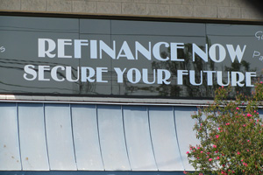
Bonds Issued Without an Election
If no election is required, the Board must adopt the facts required for an Initial Resolution (see 21-03-09).
At or after the adoption, the Board can sell, issue and deliver the bonds.
NDCC 21-03-14

Slide 120

Direct, Annual, Irrepealable Tax
If the Board has authorized the issuing of bonds, it shall also levy by recorded resolution a direct, annual tax which together with other sources of revenue authorized by the Board will be sufficient make all the bond payments until maturity.
The Board will have no power to repeal such levies or to obstruct the collection of any tax until the payments have been made or provided for.
NDCC 21-03-15

Slide 121

Direct, Annual, Ir-repealable Tax
The exception would be if the Board makes an irrevocable appropriation to the Sinking Fund of money actually on hand, or if there is enough funds in the Sinking Fund to retire the bonds.
If that is the case, the Business Manager shall notify the County Auditor and have them reduce the amount on the tax rolls when they are prepared in the future.
NDCC 21-03-15

Slide 122
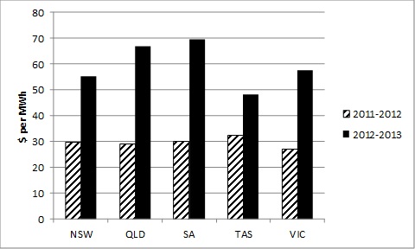
Direct, Annual, Ir-repealable Tax
If the Board has passed a resolution instituting an annual or direct tax as part of the issuance of the bonds, a copy of the this must be filed and certified with the County Auditor.
After the issuance of the bond, and tax on property from year to year must be carried into the tax roll of the District and collected as any other property tax is collected.
No further annual levy for that bond is necessary.
NDCC 21-03-15

Slide 123

Direct, Annual, Ir-repealable Tax
When insufficient funds are available to pay the matured bonds, the County Auditor will notify the Board. The Board may then levy a Direct Tax on taxable property to pay the deficiency and interest.
If the District no longer exists, the County Auditor shall levy a Direct Tax against taxable property in the original issuing District.
NDCC 21-03-15

Slide 124

Authority to Borrow and Issue Bonds –
When Complete
Every District which has complied with all the requirements to issue bonds and made applicable to it by NDCC, may borrow money and issue and sell its bonds to the amount and for the purpose specified in the Initial Resolution.
NDCC 21-03-16

Slide 125

Record of Proceedings
Every District shall provide and keep a record book in which the Business Manager shall record a full and correct statement of every step or proceedings that have taken place in the course of authorizing and issuing the bonds.
This should include a statement of affirmative and negative votes cast by the voters. (Pollbook will provide total #s)
NDCC 21-03-17

Slide 126

Form and Contents of Bonds
Every bond must be a Negotiable Instrument payable to the Bearer (registered owner).
Interest is normally paid annually or semi-annually.
The bond must specify the time and place for payment of principal and interest and must be numbered consecutively with the other bonds of the same issue.
NDCC 21-03-18

Slide 127

Form and Contents of Bonds
Each bond must show:
On it’s face - the purpose of the issue (construction, building bond, etc.)
It must contain a certificate or list of any direct, annual, irrepealable taxes that has been levied on taxable property by the District.
If any other revenue or tax source the District authorized to pledge
Any annual or periodic payments or distributions allocated by the legislature
NDCC 21-03-18

Slide 128

Bonds - Terms
Each bond must:
Be authorized by the Board
Bear dates and denomination
Be subject to redemption with or without premium
Be in the public interest
Must not have a duration of more than 20 years
NDCC 21-03-19

Slide 129
Interest –
Ceases at Maturity Unless Presented for Payment
Each bond must contain a provision that interest ceases at maturity UNLESS the bond holder presents the bond for payment and payment is refused.
NDCC 21-03-20

Slide 130

Execution of Bonds
Bonds must be executed in the name of and for the District by the Board President and Business Manager.
NDCC 21-03-21(4)

Slide 131

Bond Record
The County Auditor shall keep a bond record that must contain:
Date of issuance
Aggregate amount issued
Date of maturity
Rate of interest
Amount of levy on taxable property for each year certified
Any other amount levied on any other object of taxation
Amount pledged from other sources of revenue
Amount of any annual or periodic payments/distributions by the legislature
NDCC 21-03-23

Slide 132

Destruction of Bonds Not Sold Within 3 Years
All authorized bonds which were not delivered to the purchaser and paid within 3 years must be cancelled.
The Board President and the Business Manager PLUS at least 2 other electors of the District get to burn them!
The District has to file an affidavit that the bonds were destroyed noting the time and place of destruction.
A copy of the affidavit must be filed with the Business Manager and recorded in the official board minutes.
NDCC 21-03-24

Slide 133

Bonds – Advertised for Bids – Exception
No District can sell any issue of its bonds in an amount exceeding $1,000,000 – no matter for what purpose they were issued – without advertising for bids.
The exception is if the District needs money for payment and the fund is deficient, payment can be made out of the Special Improvement Fund without advertising for bids.
NDCC 21-03-25

Slide 134

Bonds – Advertised for Bids – Exception
The face value and accrued interest of the bonds may not exceed the face value and accrued interest of the bonds and interest coupons and the accrued in interest on them, for which they are exchanged.
NDCC 21-03-25

Slide 135

Bonds – Call for Bids – How Advertised
A Notice Call For Bids for each bond must be published at least ONCE in the official newspaper of the District.
If the District does not have an official newspaper, then it is published in the county’s official newspaper.
The notice must be published not less than 10 days or more than 30 days before the date specified for receiving bids.
The notice can be in any form but must specify the amount of bonds offered for sale and the maturity date.
NDCC 21-03-26

Slide 136

Bonds – Call for Bids – How Advertised
Failure to publish a Call For Bids Notice does not impair the validity of the bond, but it will render any executory contract entered into for the sale UNENFORCEABLE.
NDCC 21-03-26

Slide 137

Bids – Where Received - Record
The notice must specify the time and place where bids will be received.
The place must be decided by the Board and can be within or outside of the state.
At the time and the place specified at least one board member must be present or by another person acting under board authority.
NDCC 21-03-27

Slide 138
Bids – Where Received - Record
Bids can be submitted either ORALLY or in WRITING.
When the bids are received, the Board Member or person acting at the request of the Board shall enter in a permanent record:
The amount and rate of interest of each bid
Name and address of the bidder
NDCC 21-03-27

Slide 139

Sealed Bids
The Board can when calling for bids for the purchase of District bonds state that only SEALED bids will be received and considered.
NDCC 21-03-27.1

Slide 140
Bids – Accompanied by Draft –
Sale to Best Bidder – Rejection of All Bids
All bids MUST be accompanied by a certified check, cashier’s check, surety bond, or bank draft in the amount of not less than 1% of the bid.
Once bids are received, the Board will award the sale of the bonds to the bidder who agrees to purchase them on terms that are the most favorable to the District – unless the Board decides to reject all bids.
The Board has the authority to reject any and all bids.
NDCC 21-03-28

Slide 141

Bids – Accompanied by Draft –
Sale to Best Bidder – Rejection of All Bids
If no bids are received or if all bids are rejected, the Board may, without readvertising the bonds for sale, negotiate the sale of all the bonds to any person as long at the terms are the same as stated in the notice of sale AND are more favorable to the District than those specified in the rejected bid.
No sale may be less than 98% of face value of the bonds plus interest accrued on the bonds to the date of delivery to the buyer.
NDCC 21-03-28

Slide 142

Unlawful for Official to Accept Compensation From the Bidder
No official of the District may accept from the bidder, or prospective bidder at a sale of bonds, a commission or any other compensation for the officials rendered services (in connection with the issuance, sale or delivery of the bond).
NDCC 21-03-29

Slide 143

District Bonds –
Private Sale to United States or State Agencies
The procedure of calling for bids is NOT NECESSARY if the bonds are sold to:
State Board of University and School Lands
Bank of ND
The Public Finance Authority
Trust funds administered by public officials
The United States of America, or any agency or instrumentality thereof.
NDCC 21-03-30

Slide 144

Registration of Ownership of Bonds – How Made
The holder of any bond payable to “bearer or registered owner”, that is issued by any District, may have the ownership registered with the County Auditor.
If the District has over 4,000 population, the County Auditor or Business Manager may register the bond.
Registration must be made in the bond register and must be noted on the bond.
NDCC 21-03-34

Slide 145

Money Borrowed or Payable to be Lawful Money of United States
All money borrowed by Districts and all money received in payment of any tax levied, is lawful money of the United States.
All bonds must be payable in US currency.
NDCC 21-03-36

Slide 146

Appointment of Fiscal Agents
The Board of any District that has outstanding bonds is authorized to appoint a Fiscal Agent.
The agent(s) can be located inside or outside of ND.
Every Fiscal Agent must be an incorporated bank or trust company authorized by the laws of the USA or of the state in which it is located to do banking and trust company business.
The Business Manager, when necessary, shall deposit money for principal and interest payments with the Fiscal Agent for the bond payments.
NDCC 21-03-37

Slide 147
Bond Proceeds – Kept in Separate Fund –
Protection of Purchaser
All borrowed money must be paid into the District and kept in a fund separate and distinct from all other funds. (Typically, the Building Fund, and/or the Sinking & Interest/Debt Services Fund)
The money must be kept in the fund until used.
The money can only be used for the purpose for which it was borrowed and for no other purpose.
There are exceptions – Coming up in a few slides.
NDCC 21-03-38

Slide 148

Bond Proceeds – Kept in Separate Fund –
Protection of Purchaser
Funds may be temporarily invested in securities when approved by the Board in accordance with NDCC 21-03-42 and 21-03-43.
Income from the temporary investing of receipts from bond issues must be available for use that was approved or paid into the Sinking Fund for use in payment of the bonds.
NDCC 21-03-38

Slide 149

Disposal of Bond Proceeds
The proceeds of any District Bond which has not been used for the purposes that it was issued for within 3 years after date of issue, may be disposed of by the Board as follows:
Sufficient funds must be transferred to the Sinking Fund in an amount equal to the principal of the bonds outstanding and the interest requirements.
The Board may by 2/3 vote of all members, transfer the funds to any or all other debt sinking funds of the District.
NDCC 21-03-38.1

Slide 150

Disposal of Bond Proceeds
The Board, upon approval by a majority vote of the qualified electors on the question at an election, may use the funds for some other purpose authorized by law.
If any funds remain, they must be transferred to the General Fund of the District.
NDCC 21-03-38.1

Slide 151

Ancillary Contract Authorization
After the District has provided for an issue of bonds for a lawful purpose which can be achieved only through performance of an Executory Contract by some other contracting party – the contract may be entered into before the actual execution of the sale of bonds with the same effect.
In other words – the effect would be that the necessary cash for payments on the contract, were in the bank already.
NDCC 21-03-39

Slide 152

Sinking Funds - Custodian
The Business Manager of the School District is custodian of each of the sinking funds, unless the Board by resolution appoints the County Treasurer.
NDCC 21-03-40

Slide 153

Sinking Funds – Duty of County Treasurer
When the County Treasurer is custodian of any sinking fund, the County Treasurer may not remit to the Business Manager any taxes levied or any other moneys received for paying the interest on or retiring the principal of bonds issued.
The County Treasurer shall have a separate special fund maintained as a sinking and interest fund for the bonds of that taxing District.
NDCC 21-03-41

Slide 154
Sinking Funds – Duty of County Treasurer
The County Treasurer must make quarterly reports to the Business Manager of the District that shows all collections and amounts added to the fund, all payments from the fund and the net balance of each fund.
The County Treasurer shall keep the sinking funds on deposit in a public depository that can furnish the proper bond and has been approved by the District School Board.
When a sinking fund has been deposited in this manner, the County Treasurer is relieved of personal responsibility for its safekeeping.
NDCC 21-03-41

Slide 155

Sinking Funds – Sources and Uses
The Business Manager or County Treasurer of the District can disburse money from the Sinking Fund only by resolution of the Board.
As the bonds mature, the County Auditor can instruct the County Treasurer to make payment to the fund sufficient money to cover the principal and interest payments as they become payable.
The County Auditor shall authorize payment to retire the bonds at as early a date as possible.
NDCC 21-03-42

Slide 156

Sinking Funds – Sources and Uses
If the bonds are retired or if the balance in the Sinking Fund is sufficient to retire the bonds, the County Auditor will notify the School Board to terminate the levy for the bond.
The Business Manager may not disburse any such fund contrary to NDCC, EVEN THOUGH DIRECTED TO DO SO BY THE BOARD.
Can you say
Orange Jumpsuit
NDCC 21-03-42

Slide 157
Sinking Funds – Sources and Uses
The Sinking Fund of each bond must be kept separate and must be designated by a name indicative of the issue of the bonds (Building Fund, Debt Services Fund, etc.).
The sources of such funds must be:
All moneys accruing to the borrowed money fund (NDCC 21-03-38) which are not needed for the purpose for which the money was borrowed, must be transmitted to the County Treasurer.
In the case of the District having 4,000 or less population, upon the direction of the Board.
NDCC 21-03-42

Slide 158

Sinking Funds – Sources and Uses
All moneys raised by taxation and received from other sources (NDCC 21-03-15) for the purpose of paying the bond.
Money derived from other sources as the Board may elect to place in the Sinking Fund.
The premium, if any, for which the bonds have been sold over and above the face value and accrued interest.
NDCC 21-03-42

Slide 159

Sinking Funds – Sources and Uses
The County Treasurer may disburse funds for the purpose of paying principal and interest, or either, on the bonds for which the fund was created without any authorization from the Board.
NDCC 21-03-42

Slide 160
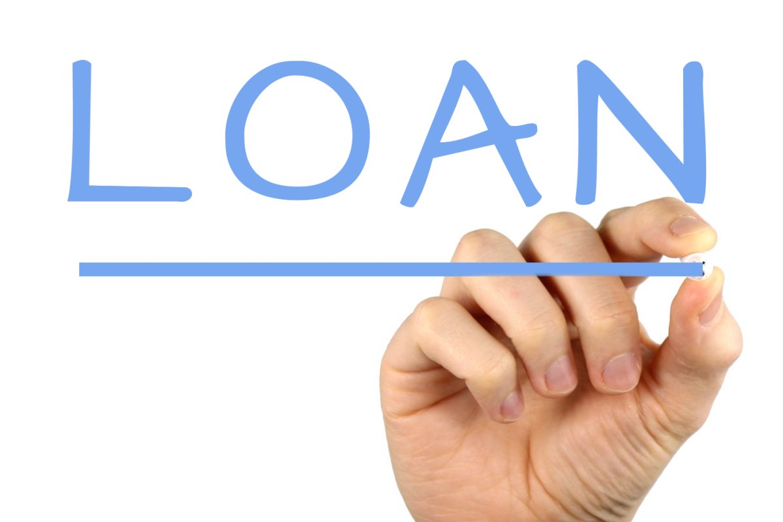
Investment of Sinking Funds
Taking care that enough cash is always retained in the Sinking Fund to provide for annual payments of principal and interest, the SURPLUS, if any, may be loaned or invested under the direction of Board as follows:
In the outstanding bonds at any price not to exceed 2 years interest on the bonds
In interest bearing bonds of the United States, or the State of ND
In conformity with provisions of depositories of public funds under NDCC 21-04.
NDCC 21-03-43

Slide 161

Investment of Sinking Funds
Investments in interest-bearing bonds of the US or State of ND continue to be a part of the Sinking Fund and must be held in custody of the Business Manager.
Bonds representing these types of investments may be sold by the Board at any time, but the money received remains, until used, a part of the Sinking Fund.
NDCC 21-03-43

Slide 162

Sinking Fund – Use for Unauthorized Purpose
Money can’t be withdrawn from a Sinking Fund and used for any purpose other than the purpose for which it was established until that purpose has been accomplished.
There are exceptions:
NDCC 6-09.4-23 and section 21-03-42 through 21-03-45 if the District notifies the Superintendent of Public Instruction, in writing, that the District has failed to pay a bond payment, DPI will withhold state aide until it is paid.
NDCC 21-03-44

Slide 163

Sinking Fund – Surplus Placed in General Fund
Any surplus in a Sinking Fund – after all the bonds for which the fund was created – have been paid and cancelled, and after all investments of the 2nd and 3rd class finally have been disposed of or realized must be placed in the General Fund of the District within 2 years.
NDCC 21-03-45

Slide 164

Districts in More Than One County
When a county officer is required to take any action regarding bond issues or sinking funds for a District that is situated in more than one county, the Board by recorded resolution shall designate the county official that shall act in that capacity.
In such cases, collection of taxes levied in any county that a portion of the District is located in, must be transmitted and delivered to the Business Manager of the District.
NDCC 21-03-46

Slide 165
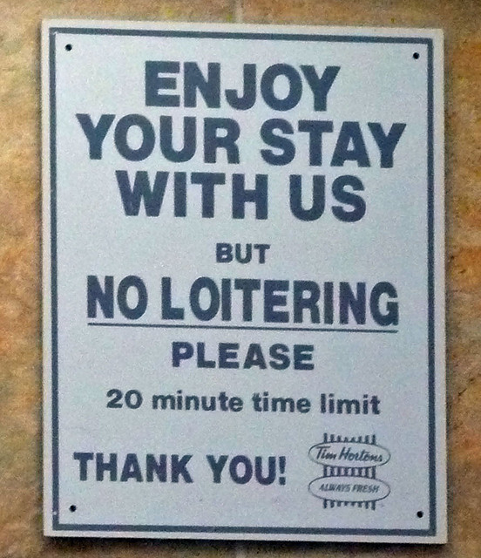
Limitation of Action
No action may be brought or maintained in any court in this state questioning the validity of any bonds issued pursuant to NDCC, or any tax levied, unless such action has been started within 30 days after the adoption of Board awarding the sale of the bonds.
NDCC 21-03-47

Slide 166
TITLE 21 - GOVERNMENTAL FINANCE
Registration of Public Obligations
NDCC Chapter 21-03.1

Slide 167

Execution - Authentication
A (bond) must be executed by the (District) by the manual or facsimile signature(s) of the authorized officers. (You and the Board President)
Any signature of an authorized officer may be attested by the signature of another authorized officer.
In addition, uncertificated obligations may include a certificate signed by an authenticating agent, registrar, transfer agent, or the like.
At least one of the required signatures must be a manual signature.
NDCC 21-03.1-03

Slide 168
Signatures
Any (bond) signed by the authorized officers at the time of signing, remains valid and binding, even if before the issuance of the bond any or all such officers have ceased to fill their respective offices.
Any authorized officer empowered to sign any (bond) may adopt as and for the signature of such officer the signature of a predecessor in office in the event that the predecessor’s signature appears on that obligation.
NDCC 21-03.1-04

Slide 169

Signatures
An authorized officer (Business Manager/Board President) incurs no liability by adoption of a predecessor’s signature that would not be incurred by such authorized officer if the signature were that of such authorized officer.
NDCC 21-03.1-04
NDCC 21-03.1

Slide 170

Seal
When a seal is required or permitted in the execution of any (bond), an authorized officer may print, engrave, stamp or otherwise place a facsimile on it.
The facsimile seal has the same legal effect as the impression of the seal.
NDCC 21-03.1-05
NDCC 21-03.1

Slide 171

Agents - Depositories
An (District) may appoint for a term that is agreed upon – so long as a bond is outstanding – corporate, or other authenticating agents, transfer agents, registrars, paying, or other agents.
The terms of their appointment must be specified, including their rights, compensation, duties, limits on their liability, and provisions for liquidated damages in the event of a breach of duties.
Also included in the terms should be what liquidated damages may be made payable to the (District), the owner or financial intermediary.
None of the agents need to have an office or do business with ND.
NDCC 21-03.1-06
NDCC 21-03.1

Slide 172

Agents - Depositories
An (District) may agree with custodian banks, financial intermediaries, and nominees of any of them, in the establishment and maintenance by others of a central depository system for the transfer or pledge of registered public obligation.
Any custodian banks, financial intermediaries, and nominees may, if qualified and acting as fiduciaries, also serve as authenticating agents, transfer agents, registrars, paying, or other agents of the (District) with respect to the same bond.
Definition: Fiduciary
An individual in whom another has placed the utmost trust and confidence to manage and protect property or money. A relationship where one person has an obligation to act for another's benefit.
NDCC 21-03.1-06
NDCC 21-03.1

Slide 173

Agents - Depositories
Nothing prohibits the (District) itself from performing, either alone or jointly with other issuers, any transfer, registration, authentication, payment, or other function described in this section of NDCC.
NDCC 21-03.1-06
NDCC 21-03.1

Slide 174
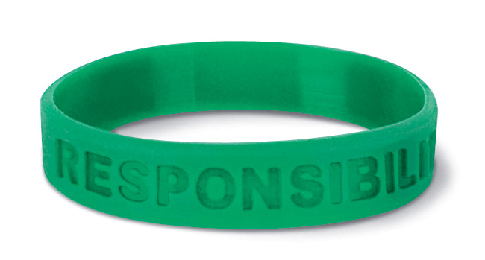
Costs - Collection
The (District), prior to or at original issuance of the bond, may as part of system of registration that the transferor or transferee of the bond, pay all or a designated part of the costs of the system as a condition to transfer OR costs would be paid out of proceeds of the bond.
The portion of the cost not provided to be paid by the transferor or the transferee or out of proceeds, is the liability of the (District).
NDCC 21-03.1-07
NDCC 21-03.1

Slide 175
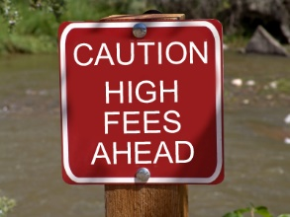
Costs - Collection
The (District), may provide for reimbursement, or for satisfaction of its liability, by payment by others. The (District) may enter into agreements with others regarding the reimbursement or payment.
They can establish fees and charges. They can also stipulate that the fees or charges must be reimbursed, paid from the same sources, by the same collection methods and with the same priority as with respect to the bond.
NDCC 21-03.1-07
NDCC 21-03.1

Slide 176

Security for Deposits
Obligations issued by School Districts in ND which are in registered form, whether or not represented by on instrument and which, except for their form, satisfy the requirements regarding security for deposits, must be deemed to satisfy all requirements.
NDCC 21-03.1-08
NDCC 21-03.1

Slide 177
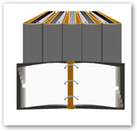
Public Records - Locations
Records of the ownership of or the security interests in bonds, are NOT subject to inspection or copying under any open record law in ND.
Registration records of the (District) may be maintained at locations both inside or outside of ND.
NDCC 21-03.1-09
NDCC 21-03.1

Slide 178
Applicability - Determination
Unless at any time prior to or at the original issuance of the bond, the Board determines otherwise, this chapter of NDCC is applicable to the bond. When this chapter is applicable, no contrary provisions apply.
Nothing in this chapter limits or prevents the issuance of bonds in any other form or manner authorized by law.
The provisions of this chapter are applicable to bonds which have been approved by vote, referendum, or hearing, authorizing or permitting the bonds in bearer and registered form, or in bearer form only.
Such bonds need not be resubmitted for a further vote, referendum, or hearing, for the purpose of authorizing of bonds pursuant to this chapter.
NDCC 21-03.1-10
NDCC 21-03.1

Slide 179
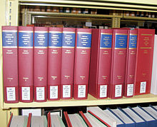
Construction
This chapter must be construed in conjunction with the Uniform Commercial Code and the principles of contract law relative to the registration and transfer of bonds.
DEFINITION of Uniform Commercial Code:
A standard set of business laws that regulate financial contracts. The Uniform Commercial Code has been adopted by most states. The code itself has nine separate articles. Each article deals with separate aspects of banking and loans.
.
NDCC 21-03.1-11
NDCC 21-03.1

Slide 180
Amendment or Repeal - Effect
ND covenants with the owners of any bonds that it will not amend or repeal this chapter if the effect may be to impair the exemption from income taxation of interest on bonds.
NDCC 21-03.1-12
NDCC 21-03.1

Slide 181
10 Minute
BREAK

Slide 182
TITLE 21
Depositories of Public Funds
NDCC Chapter 21-04

Slide 183

Definitions:
Financial Institutions:
Includes state & national banks insured by the FDIC, state-chartered or federally chartered savings and loans insured by the Federal Savings And Loan Insurance Corporation, and state-chartered or federally chartered credit unions insured by the National Credit Union Administration.
NDCC 21-04-01

Slide 184

Definitions:
Public Corporation:
Includes a county, city, township, School District and any other body corporate except a private corporation.
Public Funds:
The term includes funds of which any Board, bureau, commission or individual, created or authorized by law is authorized to have control as the legal custodian for any purpose whatsoever whether such funds were derived from general or special taxation or the assessment of persons or corporations for a specific purpose.
NDCC 21-04-01

Slide 185

Definitions:
Public Funds:
Includes all funds from taxation, fee, penalties, sale of bonds, and from any other source which belong to and are the property of the District.
The term does not include funds of students or student organizations deposited in a student financial institution approved by the and under the control of the School Board.
State:
Includes the state of ND and any institution, industry, enterprise or agency of the state.
NDCC 21-04-01

Slide 186
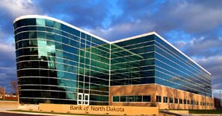
State Funds to be Deposited in Bank of ND:
Public funds belonging to or in the custody of the state must be deposited in the Bank of ND OR in financial institutions which have been duly designated as depositories in the manner prescribed in this chapter.
NDCC 21-04-02

Slide 187

Money Deposited Promptly – Withdrawal - Penalty:
The Business Manager and every other person legally charged with the custody of public funds (YOU), which, according to the provisions of this chapter, must be deposited promptly upon receipt of such funds. All such public funds must be deposited in the District’s name.
Checks or drafts on funds deposited must be drawn by the Business Manager in the Business Manager’s official capacity only, and no checks or drafts on such deposits may be paid or honored by such depository unless so drawn. In other words, you and the Board President.
PROMPTLY RECEIPTED
NDCC 21-04-04

Slide 188
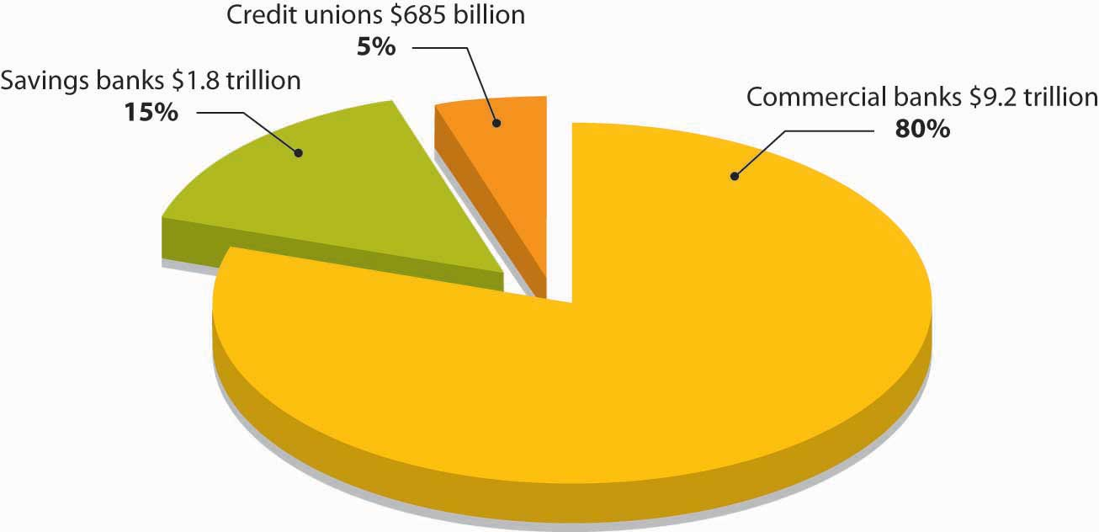
Financial Institutions – Designation as Depository:
Any financial institution duly incorporated in ND under the laws governing the incorporation of financial institutions, and any financial institution situated and doing business with ND and the Bank of ND, may be designated a depository of public funds by the School Board.
Your Board decides what the designated depository is. (bank, credit union, saving & loan, etc.)
NDCC 21-04-05

Slide 189

Financial Institutions – Designation as Depository:
The Board may select two or more financial institutions in the same county as depositories, but if more than one financial institution is designated, the Board shall deal with them impartially, both as to the deposit of funds, the withdrawal of funds, and the requirements as to bonds.
NDCC 21-04-05

Slide 190

Financial Institutions – Designation as Depository:
The Board shall take into consideration, in selecting and designating the depository, the condition of the financial institution, and their capital, surplus, and general credit.
NDCC 21-04-05

Slide 191
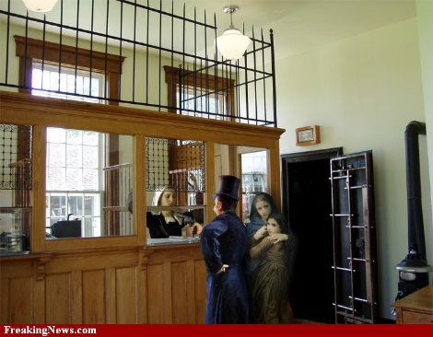
Designating Public Depositories Where There is Only One Financial Institution or no Financial Institution:
In a county where only one financial institution is located or functioning, the Board may designate such financial institution as a depository, or it may designate another financial institution within the state, or the Bank of ND, as depository in the manner, as long as the conditions provided for selection of depositories of public funds are followed.
.
NDCC 21-04-06

Slide 192

Designating Public Depositories Where There is Only One Financial Institution or no Financial Institution:
In case there is no financial institution within any city, township, or School District, the School Board, if it deems it more advantageous, for the best public interest, and convenience, may select a conveniently located financial institution as a depository in an adjoining county. This financial institution must provide a bond as is required from a financial institution within that county.
NDCC 21-04-06

Slide 193

Designating Public Depositories Where There is Only One Financial Institution or no Financial Institution:
The bond must be approved by the School Board as to sufficiency and by the State’s Attorney of the county in which the School District is located as to form and must be deposited in the office of the County Auditor of that county.
NDCC 21-04-06

Slide 194

Bond of Depository – Approval or Disapproval - Term:
Aside from the Bank of ND, any other financial institution of the School District, shall furnish a bond payable to the School District in an amount that at least equals the largest deposits that may be in that institution at any time .
The bond’s form must be approved by the State’s Attorney. The amount and sufficiency of the bond is approved by the Board.
NDCC 21-04-08

Slide 195

Bond of Depository – Approval or Disapproval - Term:
If the (financial entity’s) Board fails or refuses to approve this type of bond, the bond may be presented to the judge of the District Court, upon 3 days’ notice to the Business Manager of the School District to which such bond was submitted, and the judge shall proceed to hear and determine the sufficiency of such bond and may approve or disapprove the same as the facts warrant.
If the judge approves such bond, the financial institution must be declared a depository of the funds of the district.
NDCC 21-04-08

Slide 196

Bond of Depository – Approval or Disapproval - Term:
The School Board may require the financial institution designated as a depository to file a surety bond for a sum equal to what it may receive according to the provisions of this chapter.
This bond must be a continuing bond and must be binding until the School Board requires a new or different bond, but in no case involving the deposit of funds of the District may this bond be continued without a renewal for a longer period than 4 years.
NDCC 21-04-08

Slide 197

Pledge of Security in Place of Depository Bond
The Board of any School District may accept from any financial institution, as security for repayment of deposits, a Pledge of Securities in lieu of a personal or surety bond.
This is also called A Pledge of Assets.
NDCC 21-04-09

Slide 198

Pledge of Security in Place of Depository Bond
When securities are so pledged to the Board of any District, the Board shall require security in the amount of $110 for every $100 of public deposits.
In other words, 110% of the deposit.
NDCC 21-04-09(5)

Slide 199

Pledge of Security in Place of Depository Bond
Securities that are eligible for the Pledge of Assets are bills, notes, or bonds issued by the U. S. Government, its agencies or instrumentalities, all bonds and notes guaranteed by the U. S. Government, irrevocable standby letters of credit issued by federal home loan banks of a rating of AA or better by Moody’s Investors Service, Inc. or Standard & Poor’s Corporation, Federal Land Bank Bonds, bonds, notes, warrants, certificates of indebtedness, insured certificates of deposits, shares of investment companies registered under the Investment Companies Act of 1940., letters of credit issued by the Bank of ND.
NDCC 21-04-09

Slide 200

Pledge of Security in Place of Depository Bond
This also includes letters of credit issued by the Bank of ND, and all forms of securities issued by it, its boards, agencies, or instrumentalities, or by any county, city, township, School District, park district, or other political subdivision of the state whether payable from special revenues or supported by the full faith and credit of the issuing body, and bonds issued by any other state of the United States, or such other securities approved by the Banking Board.
NDCC 21-04-09

Slide 201
Pledge of Security in Place of Depository Bond
The securities and securities sold under agreements to repurchase must be delivered to and held for safekeeping by any financial institution, other than the depository, which the depository and the District may agree upon.
Whenever any securities are deposited for safekeeping with any custodian, the custodian shall issue a receipt therefore jointly to the depository and the District.
In other words, the financial institution will send you a copy of the Pledge of Assets.
NDCC 21-04-09

Slide 202

Pledge of Security in Place of Depository Bond
Any financial institution pledging securities, at any time it deems it advisable or desirable, and without the consent of the Board of the District, may substitute other eligible securities for all or any part of the securities pledged.
The securities substituted must, at the time of the substitution, have a market value of at least equal to the market value of the securities released and delivered to the depository.
NDCC 21-04-09

Slide 203


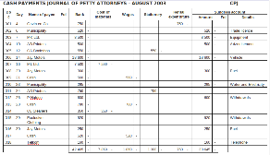
Pledge of Security in Place of Depository Bond
In the event of the substitution, the holder or custodian of the pledged securities shall on the same day, forward by mail or electronic transmission to the District and the depository financial institution a receipt specifically describing and identifying both the securities substituted and those released and returned to the depository financial institution.
NDCC 21-04-09

Slide 204
Pledge of Security in Place of Depository Bond
A depository financial institution may fulfill the pledge of securities requirements by maintaining a Security Pledge Schedule that establishes the following:
The names of all public bodies maintaining deposits with the financial institution.
The amount of each deposit maintained by each public body.
The amount of FDIC insurance applied to each account.
The net deposits exceeding FDIC insurance applied to each account.
Continued next slide
NDCC 21-04-09

Slide 205

Pledge of Security in Place of Depository Bond
The amount of net deposit exceeding FDIC deposit insurance multiplied by 110% for each account.
The amount of securities needed to be pledged to fulfill the requirements of this section.
The total number of qualified securities pledged by the financial institution under of this section.
NDCC 21-04-09

Slide 206

Pledge of Security in Place of Depository Bond
A financial institution is in compliance with this section as long as the Security Pledge Schedule discloses the total qualified securities pledged in excess of the total pledges needed for a total amount of deposits maintained by the District with the financial institution as verified by the custodian of the securities every three months and copies thereof are provided to the custodian of the securities and to each of the Districts maintaining deposits with the financial institution.
NDCC 21-04-09

Slide 207

Pledge of Security in Place of Depository Bond
No Pledge Of Security or bond may be required for funds deposited with a financial institution directly or by a financial institution’s participation as a member of a deposit placement service to the extent that the deposits are insured or guaranteed by the FDIC or the NCUA as determined by the Commissioner Of Financial Institutions or an insurance company that is qualified to offer excess deposit insurance in ND and which has a rating A- or better by A. M. Best Company Inc., or the equivalent rating by another recognized rating organization as determined by the Insurance Commissioner.
NDCC 21-04-09

Slide 208
Letters of Credit for Public Deposits –
Security Interest – Priority - Written
Letters of credit issued by the Bank of ND in connection with section 21-04-09 must be secured by collateral.
A Security Interest is created and attaches when the Bank issues a Letter of Credit in connection with this section.
Filing is not required for perfection of the security interest created and it is entitled to priority as to all creditors.
Perfection of Security Interests means additional steps are taken to protect the security interest against 3rd parties and/or to retain its effectiveness in the event of default by the grantor of the security interest.
NDCC 21-04-09.1

Slide 209

Letters of Credit for Public Deposits –
Security Interest – Priority - Written
The Board of Directors of a financial institution seeking a Letter of Credit from the Bank of ND shall execute a written agreement with the Bank, reflect approval of the agreement in the Board minutes and, as of the date of execution of the agreement, keep a copy of the agreement as an official record.
NDCC 21-04-09.1

Slide 210

Interest Payable to Financial Institution –
Sale of Pledged Securities on Default
All interest which becomes due and is paid on securities pledged to secure public deposits must be paid over to the depository financial institution until such time as it defaults in the repayment of the funds of the of the (District) deposited.
NDCC 21-04-10

Slide 211


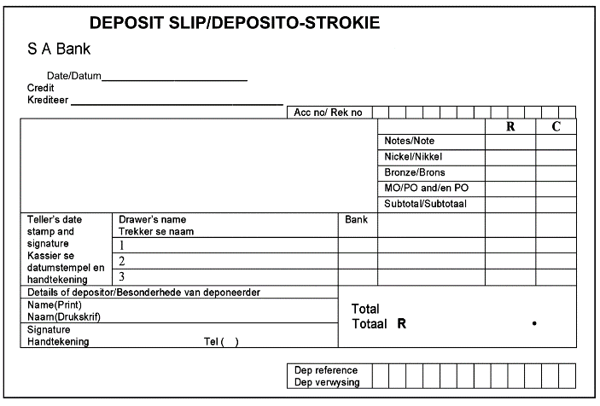
Interest Payable to Financial Institution –
Sale of Pledged Securities on Default
After 30 days from default, upon demand in writing made by the (District) involved, the custodian shall deliver the securities to the (District) with which pledged, and the securities may be sold as in the case of other pledges, and the proceeds must be applied to the repayment of the District deposit.
NDCC 21-04-10

Slide 212

Townships and School Districts –
Selection of Depositories at Any Time
. . . The School Board may designate depositories at any meeting of the Board and no notice to financial institutions need be given and no formal proposal need be received.
NDCC 21-04-15

Slide 213

When NO Bonds Are Required
Whenever it appears that a bank designated by a District as a depository of its funds has complied with the provision of the Act of Congress relating to the guaranty of deposits in state and national banks, no bond may be required of the bank to secure the deposits of any part of the public funds up to the amount of the deposit is secured in the bank under the federal act.
BOND
NDCC 21-04-16

Slide 214
When Bonds Are Required
If it appears that the benefit of the federal act guarantying deposits in financial institutions has been withdrawn or is about to be withdrawn from the financial institution in which any public funds are deposited, the School Board having control or supervision of the public funds, immediately shall withdraw the full amount from the financial institution or shall require the usual bond required to secure the deposits of these public funds.
It is unlawful to continue any financial institution as a depository of public funds unless and until the bonds are furnished.
NDCC 21-04-17

Slide 215
Interest or Dividend Rates
Depositories of public funds in this state shall pay substantially the same rate of interest or dividend as is paid on individual deposits.
NDCC 21-04-18

Slide 216
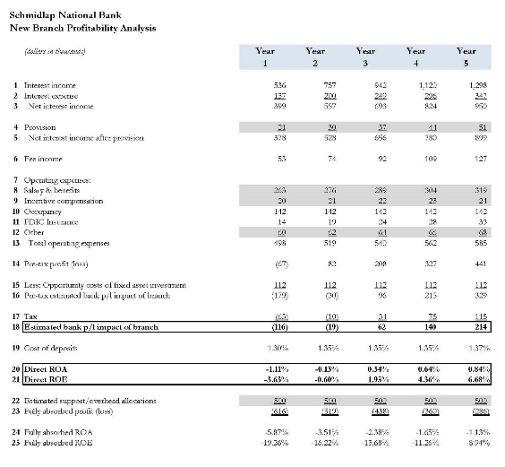
Itemized Statements
Each depository shall:
Furnish on the 1st day of each month to the District, an itemized statement of the amount of the deposits. Such statement must be verified whenever required by the Business Manager of the District. All sums of interest accruing on deposited funds must be credited to the deposit account on the first day of each month for the preceding month.
NDCC 21-04-09

Slide 217
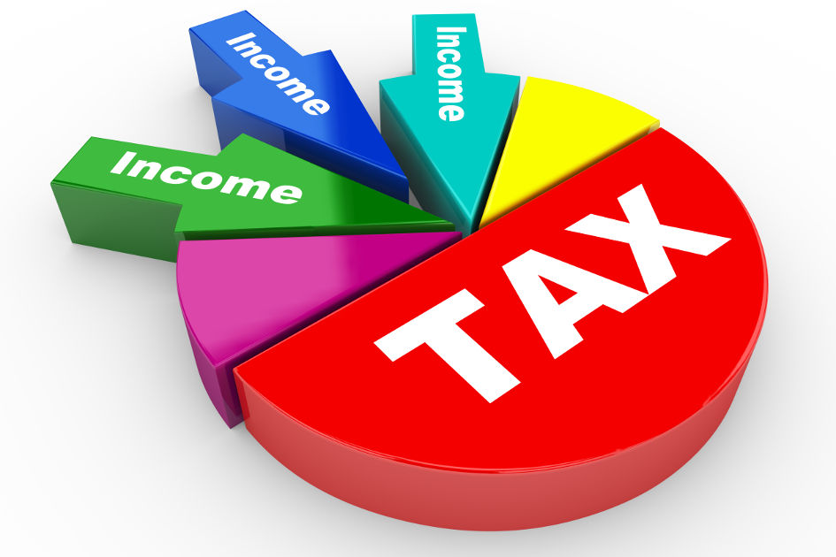
Itemized Statements
Each depository shall:
On July 1st of each year, furnish to the Business Manager of each School District, and the County Superintendent of Schools of the county in which the School District is located, a statement showing the amount of deposits to the credit of each School District at the close of business on June 30th.
NDCC 21-04-19

Slide 218

Funds Deposited – Custodian Exonerated
If District funds are deposited as provided in this chapter, the Business Manager and the sureties of the Business Manager’s Bond are exempt from all liability of loss of funds from failure or other act of a depository.
NDCC 21-04-22

Slide 219

Penalty
Any person violating any of the provisions of this chapter is guilty of a Class A misdemeanor. (Potential sentence of up to one year in jail and $3,000 in fines)
NDCC 21-04-23

Slide 220

All Public Funds are Governed by Provisions of Chapter
Any Board, or individual (you) having the legal custody of public funds that do not expressly or by name come within the provisions of this chapter, nevertheless must be governed by the provisions of this chapter.
They shall deposit funds only in legal depositories and shall comply with the other provisions as closely as possible.
They are subject to the penalties provided.
NDCC 21-04-24

Slide 221
TITLE 21
Miscellaneous Provisions
Duplicate, Lost, Defaced Obligations
NDCC Chapter 21-06

Slide 222

Duplicate Obligation – Issuance
A duplicate of any bond, warrant, interest coupon or other obligation of the District can be issued if the obligation:
Becomes so mutilated or defaced as to be unfit for circulation and it is surrendered and cancelled; or
It is lost or destroyed.
The duplicate must be issued to the owner, must be marked “duplicate” and must correspond with the cancelled or lost obligation in number, date, amount and unpaid coupons and must be signed by the proper officers who are then in office.
NDCC 21-06-01

Slide 223

Payment of Defaced or Lost Obligation
If any instrument that might be duplicated, is due and payable, it may be paid by the Business Manager, without issuance of a duplicate.
NDCC 21-06-02

Slide 224
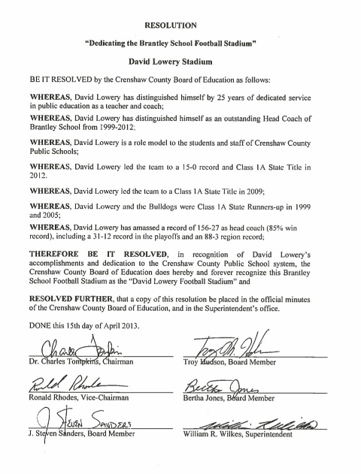
Definition of Payment – By Whom Ordered – Proof and Bond or Signed Written Agreement Required
The duplication or payment of any mutilated, defaced, lost or destroyed obligation of a District must be made upon resolution duly adopted by the District School Board.
NDCC 21-06-03

Slide 225

Definition of Payment – By Whom Ordered - Proof and Bond or Signed Written Agreement Required
Before a duplicate may be issued or payment made on a lost or destroyed obligation, the owner shall furnish proof of loss or destruction.
The state or the District, as the case may be, may require:
A surety bond in the amount of the lost obligation
A signed written agreement by the owner, or
Similar assurance conditioned to save the obligor harmless
NDCC 21-06-03

Slide 226

Definition of Payment – By Whom Ordered - Proof and Bond or Signed Written Agreement Required
If the Bank of ND is the owner of the obligation, it may not be required to furnish a bond but shall furnish proof of loss or destruction of the obligation.
They shall also reimburse the state or the District for any loss or damage suffered by reason of issuance of a duplicate or the payment of the obligation.
NDCC 21-06-03

Slide 227

Record to be Kept
A record of all payments, reissues, and duplicates made for mutilated, defaced, lost or destroyed obligations must be kept by the Business Manager of the District.
The record should show the date of payments, duplicated or reissues, and the person or persons to who paid or issued.
These records must be certified to the proper auditing official.
NDCC 21-06-04

Slide 228

Districts May Invest Funds
School Districts may invest moneys in their General Fund, or balances in any special or temporary fund, in:
  Bonds, treasury bills and notes or other securities that are a direct obligation of or an obligation insured or guaranteed by the Treasury of the USA, or its agencies, instrumentalities, or organizations created by an act of Congress.
  Securities sold under agreements to repurchase written by a financial institution in which the underlying securities are of a type listed above.
  Certificates of Deposit fully insured by the FDIC or by the State.
NDCC 21-06-07

Slide 229
Districts May Invest Funds
Certificates of Deposit, savings deposits, or other deposits fully insured or guaranteed by the FDIC and placed for the benefit of District by a public depository through an appropriate deposit placement service as determined by the Commissioner of Financial Institutions.
State and local securities:
  Any security that is a general obligation of any state or local government with taxing powers and is rated in the highest three categories by a nationally recognized rating agency.
  An obligation of the State Housing Finance Agency that is rated in the highest two categories by a nationally recognized rating agency.
NDCC 21-06-07

Slide 230

Districts May Invest Funds
  Any security that is a general obligation of a School District and is rated in the highest two categories by a nationally recognized rating agency.
  Obligations of this state and general obligations of its political subdivisions.
Commercial paper issued by a United States corporation rated in the highest quality category by at least two nationally recognized rating agencies and matures in 270 days or less.
NDCC 21-06-07

Slide 231
Districts May Invest Funds
Bonds, treasury bills and notes, or other securities must be taken into consideration in making levies for the ensuing year.
When funds are needed for current expenses, the Board may convert those obligations into cash.
NDCC 21-06-07

Slide 232

Authority to Contract With the Federal Government – Delegation of Authority
The District may enter into a contract with the USA or its agencies to purchase or lease equipment, supplies, materials or property without regard to bidding and the delivery of purchases before payment.
NDCC 21-06-08

Slide 233
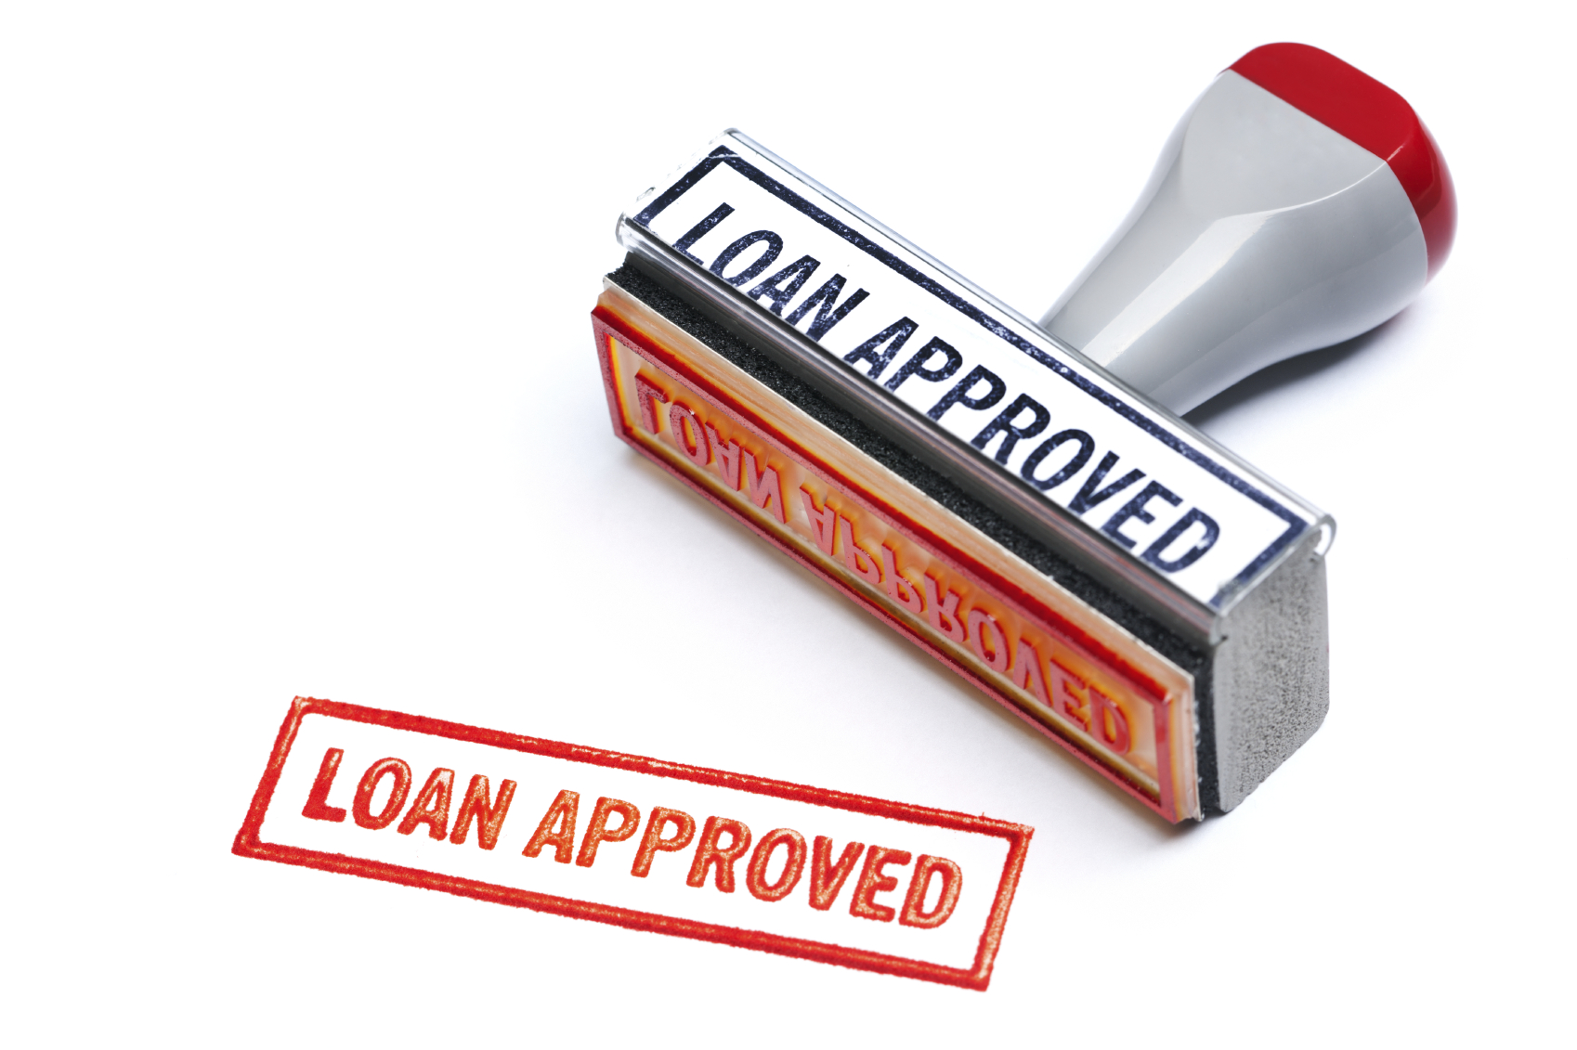
Authorization to Make Loans or Accept Grants
The state, any of its departments, boards, bureaus or commissions, by approval of the Governor, may make loans, or accept advances from the federal government for the purpose of aiding in financing the cost of architectural, engineering, and economic investigations and studies, surveys, designs, plans, working drawings, specifications, procedures, and other actions preliminary to the construction of public works and improvements.
The state may repay the federal government loans or advances at such times as the construction is undertaken.
NDCC 21-06-09

Slide 234
Authorization to Make Loans or Accept Grants
Any School District may by action of the governing Board, also make loans and accept advances and repay the same in the same manner.
These loans made or grants accepted may be made or accepted under such rules and regulations as the federal government may prescribe.
NDCC 21-06-09

Slide 235
Moneys Received Through Leasing of Lands Acquired by US for Flood Control Distributed to Counties for Schools and Roads
A county receiving an allocation under this section will pay ½ of the allocation to School Districts.
NDCC 21-06-10

Slide 236

Use of Public Funds or Property for Nonprofit Education Foundations – Public Purposes
Any School District may provide the use of public property or in-kind services of personnel to participate in the creation and administration of Nonprofit Public School Education Foundations.
The foundation would be subject to an annual audit, and can receive, manage, invest, and distribute funds or property provided to the foundation by private or non-school district governmental entities, if the foundation is established to enhance the mission of the School District.
NDCC 21-06-12

Slide 237
Use of Public Funds or Property for Nonprofit Education Foundations – Public Purposes
Enhancing the Mission of the School District could include:
Providing facilities or services for recognition of staff and students that are not normally available through the funding of the School District.
Administering funds received for education scholarships or endowments established by other entities.
Encouraging elementary, secondary and postsecondary education and assist in raising, adding, investing and distribution of funds and earnings in accordance with guidelines established by the foundation.
The records of the foundation are not subject to audit under NDCC 54-10-14
NDCC 21-06-11

Slide 238
TITLE 21
Sinking Fund Levy & Collection Records
NDCC Chapter 21-07

Slide 239
County Auditor to Deliver to County Treasurer Schedule of Municipal Tax Levies for Sinking Funds
Each County Auditor shall deliver to the County Treasurer a separate detailed schedule that shows the amount of tax and mill rate of the levy for each separate levy for Sinking Funds certified to the County by the District (Certificate of Levy).
This includes levies for Sinking Funds for bonds issued by the County – each stated separately.
A true and correct duplicate must be kept as a permanent record of the County Auditor’s Office.
NDCC 21-07-01

Slide 240
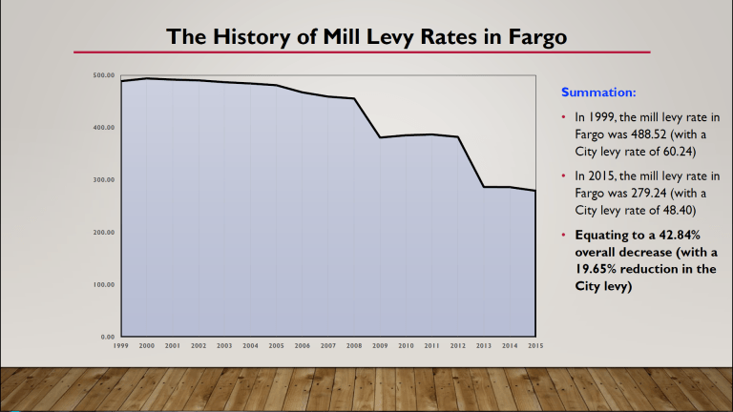
County Treasurer to Keep Record of Each Separate Municipal Levy for Sinking Fund
Each County Treasurer, at the close of each month, shall make a permanent office record showing separately and distinctly the amount of each District Levy for Sinking Fund purposes included in taxes collected.
This record shall always show the amount of each annual levy for each separate interest and sinking fund.
NDCC 21-07-02

Slide 241

County Treasurer to Deliver to Municipal Treasurer Statement Showing Amount Remitted to Sinking Fund of Municipality
Each County Treasurer, when remitting taxes to the Business Manager of the District shall deliver a statement showing definitely the amount included in the sum remitted.
It should show each separate sinking fund levied by the District to which remittance is made.
NDCC 21-07-03

Slide 242
TITLE 21
Bond Validating Act
NDCC Chapter 21-09

Slide 243

Validation of Bonds and Incidental Proceedings
All bonds issued by a District for any purpose and in any manner consistent with the Constitution of ND are validated, ratified, approved and confirmed.
This includes all proceedings taken by the Board for authorization, issuance, sale, exchange, execution and delivery of its bonds.
It also includes the performance of any conditions, provision of taxes, special assessments and other funds to pay for the bonds and their interest.
NDCC 21-09-03

Slide 244

Validation of Bonds and Incidental Proceedings
All bonds already issued by the District and all future bonds issued by the District under NDCC are binding, legal and enforceable obligations of the District.
NDCC 21-09-03

Slide 245
Matters Validated
This chapter applies to all defects, irregularities and omissions, other than constitutional:
In the calling, notice or conduct of any election, any public hearing, or any board meeting held for –
  The authorizing bonds or any project financed by bonds.
  In creating an improvement district – the determination of its necessity and making of contracts for the acquisition or construction of the project.
  In the levy of any tax or special assessment appropriated for the payment of bonds.
NDCC 21-09-04

Slide 246
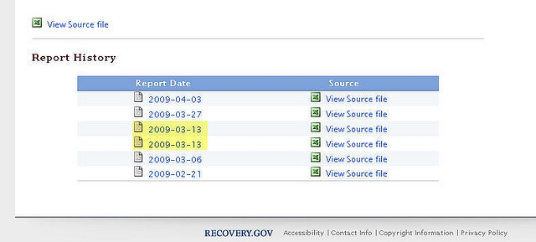
Matters Validated
  In the establishment of rates and charges for the service of any project
  In the pledge of net revenues therefrom for the payment of bonds
  In the making of covenants securing these payments.
NDCC 21-09-04

Slide 247
Matters Validated
This chapter applies to any lack of power, other than constitutional:
To engage in a project or any portion thereof, or to finance a project by issuing bonds
To combine two or more projects or bond issues in the same proceedings
To conduct proceedings in the sequence actually followed
Or to exercise jurisdiction over the site where the project is located within or outside the District.
NDCC 21-09-04

Slide 248
Application of Chapter
The provisions of this chapter relating to validation, apply to all bonds issued and proceedings taken by any District before JULY 1, 2009.
NDCC 21-09-05

Slide 249
TITLE 21
State Investment Board
NDCC Chapter 21-10

Slide 250
State Investment Board – Membership – Term – Compensation – Advisory Council
The ND State Investment Board consists of:
  Governor
  State Treasurer
  Commissioner of University & School Lands
  Director of Workforce Safety & Insurance
  Director of the Office of Management & Budget
  Two members of TFFR board or the Board’s designee
  Two members of PERS board as selected by that board
  Two members by whom experience is familiar with institutional investments, appointed by the Governor
  One member from the Senate & one member from the House of Representatives who serve on the Legacy and Budget Stabilization Fund Advisory Board as selected by those boards.
  The TFFR Board, PERS Board, WSI Director can appoint a designee to attend meetings, participate and vote when they are unable to attend.
NDCC 21-10-01

Slide 251

State Investment Board – Membership – Term – Compensation – Advisory Council
The State Investment Board may establish an Advisory Council composed of individuals who are experienced and knowledgeable in the field of investments.
The State Investment Board will determine the responsibilities of the Advisory Council.
NDCC 21-10-01

Slide 252
Board – Powers and Duties
The Board is charged with the investment of funds enumerated NDCC 21-10-06 (upcoming slide).
It shall approve general types of securities for investment of these funds and set policies and procedures regulating securities transactions on behalf of the various funds.
Representatives of the funds may make recommendations to the Board on investments.
The Board or its designated agents must be custodians of securities purchased on behalf of funds under the management of the Board.
NDCC 21-10-02

Slide 253

Board – Powers and Duties
The Board may appoint an Investment Director or Advisory Service, or both, who have experience and knowledge of the field of investments.
The Board may authorize the Investment Director to lend securities held by the funds.
These securities must be collateralized (A security that is backed by a specific asset or a pool of assets) as directed by the Board.
The Board may create investment fund pools in which the fund identified in NDCC 21-10-06 may invest.
The Board shall give preference to investment firms and financial institutions with a presence in North Dakota for investment of the Legacy Fund.
NDCC 21-10-02

Slide 254
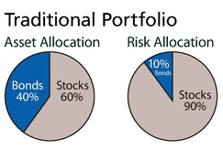
Board – Policies on Investment Goals and Objectives and Asset Allocation
The Board for each fund listed below shall establish policies on investment goals and objectives and asset allocation for each respective fund. The policies must provide for:
The definition & assignment of duties & responsibilities to advisory services & employees of the Board.
Rate of return objectives, including liability requirements & acceptable levels of risk.
Long-range asset allocation goals
Guidelines for the selection and redemption of investments
Investment diversification, investment quality, qualification of advisory service, & amounts to be invested by advisory services.
The type of reports & procedures to be used in evaluating performance.
The asset allocation & and subsequent allocation changes for each fund must be approved by the board of that fund & the State Investment Board. The governing body of each fund shall use the staff and consultants of TFFR in developing asset allocation & investment policies.
NDCC 21-10-02.1

Slide 255

Funds Under Management of Board - Accounts
The Board shall invest the following funds:
  State Bonding Fund
  Teachers Fund for Retirement
  State Fire and Tornado Fund
  Workforce Safety and Insurance
  Public Employees Retirement System
  Insurance Regulatory Trust Fund
  State Risk Management Fund
  Budget Stabilization Fund
  Water Projects Stabilization Fund
  Health Care Trust Fund
  Cultural Endowment Fund
  Petroleum Tank Release Compensation Fund
  Legacy Fund
  Legacy Earnings Fund
  Opioid Settlement Fund
  A fund under contract with the Board pursuant to subsection 3
NDCC 21-10-06

Slide 256
Funds Under Management of Board - Accounts
  Separate accounting must be maintained for each of the fund.
  The moneys of the individual funds may be commingled for investment purposes when determined to be advantageous.
  The State Investment Board may provide investment services to and manage the money of, any District in the state, subject to agreement with the Industrial Commission.
  The scope of services provided to the District must be specified in a written contract.
  The State Investment Board may charge a fee for providing investment services and any revenue collected must be deposited in the State Retirement and Investment Fund.
NDCC 21-10-06

Slide 257

Board – Investment Reports
  The Board prepares annual reports on the investment performance of each fund under its control. The reports must include:
  A list of the advisory services managing investments for the Board.
  A list of investments at market value, compared to the previous reporting period, of each fund managed by each advisory service.
  Earnings, % earned, and change in market value for each fund’s investments.
  Performance comparisons for each fund managed by each advisory service to other funds under the board’s control and to generally accepted market indicators.
NDCC 21-10-06.1

Slide 258

Investment Costs
  The amounts necessary to pay for investment costs are appropriated and must be paid out of the designated funds listed in NDCC 21-10-06 by the fund incurring the expense.
NDCC 21-10-06.2

Slide 259

Legal Investments
  The State Investment Board applies the Prudent Investor Rule
  (In other words, invest as if its your own money you are investing) in investing for funds under its supervision.
  The retirement funds belonging to TFFR and PERS must be invested exclusively for the benefit of their members & in accordance with the respective funds’ investment goals & objectives..
NDCC 21-10-07

Slide 260

Prudent Investor Rule - Exception
  The State Investment Board shall give preference to qualified investment firms and financial institutions with a presence in North Dakota for investment of the Legacy Fund.

Slide 261

Reserves – Percentage Limitations
  In order to meet claims and liabilities, reserves (money that is set aside to meet any unexpected costs that may arise in the future as well as the future costs of upkeep) must be established and maintained in each of the funds in accordance with the investment policy and asset allocation established for each fund.
NDCC 21-10-08

Slide 262

Social Investment - Prohibition
  Social Investment means the consideration of socially responsible criteria & environmental, social, and governance impact criteria in the investment or commitment of public funds for the purpose of obtaining an effect other than a maximized return at a prudent level of risk to the state.
  The State Investment Board or other state entity, MAY NOT invest state funds for the purpose of Social Investment unless it can demonstrate that a social investment would provide an equivalent or superior rate of return compared to a similar investment that is not a social investment.
NDCC 21-10-08

Slide 263
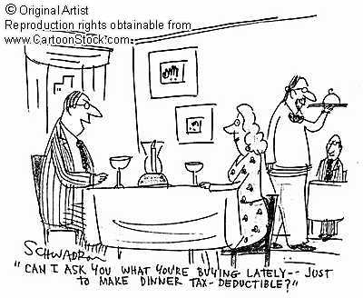
Personal Profit Prohibited - Penalty
  No member, officer, agent or employee of the State Investment Board may profit in any manner from transactions on behalf of the funds.
  Any person violating any of the provisions of NDCC is guilty of a Class A Misdemeanor.
NDCC 21-10-09

Slide 264
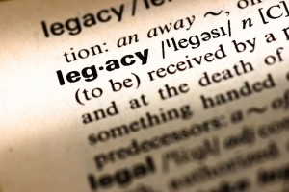
Legacy and Budget Stabilization Fund Advisory Board
  The Legacy and Budget Stabilization Fund Advisory Board was created to develop recommendations in the Legacy Fund and the Budget Stabilization Fund for the investment of their funds and to present this to the State Investment Board.
  The goal of the Legacy Fund investments is principal preservation while maximizing total return.
NDCC 21-10-11

Slide 265

Legacy Earnings Fund – Transfers
  This new section of law outlines the creation of the Legacy Earnings Fund and the State Treasurer’s responsibilities to oversee the fund and the reporting requirements and dates.
NDCC 21-10-13

Slide 266
TITLE 21
Private Activity Bond Ceiling Allocation
NDCC Chapter 21-12

Slide 267
What is a Private Activity Bond?
Private Activity Bond – “PAB”
Tax-exempt Bonds issued by or on behalf of local or state government for the purpose of providing special financing benefits for qualified projects. The financing is most often for projects of a private user, and the government generally does not pledge its credit.
These bonds are used to attract private investment for projects that have some public benefit. (There are strict rules as to which projects qualify.) This type of a bond results in reduced financing costs because of the exception of federal tax.
Do you think a School District would take advantage of this type of bond?

Slide 268
TITLE 21
Political Subdivision Borrowing
NDCC Chapter 21-13

Slide 269

Political Subdivision Authority to Enter Agreement for Bank or Credit Union Loans
  A District may borrow against its anticipated revenue, from a bank or credit union located in ND.
  A bank or credit union loan and its terms must be authorized by a resolution of the Board.
  The resolution must identify the revenue to be used to repay the loan and any collateral that will secure repayment of the loan.
  The resolution must be signed by the Board President and the Business Manager.
NDCC 21-13-02

Slide 270
Limit on Amount of Loans – Loan Terms
  Except as limited by this section, a District may agree to terms & conditions of a bank or credit union loan, including interest rate and any collateral.
  A District may have no more than $500,000 in outstanding principal on bank or credit union loans at any time
  A District bank or credit union loan must be paid in full within 5 years for the date of loan origination
  The loan documents must describe the revenues from which the loan is anticipated to be paid and may require the District to establish a separate fund for the repayment of the loan, including interest, on or before the due date
  Collateral for a loan may consist only of property that is purchased with loan proceeds
NDCC 21-13-03

Slide 271

Delinquent Loans
  If revenues are not sufficient to pay a loan balance, in addition to the designated revenues, the District may set aside up to 10% of the amount of the collections from current tax revenues to pay to the lending bank or credit union on a monthly basis until the delinquent loans have been paid in full.
NDCC 21-13-04

Slide 272
School District Special Reserve Fund
NDCC Chapter 57-19

Slide 273

School District Special Reserve Fund
  Each School District may establish and maintain a Special Reserve Fund subject to the limitations in section 57-15-14.2.
  The balance of the moneys in the fund may not exceed that which could be produced by a levy of 15 mills in that District for that year.
NDCC 57-19-01

Slide 274
Special Reserve Fund – Separate Trust Fund
  Money in the Special Reserve Fund may be deposited, held or invested in the same manner as the Sinking Fund of the District.
  It can also be used in the purchase of shares or securities of federal savings and loan associations or state-chartered building and loan associations, within the limits of federal insurance.
  Each July 1st, the Board shall transfer from the Special Reserve Fund to the General Fund any amount that exceeds the limitation of 15 mills for that fiscal year.
NDCC 57-19-02

Slide 275

Transfer of Other Funds to Special Reserve Fund
  Any School District having funds – other than sinking or building funds, which are not otherwise encumbered, and are not required for items in the current operating budget – may set aside a part or all of these surplus funds in the Special Reserve Fund.
  This must be approved by Board Resolution and is subject to the limitations (what 15 mills produce for that year).
NDCC 57-19-03

Slide 276

Fund NOT Considered in Fixing Budget
  The money in the Special Reserve Fund may not be considered in determining the budget or the amount to be levied for each fiscal year – for normal tax purposes - but must be shown in the budget as a Special Trust Fund and may not be deducted from.
NDCC 57-19-05

Slide 277

When Fund May Be Transferred
If a District considered all or part of its Special Reserve Fund in determining its budget and deducted all or part of its Special Reserve Fund from the amount necessary to be levied for a fiscal year, the District may transfer from its Special Reserve Fund into its General Fund all or part of the amount so considered, contrary to NDCC 57-19-05.
NDCC 57-19-09

Slide 278

Special Reserve Fund - Use
If collections from taxes levied for the current budget are insufficient to meet the requirements of the budget for teacher’s salaries, heat, light, and fuel – a majority of the School Board may direct the Business Manager to draw on funds in the Special Reserve Fund.
The Board, by resolution, may withdraw without repayment 50% of funds from the Special Reserve Fund of the District.
NDCC 57-19-11

Slide 279
IRS REMINDERS to
KEEP IN MIND!

Slide 280

Finally –
After hearing all of this, how many of you have an outside Booster Club (such as a parent-based prom party committee, athletic equipment committee, etc.) that use the District’s tax-exempt status or Tax Identification Number (TIN) for fundraising?
Don’t do that! They need their own TIN!

Slide 281

Is this Activity a Tax-Exempt Form of Fundraising?
Booster Club for a HS marching band, (FBLA Nationals, FCCLA Nationals, etc.) holds a weekly car wash, charging $10 per car washed
Parents & their children wash the vehicles
The gas station that provides the water, soap, & location is paid $25 a session for the use of the station’s parking lot.
The participants are allocated a % of the proceeds towards payment of the child’s trip for various competitions
Families that don’t participate are not underwritten for the trips

Slide 282
Here is how the IRS views this fundraising scenario
The activity is regularly carried on, constitutes a trade or business, and is not substantially related to the tax-exempt purposes of the Booster Club.
The activity is NOT excluded from taxes as families are compensated for their labor through the underwriting of their child’s travel expenses, and none of the materials are donated
Not only is this activity subject to unrelated business taxable income treatment, the allocation of the proceeds in this manner jeopardizes the tax-exempt status of the club
https://www.irs.gov/pub/irs-tege/atg_fundraising.pdf (Page 26)
Keep this in mind when your District considers fundraising options.

Slide 283
What’s Next:
Final Test consists of 50 questions = 75% of your grade
Proctor Form Required
Coursework must be in my hands by
midnight Monday, January 2, 2024

Slide 284


Questions?
Contact Information:
Patty VerDouw
patty.verdouw@ndsba.org
701-255-4127 or 800-932-8791 (Work), 701-709-0744 (Cell)

