Slide 1
The North Dakota School Business Manager Certification Program Child Nutrition & Food Distribution October 2023 Scott Egge, Administrative Staff Officer III ND Department of Public Instruction (NDDPI)

Slide 2
Importance
As a School District Business Manager, why is this important to me?
A School District Business Manager is critical to the organization and day-to-day functioning at the local level
The business manager must be aware of the following for their school district for all local and federal programs:
Grant Award funds
Other Incomes
Claims for reimbursement
Entitlement Dollars
Department of Defense (DOD) Funds
USDA Food Invoices

Slide 3
Agenda
Reporting Systems
Program Renewals
New ND State Legislation
Student Meal Status / Direct Certification
Claiming & Reimbursement Rates
October Enrollment / Verification Collection
Entitlement Dollars / Food Invoices
Grant Programs

Slide 4
Reporting Systems
NDFoods – CNFD system for applications, payments, food ordering
National School Lunch Program
Seamless Summer Option
School Breakfast Program
Summer Food Service Program
After School Snack
USDA Entitlement Dollars
Fresh Fruit and Vegetable Program
Direct Certification Program – Power School tied to (STARS) for free meal eligibility for nutrition programs
Student Meal Status
Free / Reduced / Exempt
Direct Certification
McKinney-Vento Homeless & Migrant
PowerSchool *Address Information – Birth Dates

Slide 5
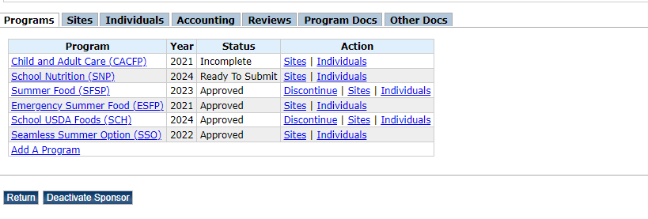
Program Renewals

Slide 6
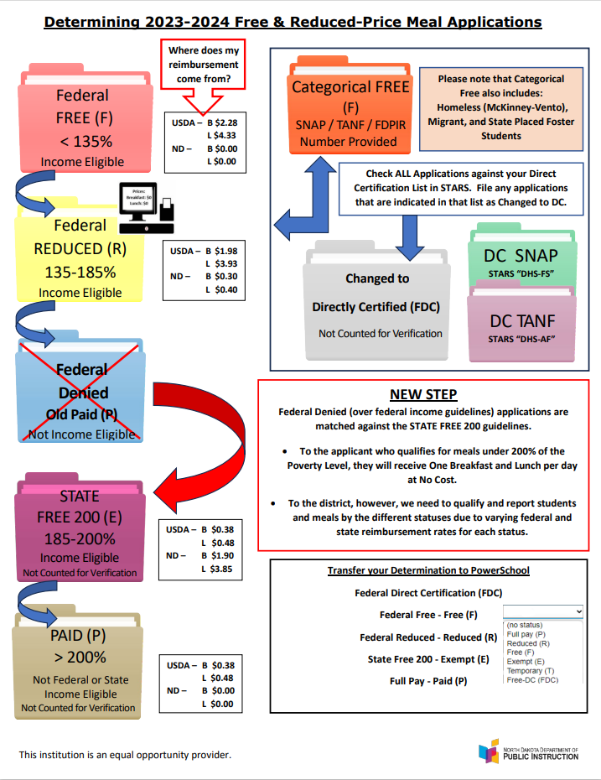
New State Legislation
House Bill 1494
Anti-Lunch Shaming Bill
Senate Bill 2284
State Free 200
185%-200% Poverty Level

Slide 7
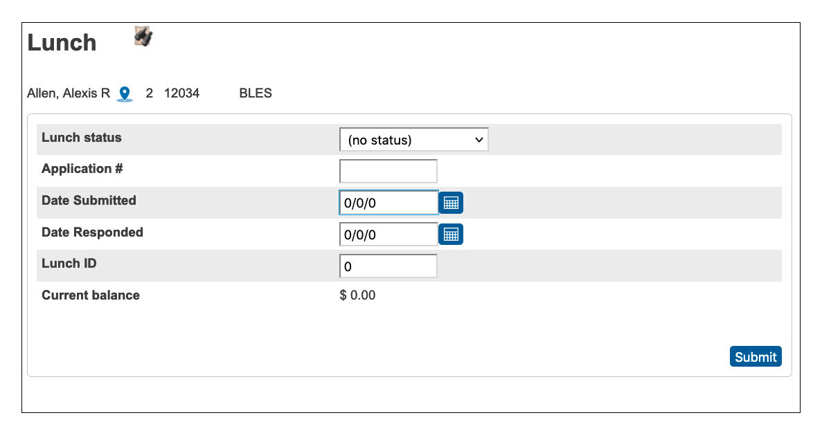
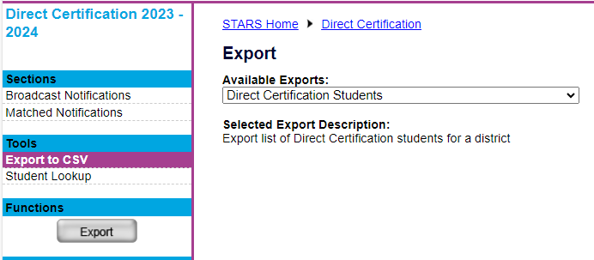
Student Meal Status / Direct Certification
30 Day Carry-Over
PrimeroEdge
online F/R meal applications module available

Slide 8
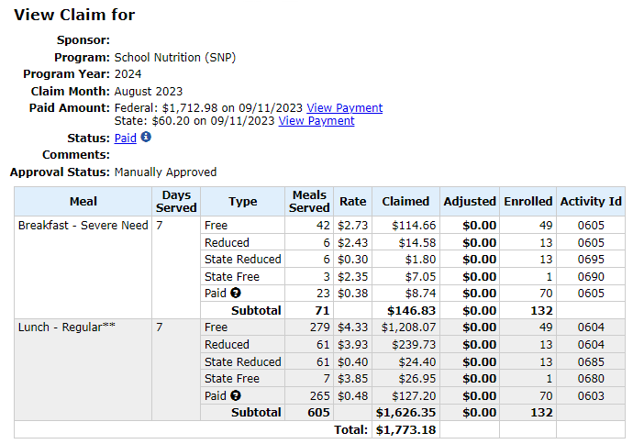
Claims & Reimbursement Rates
Claims open the 1st of the month for the Prior Month
Payments are made on the first business day after the 10th of each month

Slide 9
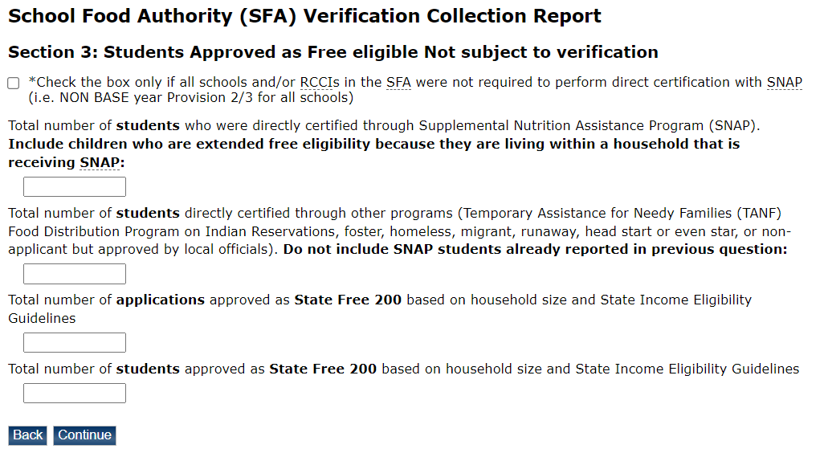
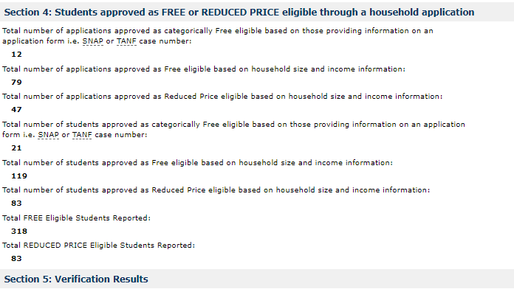
October Enrollment/ Verification Collection

Slide 10
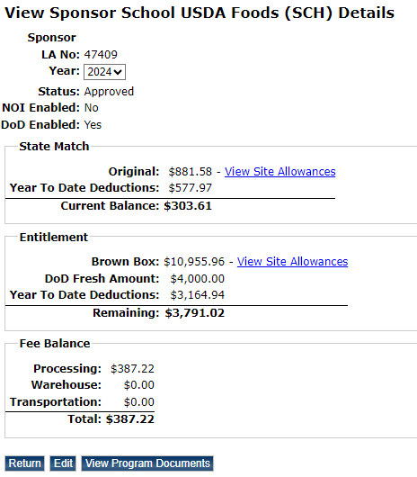
Entitlement Dollars / Food Invoices

Slide 11
Grant Programs / Other Income
Fresh Fruits and Vegetables Program
USDA Program to Introduce Students to Eating Healthier and Trying New Fruits and Vegetables
Usually Email with Grant Application sent in April and Due July
Farm to School Grant
USDA Grant for Farm to School or Ag in the Classroom Projects
Usually Email with Grant Application sent in October and Due December
Equipment Grants
USDA Grant for School Kitchen Equipment
Usually Email with Grant Application sent in September and Due November
Other Incomes
Supply Chain Assistance Funds
Reallocated SAE & State Match

Slide 12
Questions ?

Slide 13
Thank you☺
DPICNFD@ND.GOV

