Slide 1

2023
Business Manager Roles & Responsibilities

Slide 2

Presented by: Patty VerDouw
VerDouw – All One Word
Rhymes with Her Cow

Slide 3
Everything You Ever Wanted to Know About Patty but were Afraid to Ask!
Oldest of 7 Children – Graduated from Edgeley High School
Education - Valley City State & Dickinson State
Licensed Insurance Agent 20+ Years - Licensed in All Lines of Insurance
Sold and Drove Over the Road Heavy-Duty Semis
Finance & Insurance Manager at Car Dealership
Retail Jewelry Sales
Diocese of Bismarck – SEARCH Coordinator
Retired after 15 Years with Deere & Co
    Insurance Agent
    Collection Manager – Repossess Equipment – Inventory – Five State Area
    Manager Office Administration John Deere Credit Corporate Office
        OSHA Certified - Organized and Trained All First Responders
        Relocated 1,200 Deere Employees From Four Buildings into 264,000 Square Foot World Headquarters in Three Months, With No Interruption of Business
        Responsible for Facilities, Vendors, Microfilm/Records, Security, Cafeteria, and Building Management
12 Years as Business Manager of the Edgeley Public School
9 Years as Policy Services Assistant for ND School Board Association
Instructor for Business Manager Certification Since 2013

Slide 4


Things To Keep In Mind When Viewing This Presentation:
Your Tool Box
Contains Forms, Examples, Checklists, Etc.
North Dakota Century Code References
Notes Applicable NDCC that Pertains to the Slide
Yellow Background Signifies
Important Information that will be on the Test!
NDCC

Slide 5

What Are We Going To Cover?
What Does Being a Business Manage Require Under Law & Otherwise?
Employment, Oversight, and Reports to the Board
Century Code Mandated Duties – How to Avoid the Orange Jumpsuits!
Your Challenges – Ethics and You
Things Nobody Told You to Expect!
Questions

Slide 6

While we are on the Subject,
Whom do YOU Report to?
Board of Education?
School Board?

Slide 7
You Report To AND Work For:
The SCHOOL BOARD!!!
FARGO is the ONLY ND District with a Board of Education Per NDCC!

Slide 8

If you get this Wrong on the Final Test, I will REDUCE your Grade!

Slide 9
ND Century Code Clearly States:
All Decisions Regarding the Selection and Employment of a School District Business Manager and all Decisions Regarding the Suspension and Dismissal of a School District Business Manager Belong to the Board of a School District, as set Forth in Section 15.1-09-33(27, 28, 29).
NDCC 15.1-09-33

Slide 10

The Board Shall Exercise Administrative Oversight with Respect to the School District Business Manager unless the Board has Established an Alternative Supervisory Structure that is Clearly Defined in the Board’s Policy and is Represented in the School District’s Organizational Chart, and Through Board Action Delegates to the Superintendent Supervisory Responsibility of the Business Manager’s Daily Operations.
NDCC 15.1-07-20.1(2)

Slide 11

All Financial Reports, Whether Statutorily Mandated or Request by the Board, and Whether Written or Oral, MUST be PERSONALLY Presented to the Board by the School Business Manager.
NDCC 15.1-07-20.1(3)

Slide 12
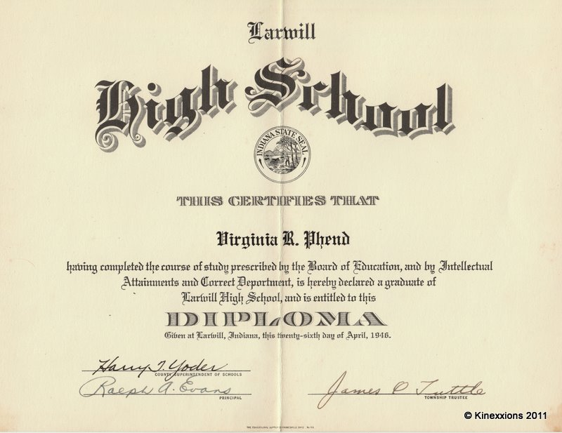
How Much Education is Require to be a
Business Manager
Prudently, a High School Diploma is a Minimum

Slide 13
Job Goals of a Business Manager
Works to Ensure that the District has the Money and Resources Needed to Operate Effectively.
Oversees School Operating Finances
Develop a Budget for the District
Ensures Existing Finances are Used Efficiently
Identifies Resources that are Needed
Prioritizing Expenses
Reducing Operating Expenses

Slide 14
What Functions are Essential?
YOU Advise the Board on Financial and Budgetary Matters
YOU Assure that the District Claims all the County, State and Federal Money it is Entitled to
YOU Assist the Board with Purchases that Require Formal Bids
YOU Attend Meetings as Required by Law, Assigned by the Board, or Requested by the Superintendent
    Record Minutes of ALL Meetings (Committee, Negotiations, Etc.)
    Publish Minutes in the District’s Official Newspaper if Applicable
NDCC 15.1-07-21

Slide 15



YOU Comply with Internal Audit Procedures (Checks & Balances), Schedule External Audits, and Respond to Audit Recommendations
YOU Establish Procedures for Records Retention and Comply with Financial Record Keeping and Security of District Records
YOU Maintain Bond and Note Register (Capital Projects, Debt Services, Etc.)
NDCC 15.1-07-21

Slide 16

YOU Perform all Other Duties Required by Law
YOU Prepare, Distribute, and File all Reports and Contracts Requiring Business Manager Signature and/or Assigned to the Business Manager by the School Board
YOU Prepare, Process, and Disseminate Payroll
NDCC 15.1-07-21

Slide 17

YOU Provide Financial Information for Budget Preparation, File the Budget, and Mill Levy Certification
YOU Manage District Budget Throughout the Fiscal Year
YOU Oversee Accounts Payable and Accounts Receivable
NDCC 15.1-07-21

Slide 18

YOU Receive, Manage, and Maintain Custody of ALL MONEYS for Which the District or the Board is Responsible, Including, but not Limited to, Overseeing Investments, Purchasing System, and Managing all Other Financial Accounts.
NDCC 15.1-07-21

Slide 19

YOU Supervise the District’s Business Computer Operations Regarding ALL Financial, Personnel, Inventory, Etc.
YOU Supervise, Organize, and Coordinate ALL School Elections
YOU (MAY) Supervise Business Office Clerical, Accounting, or Other Staff as Assigned.
NDCC 15.1-07-21

Slide 20

YOU Assist the School Board
YOU (MAY) Notify Board Members of Meetings
YOU (MAY) Provide Notice of all Meetings of the Board Including Committee Meetings, Budget Hearings, Community Meetings, Etc., to the District’s Official Newspaper and the County Auditor

Slide 21

YOU File Loss Claims and Accident Reports with Insurance Carrier
YOU Maintain Inventory of District Equipment & Update as Needed
YOU Call for Bids or Negotiate Insuring Agencies
YOU Determine Insurable Values of Building & Contents
YOU Recommend Insurance Policies for Casualty, Liability, Fidelity and School Indemnity

Slide 22

YOU Act as Personnel Manager
    Administer all Employee Benefits Policies/Programs and Make Recommendations to the Board Regarding Changes to These Policies/Programs
    Maintain Permanent Records of District Employees, Maintain Personnel Files Following Law, and District Record Retention Schedule

Slide 23


YOU Act as Personnel Manager
    Process Workforce Safety & Insurance (WSI) Claims and Payments
    Provide for In-Service Training on Benefits
    Process Unemployment Claims & Payments Information

Slide 24
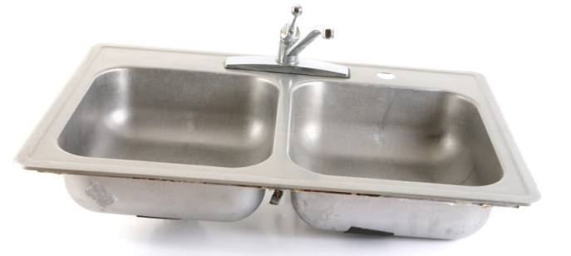
Miscellaneous Duties You Have
  YOU Build a Positive Rapport with Patrons
  YOU (MAY) Compute District Enrollment Projections
  YOU Exhibit Professionalism, Including Accountability, Confidentiality, Honesty, Tactfulness, and Courtesy
  YOU Keep Abreast of Financial and Business Trends
  YOU (MAY) Maintain Records of Open Enrollments, Out-of-District Students, and Tuitioned Students

Slide 25

Miscellaneous Duties You Have
  YOU Respond to Open Records Requests
  YOU Comply with District Policies Applicable to Position
  YOU (MAY) Oversee Operation of District Transportation Services
  YOU (MAY) Oversee Operation and Maintenance of District Facilities
  YOU Perform Other Duties as Assigned

Slide 26
Business Manager Terms of Employment
Twelve-Month Position with Salary and Benefits to be Established by the Board.
NDSBA Recommends Consulting with District Legal Counsel Before Placing a Business Manager on a Salary. ND Business Managers are Typically NONEXEMPT and Entitled to an Hourly Wage Subject to Overtime Unless Meeting Exemption Criteria Under the Fair Labor Standards Act Law.

Slide 27

Business Manager Evaluation
The Board will Evaluate the Performance of the Business Manager with Input from the Superintendent.
Note: This is NOT Required by Law.

Slide 28

Business Manager Duties
ND Century Code (NDCC) Description of Business Manager Duties are Outlines at:
https://www.legis.nd.gov/cencode/t15-1c07.pdf, AND
Business Manger Specific Duties are Listed in Century Code OVER 100+ TIMES!!
NDCC 15.1-07-21

Slide 29

Business Manager Duties
Keep a True & Accurate Record of All School Board Proceedings
    Board Meetings
    Committee Meetings
    Public Meetings
    Negotiations
    Executive Sessions **
    What Does “True & Accurate Record” That Mean?
NDCC 15.1-07-21(1)

Slide 30

Some Helpful Information on Meetings – Start to Finish

Slide 31

Board Meetings
Committee Meetings
Special Meetings
Negotiations
Board Retreats
Agendas

Slide 32
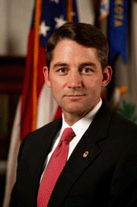
The ND Attorney General has a Wealth of Information on Their Website:
ND Attorney General Meeting Notices & Minutes at: https://attorneygeneral.nd.gov/open-records-meetings/public-meetings/meeting-notices-and-minutes
ND Attorney General Open Meetings Guide:
  OM-Guide.pdf (nd.gov)

Slide 33
Definition of a Meeting
Meeting Means ANY Gathering of a Quorum of Members of a Governing Body (School Board) Regarding Public Business, and Includes:
Committees & Subcommittees,
Informal Gatherings, or
Work Sessions, and
Discussions Where a Quorum of Members are Participating by Phone or any Other Electronic Communications (Either at the Same Time or in a Series of Individual Contacts). Other Electronic Communications Includes, Texts, Social Media Posts, Emails, Etc.

Slide 34
Definition of a Meeting
If the Board Delegates any Authority to Two or More People, the Newly Formed Committee is Subject to the Open Meetings Law – Even if the Committee Does Not have Final Authority or is Just Fact-Finding.
What it is called Doesn’t Matter, it is Still a Committee!
Committee Meetings MUST be Noticed and Minutes Taken!
Emails or Text Messages Between Members of a Committee or Subcommittee Regarding Public Business May Constitute a Meetings and Violate Open Meeting Laws.

Slide 35

Definition of a Meeting
Training Seminars and Purely Social Gatherings Attended by a Quorum of the Board Members are NOT Meetings.
However, as soon as the Members Discuss any Public Business, it Becomes a “Meeting”.

Slide 36
Meeting Notices
Prior Written Notice is Required for all Meetings of the Board, Including Committees and Subcommittees.
Generally, There is NO Minimum Advance Notice Period for Public Meetings.
A Board Must Provide Public Notice of the:
  Date,
  Time,
  Location of a Meeting - When the Board is Notified
If an Executive Session is Anticipated, the Meeting Notice Must Also Include the Executive Session as an Agenda Item, Along With the Subject Matter and the Legal Authority for the Executive Session.
NDCC 44-04-19.2

Slide 37
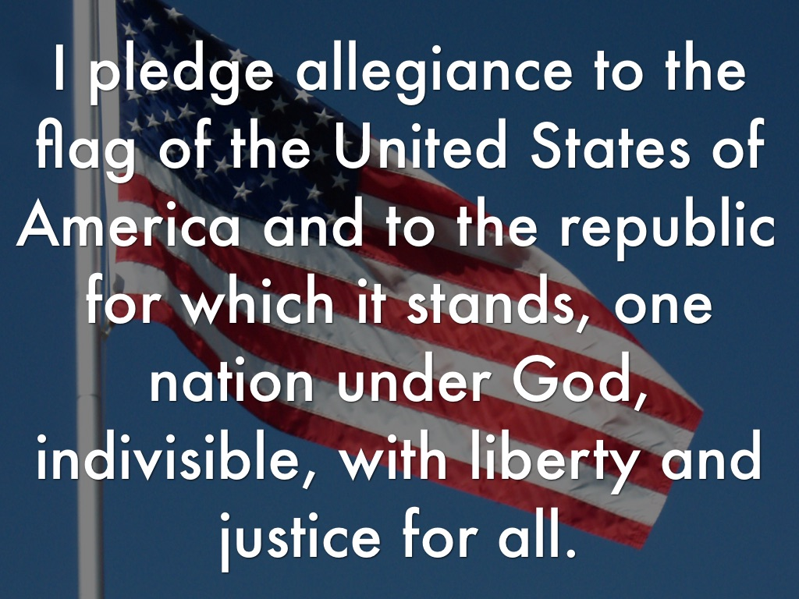
New Provisions for School Board Meetings
The 2023 Legislature Made Some Significant Changes:
HB1120 Requires School Boards to Allow Board Members the Opportunity to Participate in the Voluntary Recitation of the Pledge of Allegiance Prior to Every Regularly Scheduled School Board Meeting.
  This requirement only applies to school board members
  It does not extend this requirement to meeting attendees in general
** This Will Require a Change to the Board Agenda

Slide 38
New Provisions for School Board Meetings
  At the Request of a Resident of the District:
  The District must Record a Regular or Special Meeting,
  Archive the Recording, and
  Make the Recording Available to the Public.
  A Request Must be Submitted to the Superintendent no Later than Seven Days Prior to the Meeting.
  The District Shall Publish on its Website a Link to the Recording of a Board Meeting.
  The Recording Must be Available on the District’s Website for no Fewer than Three Months from Seven Days after the Meeting. This Requirement does NOT Apply to Executive Sessions nor Work Sessions held as Part of a Regular or Special Meeting.

Slide 39
Providing Public Notice of a Meeting
At the Same Time the Board is Notified of the Meeting the Meeting Notice Must be:
Posted at the Main Office of the District, if the District has a Main Office
Posted at the Location of the Meeting, if Held Somewhere Other than the District’s Main Office
Posted on the District’s Website OR Filed with the County Auditor
Provided to any Individual who has Requested Notice of the Meeting
Notice of Special or Emergency Meetings also Must be Given to the District’s Official Newspaper. Generally, There is NO REQUIREMENT that the Meeting Notice be Published.
North Dakota Attorney General | Meeting Notices and Minutes

Slide 40

Public Participation
A Member of the Public has the Right to Attend an Open Meeting and to Record the Meeting but DOES NOT HAVE THE RIGHT TO SPEAK!
OM-Guide.pdf (nd.gov)

Slide 41
Board Minutes Should Follow the Order of Business on the Agenda
The Superintendent, in Consultation with the Board President, Should Prepare the Agenda.
Persons Wishing Items to be Included in the Agenda Should Submit those Items to the Superintendent no Later than [Five] Days Prior to the Meeting. Inclusion Shall be at the Discretion of the Superintendent and Board President.
The Board Should Follow the Order of Business set up by the Agenda Unless Altered by Consent of the Members Present at the Meeting.
Items May be Added to the Agenda at Regular Board Meetings with Consent of [2/3^{rds}] Majority of the Board.
  For Special or Emergency Meetings, ONLY the Specific Topics Included in the Meeting Notice/Agenda may be Discussed
OM-Guide.pdf (nd.gov)

Slide 42

Board Minutes Should Follow the Order of Business on the Agenda
The Order of Business For Regular Board Meetings Shall be as Follows:
Call to Order
Voluntary Recitation of the Pledge of Allegiance
Confirmation of the Agenda
Approval of the Minutes
Consideration of the Bills
Communications
Financial Reports
Unfinished Business
New Business
Miscellaneous Business
Adjournment

Slide 43
Board Minutes Should Follow the Order of Business on the Agenda
Minutes Should be as Brief as Possible but Record All Action Taken by the Board and MUST INCLUDE, at a Minimum:
  The Names of the Members Attending the Meeting;
  The Date and Time of the Meeting was Called to Order & Adjourned;
  A List of Topics Discussed Regarding Public Business;
  A Description of each Motion made at the Meeting & Whether the Motion was Seconded;
  The Results of Every Vote Taken at the Meeting; and,
  The Vote of Each Member on Every Recorded Roll Call Vote
ND Attorney General Meeting Notices & Minutes at: https://attorneygeneral.nd.gov/open-records-meetings/public-meetings/meeting-notices-and-minutes

Slide 44
You Can Record Meetings Electronically (Audio or Video Recordings)
  Recordings Should be Used to Ensure Accuracy of the Written Minutes.
  Recordings of ALL Meetings, EXCEPT Executive Sessions, Will NOT be Considered the Official Record of the Meeting and May be Reused After the Written Minutes Have Been Transcribed and Approved.
Keep in Mind a Board Meeting is a Meeting Held in Public. It is NOT a Public Meeting.
Members of the Public can be in Attendance, but are Not Allowed to Participate in the Meeting Unless they are on the Agenda
If your District now Allows for Guest Comments, the District may want to Reconsider!

Slide 45

Minutes Should Include The Facts
Who Made a Motion
Who Seconded the Motion
If it was Brought to a Vote and Carried – or Indicate Who Voted for or Against:
Example:
  It was moved by Anderson, seconded by Brown and carried (all voting yes) to approve the 2023-2024 Certificate of Levy.
Or:
  It was Moved by Anderson, seconded by Brown, to Approve the Certificate of Levy for 2023-2024. After Discussion, Anderson and Brown – Voted Yes, James, Arthur and Kenyon – Voted No. Motion DEFEATED.

Slide 46

If A Discussion Took Place, And No Motions Were Made, Say So!
Example:
  Discussion was held regarding the Formation of a Football Cooperative, New I-Pads for Kindergarten, and Applying for a Technology Grant.

Slide 47
While we are on the Subject,
Whom do YOU Work For?
Board of Education?
School Board?

Slide 48

REMEMBER
You Work for the
SCHOOL BOARD!

Slide 49



REMEMBER
Don’t Offer An Opinion - They Will Ask If They Want Your Opinion
Don’t Nod in Agreement
OR
If You Have Relevant Information To Help The Board Make An Informed Decision.

Slide 50

REMEMBER
DO NOT INTERJECT EMOTION IN THE MINUTES
STATE THE FACTS!
DON’T REPORT:
  Director James was angry that the Superintendent didn’t have a report ready.
  The Directors argued about 15 minutes before voting on the budget.

Slide 51

ARE YOU LONELY???
Don’t Like Working on Your Own?
Hate Making Decisions?
Then Call a MEETING!!!
You Can:
SEE People
DRAW Flowcharts
FEEL Important
FORM Subcommittees
IMPRESS Your Colleagues
MAKE Meaningless Recommendations ALL on DISTRICT TIME!!!
MEETINGS – THE PRACTICAL ALTERNATIVE TO WORK

Slide 52

The Agenda, Minutes of the Previous Meeting, and Relevant Supplementary Information Should be Delivered to Each Board Member at Least Three Days in Advance of Each Regular Board Meeting and will be Available to any Interested Citizen at the Superintendent’s Office at that Time.
Upon Request, Local News Media Representatives and Citizens also may Obtain Copies of Board Meeting Materials from the Superintendent’s Office.
The Agenda will be Posted in Each School Building, the Meeting Room [and Website].
North Dakota Attorney General | Meeting Notices and Minutes

Slide 53
Minutes are to be Kept PERMANENTLY!!
Whether it is a Regular or a Special Meeting (Negotiations, Committee, Etc.)
Approval of the Minutes of the Preceding Meetings or Meetings
The Names of all Persons who Speak Before the Board and the Topic of Their Remarks
NDCC 15.1-07-25.2(1)

Slide 54

The Order of Business for a School Board Meeting
Call to Order
  Note Attending School Board Members, Administration, and Anyone that Addresses the Board in the Board Minutes
  Voluntary Recitation of the Pledge of Allegiance
    Remember this only applies to Board Members.

Slide 55
Confirmation of the Agenda
  Items May be Added to the Agenda at Regular Meetings, Work Session, or Board Retreat with Consent of a [2/3rds*] Majority of the Board.
  NO ITEMS CAN BE ADDED TO THE AGENDA OF A SPECIAL or EMERGENCY BOARD MEETING!
    ONLY Agenda Items Can Be Discussed at a Special or Emergency Board Meetings!
    * Check you District’s Current Policy Requirements

Slide 56
Approval of the Minutes
  This Would be the Minutes of the Last Regular Meeting but may Include any Minutes from a Work Session or Board Retreat.
Consideration of Bills (Expenditures)
  Districts are Required to Publish an Itemized List of Obligations Approved for Payment by the Board if Voter Approved.
    General Fund
    Special Reserve Fund
    Miscellaneous Fund
    Capital Projects (Building) Fund
    Debt Services (Sinking & Interest) Fund
NDCC 15.1-09-31

Slide 57
Notice – The Previous List Did Not Contain:
Hot Lunch Fund Expenditures
These are Generally Approved by the Board-Appointed Hot Lunch Representative – Typically the Superintendent Because These are Non-Tax Dollars. The Hot Lunch Representative Would Also Co-sign Hot Lunch Checks.
Activity Fund Expenditures
These Are Non-Tax Dollars and Typically Approved by the Athletic Director. The AD Would Typically Also Co-sign Activity Checks.
These Expenditures MUST be Reported to the Board and Appear in Their Board Packets
NDCC 15.1-07-10

Slide 58
Communications
  Reports From the Superintendent, Principals, Staff
  Reports From Guests THAT ARE ON THE AGENDA
Financial
  The Business Manager Shall Present the Monthly/Quarterly/Annual Financial Reports to the Board for All Funds.
    NDCC States, “All Financial Reports, Whether Statutorily Mandated or Requested by the Board, and Whether Written or Oral, Must be Personally Presented to The Board by the School District Business Manager.”
NDCC 15.1-07-20.1(3)

Slide 59

Unfinished Business
  Any Items that Had Been Tabled from a Past Board Meeting, or Items that Needed More Study Before Being Brought for Consideration to the Board.
New Business
  Items that were on The Approved Agenda as New Business Should be Discussed and Any Necessary Board Action Should be Noted in the Minutes.

Slide 60

Miscellaneous Business
  Any Items That Were Added to the Agenda or Other Items to be Brought to the Board’s Attention.
Adjournment
  Prior to Adjournment, the Board Should Determine the Date, Place, and Time of the Next Board Meeting.

Slide 61

After the Board Meeting:
Have the Board Checks Ready
Give Checks to Board President to Sign, OR Give to the Superintendent to Stamp
Complete and/or Follow-up Correspondence, Contracts, Notices, Etc.
Prepare Meeting Minutes
File Board Packets in the Board Binder

Slide 62
Executive Sessions
Board Committee Meetings
Negotiations
Board Retreats

Slide 63
Definitions:
Exempt Meeting or Exempt Record
All or Part of a Record or Meeting that is Neither Required by Law to be Open to the Public, Nor is Confidential, but May be Open in the Discretion of the Board
Closed Meeting
All or Part of the an “Exempt” Meeting That the Board has Not Opened to the Public. (Any Person Necessary to Carry Out or Further the Purposes of a Closed Meeting May be Admitted)
Confidential Meeting or Confidential Record
All or Part of a Record or Meeting That is Either Expressly Declared Confidential or is Prohibited From Being Open to the Public.
Executive Session
All or Part of the Meeting is Closed or Confidential
NDCC 44-04-17.1

Slide 64
Meeting Does NOT Include:
A Chance or Social Gathering at Which Public Business is NOT Considered;
Emergency Operations During a Disaster or Emergency Declared Under NDCC 37-17.1-10 or an Equivalent Ordinance if a Quorum of the Board are Present but are NOT Discussing Public Business as the Full Board, or as a Task Force, or a Working Group; and
The Attendance of Members of the Board at Meetings of any National, Regional, or State Association to Which the District, the Board, or Individual Belong
NDCC 44-04-17.1

Slide 65

Public Business:
All Matters That Relate or May Foreseeably Relate in any way to:
The Performance of the District’s Governmental Function, Including Any Matter Over Which the Board has Supervision, Control, Jurisdiction, or Advisory Power; or
The District’s Use of Public Funds
Public Funds:
Cash and Other Assets with More Than Minimal Value Received From the State or any Political Subdivision of the State (County Taxes for Example)
NDCC 44-04-17.1

Slide 66

Record
Recorded Information of any Kind, Regardless of the Physical Form (Minutes, Audio, Video Tape, Emails, Texts, Etc.) or Characteristic, by Which the Information is Stored, Recorded, or Reproduced, Which is in the Possession or Custody of the District or its Agent (YOU) and Which has Been Received or Prepared for Use in Connection with Public Business or Contains Information Relating to Public Business.
“Record” Does NOT Include Unrecorded Thought Processes or Mental Impressions, but DOES INCLUDE Preliminary Drafts and Working Papers
“Record” Also Does NOT Include Records in the Possession of a Court of ND
NDCC 44-04-17.1

Slide 67
Executive Sessions

Slide 68
An Executive Session May Be Held if:
The Board First Convenes in an Open Session and Passes a Motion to Hold an Executive Session for a Reason Authorized in Law.
During the Open Portion of the Meeting, the Topics to be Discussed or Considered are Announced.
THE EXECUTIVE SESSION IS RECORDED
The Topics Discussed During the Executive Session Are Limited to Those Announced in the Open Public Meeting and are Authorized by Law
NDCC 44-04-19.2

Slide 69
The Board May ONLY Hold an Executive Session to Consider or Discuss:
Negotiation Strategy or Provide Negotiating Instructions to its Attorney or Other Negotiator Regarding:
  Adversarial Administrative Proceedings, Litigation, or Contracts, Which are Currently Being Negotiated or for Which Negotiation is Reasonably Likely to Occur in the Immediate Future. Negotiations Caucus of Board Negotiators in Executive Session is also OK
Nonrenewal of Probationary Teacher or Principal Employed Less than 2 Years
Contemplated Nonrenewal Hearing
Discharge for Cause Hearing and Suspension During Discharge Proceedings
Confidential Applications for Employment with THREE or More Applicants
Applicant, Employee, or Former Employee’s Personal, Medical, and Employee Assistance Records

Slide 70
The Board May ONLY Hold an Executive Session to Consider or Discuss:
Student Records
  ONLY Discussion of Educational Records – not for General Discussion Regarding Students
Attorney Consultation
Security Plans
Attorney Work Product
Contractual Investigatory Work Product
To Consider or Discuss Closed or Confidential Records
      IF its NOT on this List, you CAN’T
      Legally Have an Executive Session!

Slide 71
Executive Sessions
Final Action on Topics Discussed or Considered During the Executive Session MUST be Taken at an Open Public Meeting, unless Final Action is Otherwise Required by Law to be Taken During a Closed or Confidential Meeting.
  “Final Action” Means a on Any Collective Decision or a Collective Commitment or Promise to Make a Decision on Any Matter, Including Formation of a Position or Policy, but Does Not Include Guidance Given by Member of the Board to Legal Counsel or Other Negotiator in a Closed Attorney Consultation or Negotiation Preparation Session Authorized by NDCC 44-04-19.1
NOTE: This Mentions Guidance, NOT Passing a Motion in Executive Session!

Slide 72
Executive Sessions
The Remainder of a Meeting During Which an Executive Session is Held is an OPEN PUBLIC MEETING, Unless a Specific Exemption is Applicable.
The Minutes of an Open Meeting During Which an Executive Session is Held MUST Indicate:
  The Names of Those Attending the Executive Session,
  The Date and Time the Executive Session was Called to Order and Adjourned,
  A Summary of the General Confidential Information, and
  The Legal Authority for Holding the Executive Session.
NDCC 44-04-19.2

Slide 73

Official Minutes of the Open Meeting Should Look Something Like This:
EDGELEY SCHOOL DISTRICT
Special School Board Meeting – Negotiation Strategy
June 4, 2022, 7:06 AM
A Special School Board Meeting was held to discuss Negotiations Strategy. Those in attendance were, President Long, Directors Feist, Solinger, Madcke, and Kenyon. Also in attendance were Superintendent Diegel and Business Manager Patty VerDouw.
President Long called the Special Board Meeting to order at 7:06 AM. It was moved by Madcke, seconded by Feist and carried (all voting yes) to go into Executive Session to discuss Negotiations Strategy, Citing the Legal Authority to Close This Portion of the Meeting in NDCC 44-04-19.2.
The Board came out of Executive Session at 8:19 AM. President Long invited the public back to the meeting. Having no additional business, the meeting was adjourned at 8:19 AM.
President________________________________
Approved________________________________
Business Manager_________________________
NDCC 44-04-19.2

Slide 74

Executive Sessions for Negotiations Strategy
An Executive Session May be Held ONLY When an Open Meeting Would Have an Adverse Fiscal Effect on the Bargaining or Litigating Position of the District.
A Record Revealing Negotiations Strategy or Instructions Under this Section is Exempt (Not an Open Record)
Drafts, Contracts, or Agreements Subject to Negotiations are Exempt BUT ONLY if Release Would Have an Adverse Fiscal Effect on the District, Unless the Records are Otherwise Exempt or Confidential
NDCC 44-04-19.2-9

Slide 75
Executive Sessions
A Settlement Agreement Between the District and Another Party (Teachers for Example) is Exempt from Disclosure Until it has been Fully Executed and Accepted by ALL Concerned Parties Unless the Records Are Otherwise Exempt or Confidential (Student Records for Instance).
Remember: Student Names Should NEVER Appear if Official Board Action is Taken Regarding that Student.
Example: The Board Came out of Executive Session at 4:30 PM. The Public was Invited to Return to the Open Public Meeting that was Convened at 4:31 PM. It was Moved by Long, Seconded by Mathern, to Expel a Student for 30 Days. On a Roll Call Vote (Long, Mathern, Kipp, Brown all Voting Yes), Motion Carried.
NDCC 44-04-19.2

Slide 76
Executive Sessions
When Conducting an Executive Session, the Board and Authorized Subcommittees of the Board Shall Comply With the Following:
Attendance at an Executive Session is for:
Only Members of the Governing Body (School Board)
Those Individuals Deemed Necessary to the Functioning of a Closed Meeting by the Board (Superintendent, Business Manager, Etc.)
Those Individuals Listed in the Law(s) Pertaining to the Executive Session (Hearing Officer, Etc.)
Only Those Listed Above will be in Attendance at the Executive Session Unless Law Requires Otherwise.
NDCC 44-04-19.2

Slide 77
Executive Sessions
Location of Recordings & Documents
All Recordings and Documents from an Executive Session shall be sealed in an Envelope with:
  The Date of the Executive Session
  Purpose of the Meeting, and
  The Word “Confidential” Written on the Outside of the Envelope.
Envelopes will be placed in a locked area (safe) and Retained for Six Years if Executive Session was Related to Contract Negotiations, Nonrenewal, Discharge, or Expulsion
NDCC 44-04-19.2

Slide 78

Executive Sessions
When an Executive Session was Held for the Purpose of:
Discussion of Student’s Educational Record
The Business Manager Should Complete a Notice of Executive Session Tape on File for Student Files
NDCC 44-04-19.2

Slide 79

Executive Sessions
Access to Recordings & Documents
Only the Following Individuals, in the Following Cases, Shall View or Listen to Executive Session Documents or Recordings:
Those Individuals in Attendance at the Executive Session;
At the Attorney General’s Request;
Pursuant to a Court Order;
By a Majority Vote of the Board Unless the Executive Session was Required to be Confidential (Versus a Closed Meeting)

Slide 80
Negotiations

Slide 81
Negotiations
The Board Can’t Make a Motion in Executive Session, but Can Provide Instructions to the Negotiating Team
If Negotiations Are Unproductive: In Executive Session,
The Negotiating Team can Request Authority From the Board to Make a Final Offer Before Impasse
The Board’s Negotiating Team then Meets With the Teacher’s Negotiation Team to Negotiate and Make a Final Offer
When/If the Offer is Rejected, the Board Waives Mediation and Declares Impasse in an Open Meeting
The Fact-Finding Commission is then Notified

Slide 82

Negotiations
Negotiation Meetings Minutes Should be Taken by YOU!
Negotiation Meetings Can be Recorded –
Highly, Highly Recommended
The More Detailed The Minutes, The Better
Negotiations Seem to Shorten Memories of What was Said
Recordings will SAVE You and the District
If You Ever go to Impasse!

Slide 83

HINT:
I Recorded the Negotiations Meetings and Posted Them on the School Website
There Wasn’t Any Debate About What Was Said or By Whom
This Greatly Improved Memories When the Next Meeting Rolled Around and Squelched any “Rumors” on the Street as to What was Happening.
It also Improved Participant BEHAVIOR!

Slide 84
Committees

Slide 85
Committees Created by School Boards
And the Open Meeting Law
All Meetings of a Public Entity must be OPEN to the Public Unless the Law Specifically Provides Otherwise
What About School Board Committee Meetings?
If the Board Creates a Committee and Asks the Committee to Perform a Function, That Committee is Deemed to be Doing Public Business and it MUST Abide by the Same Notice Requirements as the School Board Including Board Minutes.
Attorney General’s Opinion 2016-0-09
OM-Guide.pdf (nd.gov)

Slide 86

This is the Case if the School Board Creates a Committee That:
Consists Entirely of School Board Members;
Consists of a Majority of School Board Members
Consists of a Minority of School Board Members
Consists of Individuals Who Are Not School Board Members
In Other Words:
ALWAYS Notice a Committee Meeting and Take Minutes

Slide 87


What Would You Do?
You Know the Board had an Undocumented Meeting to Discuss Impending Negotiations.
They Just “Happen” to Have a Quorum of Members at the Coffee Shop and Started Talking “Shop” Within Earshot of District Patrons and Employees.

Slide 88

Business Manager Duties
Hold ALL the Books and Records of the District and Deliver them to the Business Manager’s Successor in Office.
NDCC 15.1-07-21(2)

Slide 89

Record Retention
You will have a Formal Record Retention Class as Part of Your Certification.
Be Aware that in the Interim, You Could Need a “Record” or “Litigation Hold” for Certain Files.
A Records Hold Should be Placed on Documents (Including Electronic Documents such as Email or Texts) When There is a Need to Retain a Document for Purposes such as, but not Limited to, Complying with an Open Records Request or to Prepare for Foreseeable Litigation (Litigation Hold)

Slide 90
What are the Indicators that a Records Hold or Litigation Hold Should be Placed on Documents?
A Formal Complaint, Subpoena, or Notification of a Lawsuit is Received
Litigation is Threatened
A Regulatory or Governmental Body (e.g., Office Of Civil Rights (OCR), Department of Justice, Department of Labor) Begins an Investigation
An Attorney Requests Facts or Documents Related to an Incident or Dispute
An Injury
An Open Records Request is Made
An Employee or Student/Parent Requests Access to Their Records
Consult The District’s Attorney for Retention Recommendations on Items Retained Under a Litigation Hold.

Slide 91


How Do I Know How LONG to Retain all These Records?
See Record Retention Schedule in the Tool Box!

Slide 92
Business Manager Duties
Prepare and Submit an Annual Report to the Board and to the County Superintendent of Schools.
  Annual Financial Report
  Annual Report for Publication
Ideally, Have Your Auditor Perform the Audit BEFORE the Reports are Presented to the Board so They Can be Approved it.
NDCC 15.1-07-21(3)

Slide 93

How Often Should the District have an Audit Performed?
The State Auditor MUST Audit a School District Every Two Years by Law.
In Lieu of Conducting an Audit Every Two Years, The State Auditor May Require Annual Reports from Districts with Delinquent Reports or with Less than $2,000,000 of Annual Receipts.
To Protect the District, AND YOURSELF, have an Audit Preformed EVERY YEAR!
NDCC 54-10-14

Slide 94

Questions to Ask the Auditor Before they Leave the School:
Should I Do Anything Differently?
What Changes Could I Make so Your Job is Easier?

Slide 95
What Would You Do?
You Suspect a Principal of Taking Money from the Cash Box After Games and Before it is Receipted.

Slide 96
Business Manager Duties
Authorize the Preparation of ALL Negotiable Instruments as Directed by the Board.
NEGOTIABLE INSTRUMENTS are a Signed Document that Promises a Sum of Payment to a Specified Person or the Assignee. It is an Unconditional Order or Promise to Pay, and Includes Checks, Drafts, Bearer Bonds, Some Certificates of Deposit, Promissory Notes, And Bank Notes (Currency).
It is a Transferable, Signed Document that Promises to Pay the Bearer a Sum of Money at a Future Date or on Demand.
NDCC 15.1-07-21(4)

Slide 97
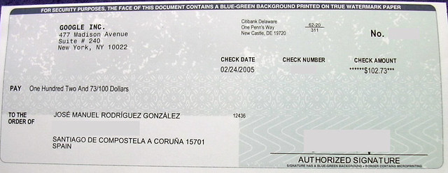
Some Examples Would be:
Writing Checks
Issuing Vendor Contracts
Transferring Money
CD or Money Market Accounts, Etc.

Slide 98
Business Manager Duties
5. Perform ALL Duties Required by Law.
Federal
Title Programs
Grants
Child Nutrition, Etc.
State
Foundation Aid
Career & Technology Education
Other State Programs, Etc.
Local
Levy
Tuition
Fees
Interest
Miscellaneous Income, Etc.
NDCC 15.1-07-21(5)

Slide 99

Business Manager Duties
6. Perform ALL Duties Required by the Board
  Board Meetings
  Elections
  Negotiations
  Public Meetings
  Payroll
  Accounts Payable
  General Ledger Accounts
  Administrative
  Reporting
  Insurance
  Fixed Assets Inventory
  Budget
  TFFR
  Cafeteria Plan
  New Hires
  ETC., ETC., ETC.
NDCC 15.1-07-21(6)

Slide 100
ELECTIONS

Slide 101
You will have a Class on Elections, so This is JUST THE BASICS.
Terms of Office for School Board Members are 3 or 4 Years and are Staggered. You Should Always Have an Experienced Board Member on the Board.
School Board Election Dates are set at the Discretion of the Board Between April 1st and June 30th.
Thirty Days Before the Filing Deadline for Candidates (or 94 days Before the Election) to have Their Names Printed on the Ballot, an Official Notice of this Deadline Must be Published in the Official Newspaper of the District
  Advertise for Candidates at Least Two Times
    Newspaper
    Newsletter
    School Website
    Posted Around Town
NDCC 15.1-09-09

Slide 102

An Individual Seeking Election to a School Board
Shall Prepare and Sign a Statement of Intent, Stating the Individual’s Name and the Position for Which they are a Candidate.
  The Candidate Shall File a Statement of Interest (NDCC 16.1-09-02)
A Candidate Shall Also File a Campaign Contribution Statement as Required by NDCC 16.1-08.1-02.3
  A School Board Candidate is EXEMPT from this Requirement if the District’s Fall Enrollment is Fewer than 1,000 Students.
NDCC 15.1-09-08

Slide 103

Documents Must be Filed With the Business Manager, or Mailed to and in the Possession of the Business Manager, by 4:00 p.m. of the 64th Day Before the Election (NDCC 15.1-09-08)
Each Board that Enters into an Agreement with the County (to Share Election Expenses) Must Notify the County Auditor, in writing, at least 64 Days Before the Election of the Offices to be Filled at the Election and any Measures to Appear on the Ballot (NDCC15.1-09-24)
NDCC 15.1-09-09

Slide 104
At Least 40 Days Before the Election, the Business Manager Prints the Official Ballots Containing the Names of the Candidates
NOTE: This Doesn’t Say PUBLISH. You Print the Ballots to Allow for Absentee Voters.
So, What Happens if Someone Doesn’t File a Statement of Intent Until After the Cut-off Date?
They can Run as a Write-in Candidate, but their Name Should Not Appear on the Ballot.
NDCC 15.1-09-11

Slide 105

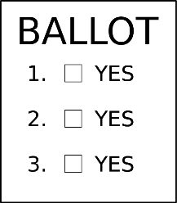
Every 2 Years, at the Time of the School District’s Annual Election of Board Members, The Electors of the District Shall Determine Whether a Record of the Board Proceedings Must be Published in the Official Newspaper of the District
    If Approved, You Should Provide for Publication the Minutes of Meetings, Including an Itemized List of Obligations Approved for Payment
    You Should Ensure That the Proceeding are Published Within a Reasonable Time After Each Board Meeting
NDCC 15.1-09-31

Slide 106

Does it Matter What Name is Listed First, if you have Multiple People Running for the Board?
The Business Manager Shall Notify the Candidates as to the Time and Place of the Drawing for Position on the Ballot
  Draw Lots
  Flip a Coin
  Rock, Paper, Scissors
NDCC 15.1-09-11

Slide 107
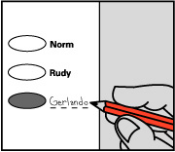
The Ballot Must be Nonpartisan in Form and Include:
  The Words “Official Ballot” at the Top;
  The Name of the School District;
  The Date of the Election;
  The Number of Persons to be Elected to Each Office; and
  Below the List of Candidates for Each Office, Blank Spaces in Which Names NOT Printed on the Ballot may be Written.
NDCC 15.1-09-11

Slide 108
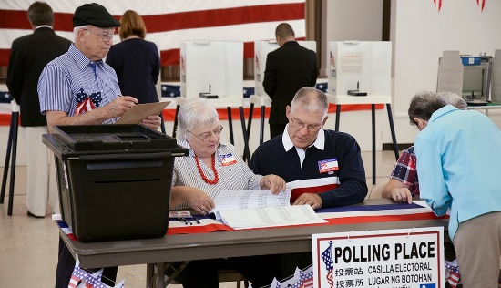
At Least 35 Days Before the Election, the Board Shall Designate One or More Precincts for the Election. The Board Shall Arrange the Precincts in a Way that Divides the Electors of the District as Equally as Possible
If Board Elections are Not Held in Conjunction with County Elections, The Board Shall Appoint 2 Elections Judges and 2 Election Clerks for Each Polling Place.
There is an Exception for Bond Elections on the Number to Election Officials. Bond Elections Require an Inspector, 2 Judges, and 2 Clerks for each Polling Place.
NDCC 15.1-09-13 (2)

Slide 109
At Least 14 Days Before the Date of an Annual or Special School Board Election, the Board Shall Publish a Notice in the Official Newspaper of the District Stating the Time, Place of the Election, and the Purpose of the Vote.
NOTE: Polls may be Open at any Time After 7:00AM and must be Open by 11:00AM and Remain Open Until 7:00PM.
    I Published this Notice of Election 2 Times before the Election Along with a Sample Ballot.
    NOTE: Publishing a Sample Ballot is NOT Required by Law.
Election Returns are to be Filed with the Business Manager Within 24 Hours of the Closing of the Polls.
Breaking a Tie Vote Has to Take Place Within 3 Days of the Election. (NDCC 15.1-09-16)
NDCC 15.1-09-09

Slide 110

Upon the Closing of the Polls, the Judges Shall Count and Canvass the Votes for each Office. At the Conclusion of the Canvass of Votes on Election Night, the Judges and Clerks of the Election Shall Sign the Return and File them with the Business Manager of the School District.
Note: If the Election is Held Under an Agreement with a City or County Pursuant to Sections 15.1-09-22 and 15.1-09-24, the Returns Must be Canvassed and the Winners Declared as Set Out in the Agreement.
NDCC 15.1-09-14

Slide 111
Declaration of Winner
On the 13th Day after the Election, the School Board Shall Meet to Canvass all Election Returns and Shall Declare the Result of an Election. In the Case of the Tie, Within Three Days from the Determination of a Winner.
The Individual Receiving the Highest Number of Votes Must be Declared Elected. The Board Shall Record the Result of the Election.
NDCC 15.1-09-15

Slide 112

Within 3 Days After the Canvass of the Votes, The Business Manager Shall Provide to Each Elected Individual a Written Notice of Their Election and of the Duty to Take an Affirmation or Oath of Office.
I Sent this Notice by Certified Mail, Email and Text.
NDCC 15.1-09-17

Slide 113
Within 10 Days After the Canvass by the Board, The Business Manager Shall Certify the Individuals Elected and Their Terms to the County Superintendent of Schools
If you don’t have a County Superintendent of Schools, notify your County Auditor
An Elected or Appointed Member of the Board Shall Take and File with the Business Manager an Affirmation or Oath of Office within 10 Days After Receiving Notice of the Election or Appointment and Before Commencing Duties (NDCC 15.1-09-25)
NOTE: New Board Members Officially Become Members of the School Board at the Board’s Annual Meeting In July – Not Before Then.
NDCC 15.1-09-17

Slide 114
PAYROLL

Slide 115

Create a File Folder & Record:
  Employment Date
  Wages
  Position Held
  Benefits
W-4 Completed – for Taxes
https://www.irs.gov/pub/irs-pdf/fw4.pdf
I-9 Employment Eligibility Verification - for Homeland Security
https://www.uscis.gov/i-9
  Verifies Citizenship
  Make sure you Have the Verification Documentation to Accompany Form I-9

Slide 116

Get a Copy of:
The Employee’s Social Security Card
  All Employee Paperwork Should Reflect the EXACT Spelling of the Employee Name
  The Employee’s Driver’s License
  The Teaching/Sub License
    Before Being Employed to Teach by a School District, an Individual Shall Present to the School Business Manager a Teaching License or Other Evidence of Approval to Teach Issued by the Board.
NDCC 15.1-13-18

Slide 117
TFFR/PERS Forms Completed
Direct Deposit Form Completed
Copy of Voided Check
Medical, Life, & Disability Insurance Forms Completed
Notice of Cafeteria/Flex Spending Sign Up Form/Waiver Eligibility
  Eligibility Notice of Cafeteria Plan/Flex Spending Explained & Given to Employee
Cafeteria/Flex Spending Forms Completed and Filed
If the Employee’s Spouse Carries Medical Insurance for Both of Them – Get a Waiver Signed – In Case the Spouse Insurance Benefits are Lost.
Leave Balance Established and Recorded

Slide 118
Copy of Staff Handbook
Have Employee Sign For the Receipt of the Handbook, OR
That the Employee Has Copies of the School Policies that Pertain to Staff & Students
Copy of the Children’s Health Insurance Program Reauthorization Act of 2009 (CHIPRA)
  CHIPRA Requires Employers to Provide a Disclosure Notice to Employees Regarding Group Health Plans.
    Under CHIPRA, an Employer who Maintains a Group Health Plan in a State that Provides Group Health Plan Premium Assistance Under Medicaid or the Children’s Health Insurance Program (CHIP) Must Provide Certain Notification of Such Premium Assistance Opportunities to Each Employee Residing in Those States.
  Give to ALL Employees Regardless of Whether the Employee is Enrolling in the Group Health Plan
    It Notifies the Employee of Potential Premium Assistance Subsidies Currently Available
    See Children's Health Insurance Program | Health and Human Services North Dakota or Call 844-854-4825 for more information

Slide 119
Give Teaching Staff a Copy of The Negotiated Agreement
Give all a Payroll Schedule
  Note Pay Days
  Note When Timecards Are Due
  Note When, How and to Whom to Report Sick Days, Request Time Off, etc.
Define Pay Periods
  Define Work Week (i.e., 12:00 AM Sunday Morning to 11:59 PM Saturday Night)
  Effect on Overtime (Each Week Stands Alone for Overtime Calculation)
Give a Class Schedule for Elementary and High School to Staff
If a Bus Driver, Get Copy of the DOT Medical Certification Card
Make Sure the Background Check is Completed and Submitted

Slide 120

New Hire Report Filed With The State
https://apps.nd.gov/dhs/cs/newhire/employer/login.htm
The New Hire Reporting Requirements Changed October 1, 2013.
“A New Hire is an Employee Who was Not Previously Employed by You or was Previously Employed by You but has Been Separated from that Previous Employment for at Least 60 Days in a Row and has Now Returned to Work for You.”
Who Would This Affect?
Substitute Teachers & Coaches

Slide 121

All Employees Sign Verification of Employment (the Employee Detail Listing with SUI) Prior to Receiving 1st Check
  Verifies Notice of Eligibility for Cafeteria Plan
  Notice States that:
    WAGES WILL BE DEDUCTED FOR ACTUAL TIME ABSENT IN EXCESS OF ALLOTTED LEAVE BALANCES
  Note: This Statement Affects What Type of Employee?
  A Contracted Employee (Teacher)

Slide 122
REMEMBER
It is Unlawful to Collect Information Regarding:
Gender
Date of Birth
Marital Status
Citizenship of Applicant
Until AFTER the Applicant is Hired as an Employee

Slide 123
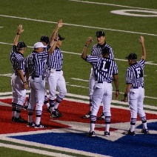
Athletics – How Should Referees, Line Judges, Clock, Ticket Takers, Etc., be Handled?
See the Toolbox for “School Athletic Coaches: Exempt or Nonexempt?” for the Latest Information from the Wage and Hour Division of the Department of Labor on this Subject!
Are They Staff or Students of the District?
    Treat Staff as Employees and Pay Through Payroll
Note: If Extracurricular Duties Appear on a Contract, the Contract Should Contain Language That States, “Extracurricular Assignments Are Not Subject to the Continuing Contract Law.”
    Contractor with a 1099 MISC Pay Through Accounts Payable - Get W-9
    Students Can be Paid Through Accounts Payable (Infrequent) – Still get W-9
Are They Hired Through NDHSAA?
    Need W-9
      Pay Referee Fee and Transportation As Separate Line Items on Check

Slide 124

Notify All Employees Annually of Eligibility & Plan Options
  At Beginning of Fiscal Year
  At Welcome Back to School Inservice
  With W-2’s
Notify all Employees of District’s Contribution
Give Employees Verification of the Options They’ve Chosen
Have Supply of Reimbursement Forms for Medical Spending &
Dependent Care Available

Slide 125



Enter Reimbursements and Any Deduction Adjustments
If Mileage is Reimbursed to Board Members for Traveling to and From Their Home for a Board Meeting, it is COMMUTING and is Subject to Payroll Taxes.
All other Mileage Reimbursements can be Paid Out of Accounts Payable
Meal Reimbursements With NO Overnight Stay = TAXABLE PAYROLL INCOME

Slide 126
Notify TFFR/PERS of Any of the Following:
  Membership Enrollment
  Marital Status Change
  Change of Notice of Disability
  Change of Address
  Change of Employment Status
  NOTE: TFFR MUST be Reported in the Month the Work Took Place.
    Driver’s Ed and Summer School are Examples.
      Make Sure you have Issued Contracts for these Employees.
      For Example:
      Don’t Report Substitute Teachers or Teachers Employed as Janitors during the Summer to TFFR

Slide 127

Retiring Teacher or Employee Leaving District
If Employee has District Medical Insurance:
Notify them VERBALLY AND IN WRITING by Certified Mail of COBRA (Consolidated Omnibus Budget Reconciliation Act) Eligibility
  Number of Months Available
  How Payment of Premium Should be Handled
  When Premiums are Due
  How Failure to Pay Premiums Will Result in Cancellation of Coverage
  How Change in Status Can Affect COBRA Coverage
    Births
    Deaths
    Marriage, Etc.

Slide 128
ACCOUNTS PAYABLE

Slide 129
Negotiable Instruments
The Board May Adopt Policies Governing the Disbursement of School District Moneys by the Business Manager. Policies May Include:
  Authorization, Creation, and Approval of Negotiable Instruments
  The Use of Credit or Debit Cards
  The Payment of Invoices
  The Use of Petty Cash
  The Use of Electronic Payments
  The Use of Facsimile Signatures
  The Policies Adopted Under This Subdivision MUST Include Internal Controls to Safeguard School District Moneys
NDCC 15.1-07-12

Slide 130
Enter Invoices
  Enter Fixed Asset Information and Tag Number if Appropriate
Review Invoices Entered for Accuracy
Post the Batch
Select Invoices to be Paid
Print the Board Report
Print Checks
Sign Checks and a get 2nd Signature
Mail, Distribute Checks or Direct Deposit
Facsimile Signatures (Signature Stamps)
**One Signature may be a Facsimile and the Other Signature must be Manually Written (NDCC 44-08-13).
**Your Signature Should ALWAYS be Manually Written!

Slide 131


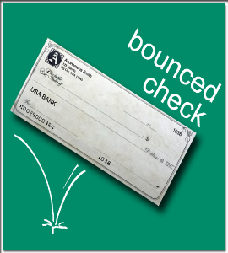
EVERY TIME YOU POST CHECKS, RUN A BALANCE SHEET!
Be sure you have Enough Funds to Cover the Checks!
NO, NO, NO!
Transfer Funds or Make a Deposit if Needed

Slide 132
What Would You Do?
A Teacher, Superintendent, Board Member Submits a Request for Reimbursement for a Meeting that You KNOW They Didn’t Attend.

Slide 133
GENERAL LEDGER

Slide 134


Manual Journal Entries
If This Panics You – Look Back at Former Reports for Guidance.

Slide 135
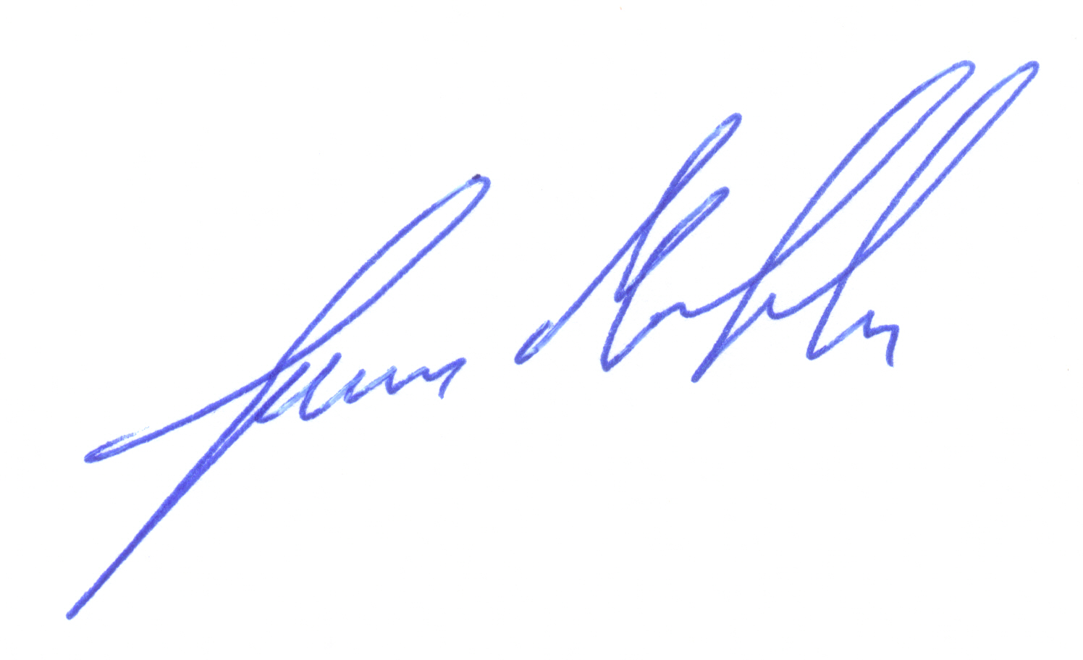
Cash Receipts
Record EVERY Monetary Transaction with a Receipt
    If Receipting Cash – Have Payer SIGN the Receipt
WHY – They Can’t Come Back and Say,
“I GAVE YOU $100 NOT $10!
Collect All Receipts and Sort by Fund
Enter Cash Receipts by Fund and Verify Totals
    Make an Adding Machine Tape by Fund
        Your Tape Totals Should ALWAYS Match Your Deposit Totals in the Accounting Software.

Slide 136

Organize the Till
  Clip Denominations in Batches
  Roll Coins
Using Your Cash Receipt Report, Assemble Checks by Fund and Endorse
  Review Checks for Errors
    Signatures Missing
    Mismatched Amounts
    Incorrect Payee

Slide 137

Go through the Safe and Each Cash Box at Least Once a Month.
Look for Envelopes Where Advisors have Squirreled Away Money.
Things I Discovered:
IOU’s?
Checks from Two Years Ago?
Gold Coins
Checks Set Aside from Cash Box?

Slide 138
Cash Receipts
Complete the Bank/Credit Union Deposit Slips by Fund
Make an Adding Machine Tape of Checks to Deposit by Fund
Clip the Adding Machine Tape to the Checks/Cash by Fund
Make the Deposit at the Bank or Credit Union
HINT: It Helps to Bring a Copy of The Cash Receipt Report with You. That Way, if There is a Discrepancy, You Can Check to See What was Entered Without Making Another Trip to Clarify.

Slide 139

Have the Teller Initial the Deposit Slip
WHY?
It is PROOF POSITIVE the Deposit was Made and Verifies the Deposit Amounts
Auditors LOVE this when Comparing Deposits to Bank Statements.
PAV

Slide 140

Cash Receipts
Post Cash Receipts Batch
If you Made a Deposit to a Money Market Account, Enter that Amount in the Fund Pages (Clip Board)
Run a Balance Sheet to Make Sure Accounts are in Balance

Slide 141

Budget
Review Previous Budget
Determine Expected Revenue
  Levies
  Federal Title Allotments
  Vo-Tech Allotments
  Fresh Fruit & Vegetables Grant
  Hot Lunch
  Local Revenues
  Supplemental Payments, Etc.
Expenditures for New Fiscal Period
  Payroll & Benefits – Largest Chunk of the Budget
  Busing
  Heat & Lights
  One Time Expenses, Etc.

Slide 142

Budget
Create a Budget Comparison of the Current & Next Fiscal Year for the Board
Have the Certificate of Levy Approved by the Board
  Preliminary Certificate of Levy to be Filed by August 10th
The Board may Increase or Decrease the Tax Levies & Budget for the Current Fiscal Year on or Before the 10th of October
Deadline for the Final Budget to be Filed is October 10th
After Board Approval, File with County Auditor
NDCC 57-15-13

Slide 143
INSURANCE

Slide 144

Workforce Safety and Insurance (Worker’s Comp)
File a First Report of Injury
If Possible, File ALL New Claims within the First 24 Hours
Even if the Employee Says,
“I’M FINE AND WE DON’T NEED TO FILE A REPORT”
If No Claim is Filed and the Employee Decides to make a Worker’s Comp Claim Weeks or Months Later
The District is Assumed to be Liable!

Slide 145

Workforce Safety and Insurance (Worker’s Comp)
File Annual Report via the Internet
Payment of Premium is Due by August 31st
Annual Training can Reduce Premiums by up to 30%
Post all Required Employee Notices
More Information at: https://www.workforcesafety.com/

Slide 146
What Would You Do?
An Employee has Filed a Claim for a Back Injury Through Worker’s Compensation. When at Work, The Employee Appears to be in Pain and Weak.
You See a Video on Social Media that Shows Them Waterskiing that Evening (Apparently – Pain Free!).

Slide 147

A Blanket Bond is an Insurance Document that Collectively Covers ALL Public Employees and Officials Without Listing their Names or Positions.
Therefore, any New Employees or Officials are Automatically Included in the Coverage Without Notice to ND Insurance Department.
NDCC 26.1-21

Slide 148

State Bonding Fund
The Bond is for 25% of the:
  Total Revenue Received From ALL Sources for the Last Annual Budget: and
  Total Cash, Cash Accounts (CD’s, Money Market Accounts) and Investments for the Last Annual Budget Period
Up to a Total of $2,000,000 Coverage is Available and Covers the District for Employee Theft/Defrauding of Funds up to the Bonded Limit.
NDCC 26.1-21-10

Slide 149

State Bonding Fund
DON’T GUESS!
Determine Who Has Access
  Typically, This Should Be:
    Administrators
    Secretary
    Business Manager

Slide 150
Liability Insurance
It Protects the District from Losses Due to Employee Actions
Some Examples:
Employee Causes Bodily Injury to Another
  Pulls Student’s Hair in Hallway. Student Falls and Breaks Arm
Employee Causes Property Damage to Another’s Property
  While Blowing Snow, the Janitor Damages Student Vehicle
An Employee Slanders/Harasses a Patron/Student and District is Sued
The Board Doesn’t Follow State Bidding Guidelines – Errors & Omissions

Slide 151

Vehicle Insurance
Vehicle Insurance has Three Parts:
Liability – ALWAYS REQUIRED For:
  Bodily Injury
  Property Damage
  Personal Injury Protection
  Under & Uninsured Motorist
Comprehensive – Optional – Covers:
  Acts of God – Subject to Deductible
Collision – Optional - Sold With Liability & Comprehensive
  Provides Coverage to Repair/Replace District Vehicles if The District Was “At Fault” or Other Party Has No Insurance – Subject to Deductible

Slide 152
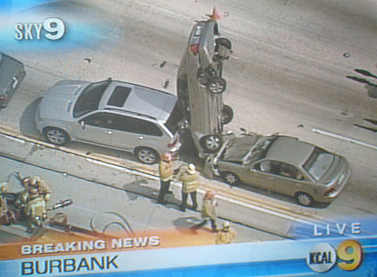
Vehicle Insurance
Liability – ALWAYS REQUIRED
Pays all Claims the District Must Pay as Damages Because of Bodily Injury or Property Damage Caused by an Accident Resulting From the Ownership, Maintenance, Or Use of a Covered Vehicle.
Parts of the Liability Coverage Also Include:
  Personal Injury Protection – Mandated By ND Law
  Funeral Expenses
  Medical Expenses
  Rehabilitation Expenses
  Replacement Services Loss
  Survivors’ Income Loss
  Survivors’ Replacement Services Loss
  Work Loss

Slide 153

Vehicle Insurance
COMPREHENSIVE – Optional – Covers Physical Damage:
  Acts of God – Subject to Deductible
    Fire, Lightning, or Explosion
    Theft
    Windstorm, Hail, or Earthquake
    Falling Objects
    Hitting a Bird or Animal
    Flood
    Mischief or Vandalism
    Rental Reimbursement
    The Sinking, Burning, Collision, or Derailment of any Conveyance Transporting the Covered Vehicle

Slide 154

Vehicle Insurance
COLLISION – Optional – Covers Repair or Replacement of the District Vehicle if the District was “At Fault” or the Other Party has No Insurance - Subject to the Deductible:
    The Covered Vehicle’s Collision With Another Object
    The Covered Vehicle’s Overturn
Note: You Must Have Comprehensive Coverage to Have Collision Coverage

Slide 155

Vehicle Insurance Definitions
ACV = What is it the vehicle worth right now based on age, mileage, and current condition. Vehicle is depreciated based on all of these factors.
RC = What does it cost to replace the vehicle with Like Kind & Quality.
Deductible = The money the District Pays for an “At Fault” Collision Claim. If the Other Party was At Fault, Their Insurance Would Cover the District’s Deductible

Slide 156
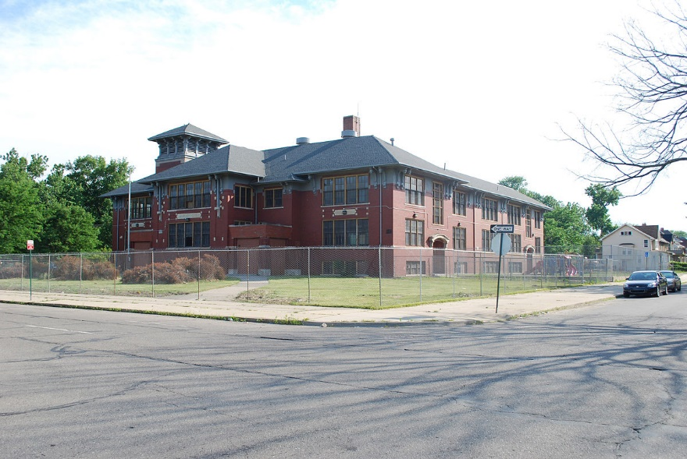
Building and Contents Insurance
Buildings:
If Anything is Permanently Attached to the Building, it is Covered Under the Building Insurance:
  Blinds
  Light Fixtures
  Walk-In Coolers
  A/C Units
  Lockers
  Plumbing Fixtures, Etc.

Slide 157

Contents:
Anything That Was Brought Into the Building:
  Computers
  Desks
  Library Books & Media
  Copiers
  Supplies, Etc.

Slide 158

Building and Contents Insurance
There are 2 Basic Types of Building Insurance
ACV (Actual Cash Value)
Replacement Cost (RC)

Slide 159



ACV Versus Replacement Cost
WHAT’S THE DIFFERENCE?
Actual Cash Value = Subject to Depreciation
Insurer Does NOT Have to Replace with New But Can Use “Like Kind & Quality” Minus Depreciation and Deductible.

Slide 160

ACV Example:
  Building is 50 Years Old and has 100 Year Life. Insured for $25,000,000. Should be Insured for $75,000,000.
  It Will Take $10,000,000 to Make School Usable After a Loss
Settlement Formula is:
Insurance You Have _ X Loss – Depreciation – Deductible = Payment
Insurance You Should Have
$25,000,000 (.33%) X $10,000,000 = $3,333,333
$75,000,000
$3,333,333 – 50% Depreciation = $1,666,667
$1,666,667 - $5,000 Deductible = $1,661,667 Insurance Payment
The District has to Come up With $8,338,333 to Make the Building Useable!

Slide 161

Replacement Cost is NOT Subject to Depreciation
Replacement Cost Will Pay Up to the Value the District Declared, to Repair or Replace
Settlement Formula is:
  Insurance You Have X Loss – Deductible = Payment
Insurance You Should Have
$25,000,000 (.33%) X $10,000,000 = $3,333,333
$75,000,000
$3,333,333 – $5,000 Deductible = $3,328,333 Insurance Payment
District Would Still Have to Come Up With $6,671,667 to Make the Building Useable!

Slide 162


THE BOARD
WILL NOT
BE HAPPY
WITH EITHER
OF THESE EXAMPLES!!

Slide 163

What is the Solution?

Slide 164

Insure the Building & Contents for
Their FULL Replacement Cost!
How to Determine Building Replacement Cost?
Figure Replacement Cost Based on Square Footage
You Will Have to Determine the Building Costs/Sq. Ft for Your Area
Measure the Outside Dimensions of the Building & Ideally Each Room
Determine Total Square Footage & Multiply by Building Cost per Square Foot

Slide 165

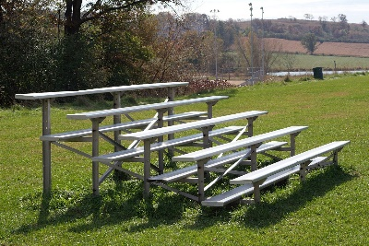


You Will Have to Include Values for Some Outdoor Items:
  Other Out Buildings/Sheds
  Outdoor Scoreboard
  Flagpoles/Bells (If Not Attached to the Building)
  Fencing
  Football/Track Lights/Bleachers, Etc.

Slide 166



How to Determine Replacement Cost on Contents
Rule of Thumb: TAKE PICTURES OF EVERY ROOM
Elementary Classrooms of 20 Students
  $1,000 - $1,500+ Per Room (Excludes any Electronics)
High School Classrooms of 20 Students
    $750 - $1,000+ Per Room (Excludes any Electronics)
EXCEPTIONS:
Band/Music Room
Media Center
Computer Lab, Etc.

Slide 167
Solution!
Have the Building & Contents Professionally Inventoried!
You Get Pictures, Diagrams & Costs Based on Building Costs for Your Area
You Will Get an Inventory for Each Room
You Will Have a File You Can Send to Your Insurer/Agent
In Other Words, You Will KNOW the Replacement Cost of Your Building & Contents AND the Proper Insurance Coverage will be in Place!
THE BOARD WILL LOVE YOU &
YOU CAN SLEEP AT NIGHT!!
YAHOO!!!

Slide 168
Unemployment Insurance
ND Unemployment Compensation Group Account
It is a Service NDSBA Provides to its Members to Handle Their Unemployment Claims (NDUC Group Account)
Established Under the ND Unemployment Compensation Law, This Service Allows Districts to Pool Their Deposits for the Purpose of Paying Claims
After Joining, ALL Unemployment Reports & Claims are Handled Through the NDUC Group Account
The Group Account Requires a Reserve of 1% of Your Previous Year’s Annual (Calendar Year) Payroll up to $1.5 Million and .2% of the Amount Over $1.5 Million
NDUC Calculates a New Required Reserve Figure Based on Your Previous Year’s Annual Payroll and Calculates What Your Payments will be for the Next Fiscal Year Each March. (This Helps With Your Budget for the Coming Year)
All Claims Matters are Sent Directly to Our Office (NDSBA) From Job Service
If you are a member of Group Account, the address should always be NDSBA’s. NEVER CHANGE YOUR ADDRESS to your district’s.

Slide 169

Unemployment Insurance
ND Unemployment Compensation Group Account
We Then Send a Form to You to be Completed and RETURNED TO OUR OFFICE
    We are Then Able to Monitor All Claims & Ensure They are Justified
If Job Service Approves a Claim That we Believe to be Unjustified, we can Assist You With Filing an Appeal
If the Claimant Appeals a Denied Claim, we will notify you.
Things to Keep in Mind When You are a Member of Group Account
NO PAYMENTS ARE MADE TO JOB SERVICE
Group Account Pays Your Claims From Your Required Reserve
Your “Address of Record” MUST BE: NDUC GROUP ACCOUNT
1224 West Owens Ave.
Bismarck, ND 58501-1385
So, we can Monitor Claims as They Come Through

Slide 170



Things to Keep in Mind When You are a Member of Group Account
Respond to Claims Information Requests IMMEDIATELY and BY THE DUE DATE. There Will Be NO APPEAL if You Fail to do This!
All Information You Supply on the Claims Form is CONFIDENTIAL, so BE HONEST and Describe the Termination Situation
  Don’t say, “He was terminated for insubordination.”
Say, “He was terminated for being drunk/impaired and was found passed out in the boiler room with a 5th of rum in his lap and a smoldering marijuana joint in his hand.”

Slide 171

Things to Keep in Mind When You are a Member of Group Account
Remember to Return Claims Information or Verification of Employment Forms to OUR OFFICE (NDSBA) NOT Job Service
If You are Asked to Verify Employment, You Have NO Ability to Determine the Benefits Paid
  The Benefits are Based on the Previous Employer’s Information
  Job Service is Trying to Verify if Your Former Employee Earned Money While Collecting Unemployment

Slide 172

Other Common Insurance Policies:
Equipment Breakdown (Boiler & Machinery Coverage)
  Added to your Property Insurance and Has its Own Deductible
Outdoor Property Insurance
Personal Property Scheduled Insurance
Inland Marine Coverage
NOTE: If the District is Constructing an Addition or a New Building, You are NOT Responsible for Insuring it Until You Take Possession.

Slide 173
BIDS

Slide 174

The School Board May Not Enter a Contract Involving the Expenditure of an Aggregate Amount Greater Than $50,000 Unless:
Publish Notice 10 Days Before Bid Opening in Official Newspaper of the District
Received Sealed Bids
Accept the Bid of the Lowest Responsible Bidder
Exceptions Noted In NDCC 15.1-09-34(1).
NDCC 15.1-09-34

Slide 175
Exceptions Noted In NDCC 15.1-09-34(1)
The personal services of district employees
Textbooks and reference books
Articles not sold on the open market
Patented, copyrighted, or exclusively sold devices or features required to match articles already in use
Patented, copyrighted, or exclusively sold articles so distinctive that only one brand can be purchased
Building construction projects under chapter 48-01.2
School transportation services purchased under section 15.1-30-11
Vehicle fuel purchased under section 15.1-09-34.1
Heating fuel purchased under section 15.1-09-34.1
The purchase of a used motor vehicle, including a school bus, motorbus, or van, intended primarily for the transportation of students
Cooperative purchases with the Office of Management and Budget under chapter 54-44.4
The purchase of products from prison industries under chapter 12-48
The purchase of products from work activity centers under chapter 25-16.2
Cooperative purchases made pursuant to a joint-powers agreement under chapter 54-40.3
For purposes of this section, a "used motor vehicle" means a motor vehicle that has been previously owned or leased and which has an odometer reading in excess of 18,000 mile (28,967 kilometers).
A Board Member who participates in a violation of this section is guilty of a class B Misdemeanor (30 days in jail and $1,500 fine).

Slide 176
Business Manager Duties
7. Keep a True & Accurate District Financial Records
It is a Given, That You Keep Accurate Computer & Paper Records BUT
You Should Also Self-Audit –
Count All The Remaining Cash in the Cash Boxes After Every Deposit - SO
  By Maintaining a Running Balance, (Like Petty Cash, Incidental Revolving, Etc.), You Can Have a Running Total of Overages and Shortages.
Report This to the Superintendent – WHY – To Reduce Fraud
If You Have an Effective Checks & Balances Policy, You Should be Able to Pinpoint Where or When the Shortage/Overage Took Place
NDCC 15.1-07-21

Slide 177
Business Manager Duties
Prepare & Submit a School District Financial Report to the Board Quarterly
OR
In the Case of a Business Manager for a District Having Only One-Room or Two- Room Schools, to Submit the Report at the Request of the Board.
The Law Says Quarterly, but Prudently, it Should be Presented Each Month at the Board Meeting
NDCC 15.1-07-21(8)

Slide 178

Reporting to the Board
Example:
If Your Board Uses Laptops or I-Pads for the Meetings:
Have Your Tech Coordinator Establish a Secure “Cloud” Depository (Dropbox, Etc.)
Create File Folders Within the “Cloud” With Restricted Access
    One for Board Members
    One for Administrator
    One for the Local Newspaper
Create a Personal File for Each Board Member, Administrator, and the Business Manager

Slide 179
To Create an Electronic Board Packet
Create a File Folder on Your Computer for Board Reports
      Organize by Month or Year
Export the Report File From Your Accounting Software to your PC
      Use Whatever Format You Are Comfortable With
        This Will Be Your MASTER FILE
Open a New File
Copy and Paste as Needed
Color Code if Desired
Save the File on Your PC in the Original Format – THEN – Save as a PDF – WHY -
    No One Can Change the File
Copy the PDF File Into the “Cloud” Board and Newspaper File

Slide 180
Examples of How the Reports Would Look
Edgeley Public School District #3 Balance Sheet
08/31/2011 04:02 PM PERIOD ENDING August 2011
Account Number Description Previous Balance Current Month Ending Balance
01 GENERAL FUND
Current Assets
01 101 Cash 94,688.64 (15,222.43) 79,466.21
01 103 Petty Cash 100.00 0.00 100.00
01 111 Investments 567,730.05 (38,732.42) 528,997.63
01 153 Revenue Receivable 7,458.52 (9,987.69) (2,529.17)
01 155 Building Project Accounts Receivable 0.00 53,000.00 53,000.00
Current Assets Subtotal: 669,977.21 (10,942.54) 659,034.67
Total Assets: 669,977.21 (10,942.54) 659,034.67
Edgeley Public School District #3 Balance Sheet
08/31/2011 04:02 PM PERIOD ENDING August 2011
Account Number Description Previous Balance Current Month Ending Balance
03 CAPITAL PROJECTS
Current Assets
03 101 Capitol Projects Cash 3,149.18 1,459.26 4,608.44
03 111 Capitol Projects Investments 32,564.11 (9,849.57) 22,714.54
Current Assets Subtotal: 35,713.29 (8,390.31) 27,322.98
Total Assets: 35,713.29 (8,390.31) 27,322.98

Slide 181
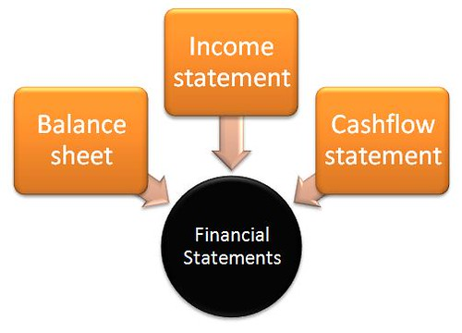
Business Manager Duties
Produce All District Financial Records When Directed to Do So by the Board
  Actual Records
  Reports (Such as Quarterly Financial Reports, etc.)
  Compile Comparative Spreadsheets (For Budget Preparation/Comparison, Negotiations, Etc.)
NDCC 15.1-07-21(9)

Slide 182

Business Manager Duties
Receive and Maintain Custody of Moneys to Which the District or the Board is Entitled
This Means YOU – Not the Activities Director, Superintendent, Cheer Team, Etc.
All Moneys Should be Made Payable to the School and ALWAYS Under YOUR Control
NDCC 15.1-07-21(10)

Slide 183


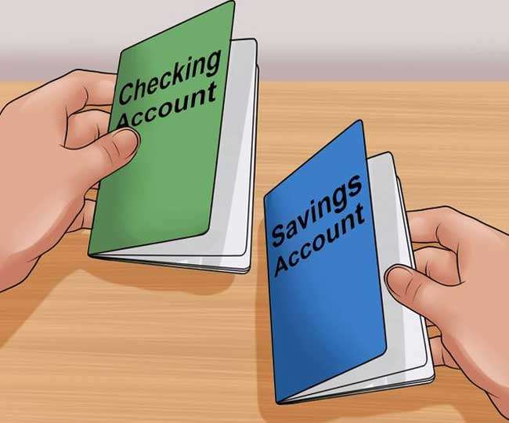
This is Considered Custody:
In a Locked Cash Box in a Locked File After Properly Receipting
In a Safe with Access Limited to Those Covered by the Fidelity Bond
In a Saving, Checking, Money Market, or CD Properly Insured by a Board Approved Financial Institution

Slide 184

This is NOT Considered Custody:
Actual Examples From Business Managers:
  Not in a Shoe Box at the Bottom of a Closet
  Not in an Unlocked Desk Drawer
  Not in the Unlocked Safe with Access by Any Employee, Student, Parent, or Visitor
  Not in Classroom Teacher’s Desk
  Not in an Envelope in the Superintendent’s Desk
  No IOU’s in Cash Box
HOLD ON TO YOUR DISTRICT KEYS – NO LENDING!

Slide 185



What will Solve the Opportunities for Fraud or Theft?
Checks and Balances
‘s &
Also Called Separation of Powers
The Less Opportunities to be ALONE with a Cash Box or Around Money, The Less Chance of Temptations Overruling Common Sense!

Slide 186

Payments Made in the HS or Elementary Office
Checks
Make a Receipt, Including:
  Date
  Fund (General Fund, Capital Projects, Debt Service, Hot Lunch, Activity)
  Amount
  Purpose/Reason
Put Check in Cash Box
Give Yellow Copy of Receipt to Payor
Put White Copy of Receipt in the Receipt Machine
Put Cash Box in Safe & Secure
Cash
Make a Receipt, Including:
  Date
  Fund (General Fund, Capital Projects, Debt Service, Hot Lunch, Activity)
  Amount
  Purpose/Reason
Put Check in Cash Box
Have Payor Sign or Initial all Cash Receipts (DO REGARDLESS - EVEN IF NO CHANGE GIVEN)
Give Yellow Copy of Receipt to Payor
Put White Copy of Receipt in the Receipt Machine
Put Cash Box in Safe & Secure

Slide 187
Notification of Direct Deposits to District by Vendor, Government
Business Manager Make Manual Journal Entries to Correct Accounts
  Attach Copy of Accounting Software Journal Entry Proof Sheet to Bank Deposit/Transfer Slip
    File by Month for Auditor
  Record Amounts on Journal Sheets (in Proper Fund) listing:
    Date
    Vendor/Action
    Amount
    Balance of MMDA
  Run Balance Sheet from Accounting Software and Make Sure Journal Sheet Matches Balance Sheet
DEPOSITS
Business Manager Gets Receipts from Both Offices and Asks for Money Drawer
    Business Manager DOES NOT Know the Combination to the Safe
Receipts are Entered and Balanced Against Receipt Report
Deposit Slip is Made and Appropriate Endorsed Checks/Cash Included
Actual Deposit Must Balance with Receipt Report Before Posting

Slide 188

Payroll
Superintendent Reviews New Teacher Contract Prior to Giving to Teacher for Signature
Superintendent Reviews Timecard Report and Timecards for Each Payroll
  Superintendent Looks at Hours Worked, Overtime, Attendance, Etc.
CONCESSION SALES AND RECEIPTS
Prior to Event Determine, Probable Number of Items That Will be Sold and Restock if Needed
Concession Advisor Counts all Inventory and Records on Spreadsheet (Concession Example)
  Number of Popcorn Bags, Number of Cans/Bottles of Pop by Type
  Number of All Candy by Type
  Number Bags of Chips by Type
  Number of (8 pieces) Pizza
  Number of Hot Dogs, Number Polish Sausage, Number of Hotdog/Hamburger Buns, etc.
Get 2 Cash Boxes Ready (1 for Concession Stand, 1 for Lunchroom)
  Record on Concession Spreadsheet Amounts of Each Denomination
  Have About $160 Between the 2 Cash Boxes
If Change is Needed for High Denomination Bills - Administrator will Get Change
After Sales are Completed, Cash Boxes Returned to HS Office
Class Advisor Combines 2 Cash Box Contents and Counts Money with Club Member
Class Advisor Records Count by Denomination - Both Initial
Secretary Recounts Money and Make a Receipt
    Record Concession Cost and Profits to the Club/School
Put Cash in Box in the Safe and Secure

Slide 189
Ticket Sales, Gate Receipts
At Teacher In-Service - Each Teacher Must Sign up for 2 Ticket Sales Activities (This Part of Contracted Duties)
  If Unable to Fulfill Ticket Sales Obligation - Teacher MUST find a Replacement
  Report Who is Replacement to Superintendent
Secretary gets Gate Cash Box ready with $100 (Gate Example)
  Record Denominations on Gate Sheet and Initial
Put Cash Box in Safe Until Ticket Sellers Pick up
Ticket Sellers Recount Money in Gate Cash Box
  Ticket Sellers Initial Gate Sheet
If Change is Needed for High Denomination Bills - Administrator will Get Change
After Activity, Ticket Sellers Take Cash Box to Office, Count Gate Receipts Together
  Record on Gate Sheet (Both Initial)
Put Cash Box in Safe
Secretary Recounts Gate Receipts the Next Day
Secretary Makes Receipt Noting Appropriate Fund/Activity
Put Cash Box in Safe
Business Manager Recounts the Cash Box Prior to Deposit and Initials Receipt
Deposit is Made
Business Manager Provides Reconciliation of Activity Programs Income/Costs to Athletic Director Monthly
Business Manager Supplies Activity Advisors with Program Income/Costs Every Other Month

Slide 190


Make Yourself Scarce Around a Cash Box
Unless
You Are Making a Deposit or Reconciling the Till.

Slide 191
Purchases for the District
All Purchase Requests Must be Approved by the Superintendent
Teachers Submit Purchase Order to the Superintendent for Approval
  Superintendent Signs the Approved Purchase Order and Gives to the Secretary
Secretary Assigns Purchase Order Number
  Secretary Files Purchase Orders Numerically in Binder by Year
Secretary Orders the Product
When Product Received
  Secretary Compares Product Received to the Product Ordered
  Secretary Checks Off the Product Received on Packing Slip and Gives the Slip to the Superintendent
Superintendent Compares the Packing Slip to the Invoice
Superintendent Codes the Invoice for Payment to the Appropriate Account and Attaches Packing Slip
Superintendent Gives the Invoice and Packing Slip to the Business Manager to Process for Payment
Business Manager Enters Invoices and Gives Board Report to the Superintendent
  Superintendent Reviews Board Report for Board Approved Invoices and tells the Business Manager to Print Checks
Superintendent Provides Agenda for Board Meeting which Includes Approval of Invoices for Payment

Slide 192

Purchases for the District
Business Manager Assembles Board Packet for Approval by Board
  Previous Month Board Minutes to Approve
  Current Month Board Report for all Funds (General Fund, Special Reserve, Capital Projects, Debt Services, Activities, etc.)
  Previous Month Fund Packet
    Balance Sheet
    Revenue Report
    Expenditure Report
    Summary Check Register
Business Manager Prints Checks
  Business Manager has Appropriate Parties Sign Checks
    General Fund = Business Manager and Board President
    Special Reserve = Business Manager and Board President
    Capital Projects = Business Manager and Board President
    Debt Services = Business Manager and Board President
    Hot Lunch = Business Manager and Superintendent
    Activities = Business Manager and HS Principal
After Board Approval and Signatures Completed
  Business Manager Gets Checks Ready for Mailing and Gives to Secretary to get to the Post Office
Business Manager Supplies Superintendent with Expenditure Report a Couple of Times Per Month
  Compares Expenditures to Budgets

Slide 193

Purchases for the District
  Credit Card Purchases
  Your District Should Follow their Purchasing Policy (NDSBA Template HCAA, Purchasing)
  To Ensure Adequate Checks and Balance, the Chief Procurement Officer (Superintendent or Business Manager) has the Authority to approve District Purchases, but Shall NOT Directly Make Purchases for the District

Slide 194
General Purchasing Guidelines
Establish a Purchasing System
  Purchases must Conform to all Applicable State Laws
  All Parties Involved in Purchasing Shall Act in Good Faith, and Purchases at all Levels shall be made in a Manner and Form that Permits the highest Degree of Fair Competition Possible.
All purchases must be Documented Through the Purchase Card (p-card) System, a Purchase Order, Contract, Invoice, or Receipt. All Records of Purchases must be Submitted to the Chief Procurement Officer
  All Purchases must have Budget Appropriations Adequate to Cover the Cost. Purchases not Meeting this Criterion must be Approved by the Board
  Prior to Making a Purchase, the Purchaser shall Check Current Inventories to Ensure that the Purchase is Necessary and Determine if the Item can be Obtained Through Existing Cooperative Purchasing Agreements under NDCC 54-44.4-13 or Federal Agencies contracted under 21-06-08. Purchases made Through such Agreements are Exempt from the Procurement Procedures
  Procurement Requirements May Not Be Artificially Fragmented as to Constitute a Small Purchase or to Avoid Competitive Purchasing Requirements

Slide 195
Artificial Fragmentation means Splitting Purchase Requirements or Splitting an Invoice to Stay Below a Certain Dollar Level to Avoid Competition or Stay within Delegated Authority Limits. Fragmentation must be Based on an Actual Need of the District, and Documentation of this Need Must be Filed with the Procurement Officer.

Slide 196
  If Purchases are made Using Restricted Funds (e.g., Grant Dollars), Purchases must Conform to any Requirements Associated with those Funds
  This is Not Applicable to Legal Services or Public Improvement/Construction Purchases
  Purchases Requiring Contracts Must Comply with the Contracting Standards Contained in Policy and Law
  Set Purchasing Authority Thresholds Example
  Purchases $2,500 and Below
  Purchases $2,500.01 - $9,999.99
  Purchases $10,000 – $49,999.00
  Purchases $50,000 and Above
  If Conflict of Interest is Declared, have a Procedure to Delegate Purchasing Authority
  If a Contract is Required for Purchase
  Contracts Must be Approved by the Board Prior to Execution
  Contract should be no Longer than One Year in Term and May Contain Options for Renewals or Extensions in Accordance with Law
Unauthorized Purchases are Prohibited!

Slide 197
How Many of You Sell Tickets at Activity Games?
How Many of You Have Cash Boxes That are Incapable of Being Locked?
How Many of You Keep Cash Boxes Unlocked and in Unlocked Drawers With Money/Checks in Them?
How Many of You Have Other Personnel That Are Responsible for Deposits, Reconciliation of Bank Statements, and Writing Checks From District Accounts?
How Many of Your Districts Have ONE Person That is Responsible for Ordering Supplies, Verifying Invoices and Paying Invoices?
How Many of You Provide a Timecard Report to Your Superintendent With Each Payroll?
How Many of you Supply the Superintendent With an Absence and Substitute Report With Every Payroll?
How Many of you go Through the Safe Contents Looking for Unreceipted Cash/Checks?

Slide 198

Other Administrative “Duties” Include:
Assist in Lunchroom
Administer Medication
  Oversee Blood Sugar Testing
  Administer Medication Tracking
  Remove Slivers
Answer Phones
  Deliver Messages
Reconcile Sports Program Expenses for Coops, Etc.

Slide 199


Other Administrative “Duties” Include:
Have a Memory Like a Steel Trap
Remind Administrators When:
  Items are Due
  Meetings are Occurring
  Notices Need to be Published

Slide 200

How Do You Get Organized and Remember What is Due When?
Monthly
Quarterly
Annually

Slide 201

GET ORGANIZED

Slide 202











The Hats You Wear

Slide 203

Getting Organized Takes Work
Things I Surrounded my Office Walls with:
Fiscal Year Calendar
Annual School Calendar
Payroll Schedule
Mileage Charts
Teacher Schedules
Salary and Leave Codes
BC/BS & Benefit Costs

Slide 204
What Would You Do?
A Board Member/Administrator wants to be your Friend on Social Media

Slide 205

What Would You Do?
An Employee, Board Member, or Administrator was Apparently Unconscious During a Meeting, Because they are Misrepresenting the Events, and What was Said at the Meeting to District Patrons & Employees.

Slide 206
What Would You Do?
A New Business Manager is Asked to Falsify an Insurance Application Stating the District had Only had Three Minor Losses When in Fact – There had Been Eight and Two of Them Were Major.
The New Business Manager Refuses But Knows The Superintendent has Forwarded the Falsified Application to the Insurance Company.

Slide 207

If Someone Asks for a Favor – Ask Yourself:
Am I Following Policy?
Am I Breaking the Law?
Am I Being Discriminatory?
Should I Report This Request?
Will This Create a Liability Situation?
Is Their Problem Going to Become MY PROBLEM?

Slide 208

Keep Yourself Out of Trouble:
Admit When You Are Wrong
  Take Responsibility
Don’t Ignore Problems – They Won’t Go Away
Always Tell the Truth
  Why Would You Possibly Need to Know That?
  When You Lie, Your Forehead Lights Up!
Be Above Reproach
  People Won’t Even Ask You to do Questionable Deeds
Expect the Same From Others

Slide 209
Don’t Be TEMPTED!
Make Opportunities for Fraud, Hard For Everyone
Establish an Auditor Approved Checks & Balances Policy
Do Not Have Cash Drawers Available, Except to Make a Deposit
  Do You Know the Combination to the Safe?
  I DIDN’T

Slide 210


Slide 211
What’s Next?
Go to the Certification Website for Course Materials
You Can Take the Final Test Anytime After the Course Through October 31, 2023.
The Test is Open Book, so no Proctor Form is Necessary.
I’ll Have Guidance on Your Final Assessment – Worth 50% of Your Grade
The Final Test and Final Assessment is Due by Midnight October 31, 2023.
Call me With Questions: 800-932-8791

Slide 212
FINAL ASSESSMENT:
You have a Choice of:
Create a Special Board Meeting Notice for a Meeting that Occurs the Next Day
Also Let me know where this is posted and who gets notified
OR
Create an Agenda for a Special Meeting that will include an Executive Session
Note: I will not accept material that you have used for a previous meeting. I want you to create the meeting notice or agenda just as you would if you got notified of a Special Meeting today.

Slide 213

QUESTIONS

