Slide 1

School district operations
North Dakota School Business Managers Certification Program
Notes:
Welcome
Mike Bitz – Superintendent of Mandan Schools
Scheduled to be here from 12:30 – 2:30
We won’t take a break, and hopefully we can end early

Slide 2
My Experience
K-8 District:
Administrator - Emerado School 1991-1996
Class B Districts:
3rd Grade – Des Lacs – Burlington 1988-1991
Shared Superintendent between Milnor & North Sargent in Gwinner 1996-1999
Superintendent - Hillsboro 1999-2010
Class A District:
Asst. Supt. In Mandan 2010-2012
Superintendent in Mandan 2012 – Present
8 Different Business Managers in 36 Years
Notes:
Emerado – 1991-1996
K-8 District 150 students. Another 50 students in grades 9-12 were tuitioned to Larimore, Northwood, Thompson, Grand Forks, & Midway. Roughly 40% of our operating budget came from Federal Impact Aid. Rita was not only the business manager, but also the school secretary.
Shared Supt. 1991-1996 between Milnor & N. Sargent in Gwinner
Went to Sioux Falls to train on Software Unlimited Accounting Software. The Supt. I replaced ran the monthly payroll and paid the board bills. The expectation was that this would continue.
In N. Sargent the business manager worked from her home, and I had no access to software unlimited .
I was in Hillsboro from 1999-2010 and worked with Vicky for all 11 years.
I am starting my 11th year in Mandan and I have with 3 different business managers.
In 30 years as a school administrator, I have worked with 7 different business manager. All had different strengths and abilities. Certain duties have been consistent for all business managers, but some duties have been added to some because of interest and abilities.

Slide 3
Course Goals
Make Connections with Business Managers across North Dakota who can be resources for you
Realize the wide-range of topics that Business Managers deal with in school districts including:
  Budget & Accounting
  Administrative Practices & Procedures
  Investments & Insurance
  State & Federal Reporting
  Human Resources
  Bidding, Purchasing, and Inventories
  School District Elections and Selling Bonds
  Support Services (Food Service, Transportation) and Activities
  3. Develop an understanding of the circular nature of Business Manager roles & responsibilities
Notes:
If you can complete this class and have an understanding that the job of a school business manager is circular in nature – that there are certain things you do every month and other things you only do once per year – then we will have accomplished our goal.

Slide 4
Assignment
No Test
50 Points - Develop a yearly calendar of duties that are expected of the business manager in your district each month.
Notes:
I do not want to give you busy work.
Ideally, I would like for you to create a calendar that is helpful to you and that you can use as a reference and update in future years. My hope is that when you retire or leave your district, you will leave it for your replacement.

Slide 5
NDCC
15.1-07-20.1
School district business manager - Employment - Oversight - Reports to board.
1. All decisions regarding the selection and employment of a school district business manager and all decisions regarding the suspension and dismissal of a school district business manager belong to the board of a school district, as set forth in section 15.1-09-33.
2. The board shall exercise administrative oversight with respect to the school district business manager unless the board has established an alternate supervisory structure that is clearly defined in the board's policy and is represented in the school district’s organizational chart, and through board action delegates to the superintendent supervisory responsibility of the business manager's daily operations.
3. All financial reports, whether statutorily mandated or requested by the board, and whether written or oral, must be personally presented to the board by the school district business manager.
Notes:
Passed by the 2015 Legislature at the request of the NDSBA
As a supt., I can suspend a teacher with pay, while we investigate a situation (only the board can suspend a teacher without pay). I can also suspend classified employees with or without pay or fire them. I can do this all without school board approval. - - - A business manager is different – all decision regarding the suspension or dismissal of a business manager belong to the school board.
The board can choose to evaluate the business manager, or they can delegate the evaluation to the superintendent. If the board does the evaluation, it needs to be acted on at an open public meeting. - - - In Mandan, the board has designated the BM evaluation to the superintendent. It is done in private, and the board never sees it.

Slide 6
NDCC 15.1-09-33
Dismissal of a Business Manager
A school board can:
Dismiss a business manager for cause without prior notice
Dismiss a business manager without cause with thirty-days written notice
Notes:
Business Managers do have some job protections.
The business manager is kind of a hybrid between teachers and at-will-employees. At will employees can be terminated at any time – while teachers have due process rights and are entitled to a dismissal hearing before their employment is terminated.
As a business manager you if you do something wrong you can be dismissed immediately. However, if the school board wants to dismiss you without cause, they are required to give you 30 days written notice. My guess is that if it gets to that point you will be dismissed you will be let go immediately and be paid for the next 30 days.

Slide 7
Chain of Command
Who evaluates the business manager in your school district?
School Board?
Superintendent?
No One?
Notes:
Who evaluates the business manager in your district?
* The Board
* The Superintendent
* No One
Most smaller district, including all of the districts I worked in did not have an Organization Chart that showed the chain of command.
I think it might be helpful for you to look at a couple of org charts so you can see how different districts view the business manager position.

Slide 8
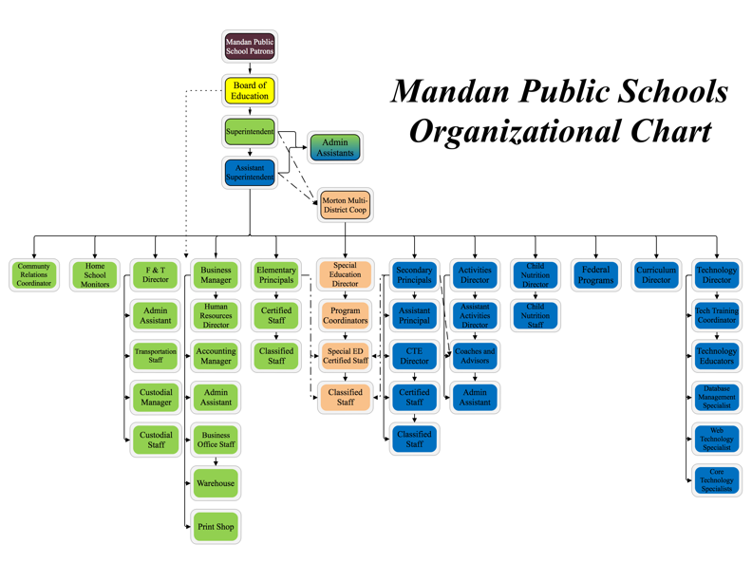
Notes:
In Mandan the BM supervises: Human Resources, Accounting, Purchasing, Warehouse, & the Printshop.
I do Ryan’s evaluation. If the school board did it, it would be a public document and need to be discussed at a board meeting.
The school board does have a direct line to Ryan

Slide 9
Notes:
Minot’s BM is supervised by the supt.
Scott oversees: Foodservices, Purchasing, Transportation, Maintenance, & Accounting

Slide 10
Bismarck Public School
Notes:
In Bismarck the business manger reports to the superintendent.
He supervises: Accounting, Facilities & Transportation, Building Safety & Security, Workforce Safety, Food Service, & Printing.

Slide 11
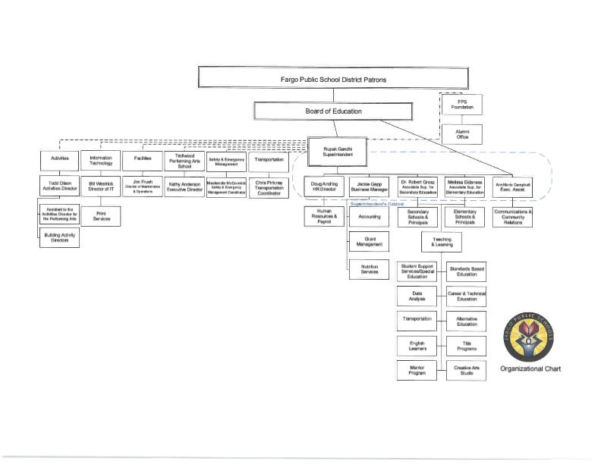
Notes:
In Fargo Jackie is supervised by the superintendent.
The business manager position is part of the executive cabinet.

Slide 12
North Dakota
School Fund Formula
Example: Mandan School District
2023-2024 State Per-Pupil Guarantee $10,646
State Assumed Local Contribution (60 Mills) -$ 2,553
From Local 60 Mill Levy
Actual State Per-Pupil Payment to Mandan $ 8,126
------------------------------------------------------------------------------
Since the assumed local minimum contribution of 60 Mills generates a different amount of revenue in every ND school district and since each school district enrollment is unique, the actual state per pupil payment is different in every school district. See Mandan example above.
Notes:
The easiest way to look at the ND School School Funding Formula is to look at the per pupil payment as a per pupil guarantee.
School Districts are required to levy 60 mills in their general fund. The state will fill in the gap from what the local 60 mills levy generates to get to the per pupil guarantee. Last year is was $10,136. In Mandan we generate about $1,872 per pupil from our general fund levy. The state then fills in the gap to get Mandan to the per pupil guarantee.
No two school in the same get the same per pupil payment from the state, but all schools have the same dollars available per pupil

Slide 13
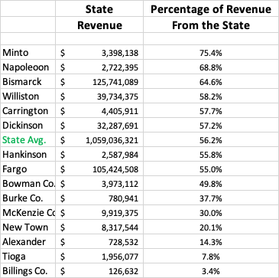
2021 -2022 School Year
Most Recent Year Available
Notes:
State Total Percentage of Revenue
Revenue Revenue from the State
Minto $ 3,299,147 $ 4,346,988 75.90%
Mandan $ 37,191,684 $ 55,086,427 67.52%
Bismarck $ 126,031,064 $ 188,259,437 66.95%
Napoleon $ 2,691,790 $ 4,045,911 66.53%
Williston $ 34,672,699 $ 52,941,899 65.49%
Hankinson $ 2,649,535 $ 4,255,054 62.27%
Dickinson $ 34,173,468 $ 55,491,333 61.58%
State Average $ 1,052,757,320 $ 1,823,132,672 57.74%
Carrington $ 4,228,528 $ 7,398,590 57.15%
Fargo $ 105,424,508 $ 185,496,055 56.83%
Bowman Co. $ 4,154,701 $ 8,440,779 49.22%
McKenzie Co. $ 11,014,916 $ 31,884,006 34.55%
Burke Central $ 814,567 $ 2,403,694 33.89%
New Town $ 7,305,418 $ 23,819,549 30.67%
Tioga $ 2,535,279 $ 8,768,314 28.91%
Alexander $ 919,449 $ 6,229,205 14.76%
Billings Co. $ - $ 3,517,565 0.00%
Here are some random schools I chose. The total revenue includes federal funds, but you can see that the state contribution varies a lot from district to district depending upon what the wealth of the district.
You can see that there is am east/west split. Districts that receive oil money generally get less from the state in their per pupil payment.
However on the chart above both Burke Central on the bottom and Minto on the top have the same amount of money to spend on each student.

Slide 14
Challenges to the
ND School Funding Formula
Bismarck Public School District #1 vs. State of North Dakota
    Filed in 1989 (9 school district with Bismarck as the lead plaintiff). This case was based on equity.
    Alleged that the current system of funding schools was based predominately on a school district property tax base.
    They claimed that as a result of the formula, property poor school districts and their pupils were receiving fewer educational resources per pupil than property wealthy school districts.
    Argued that the system for distributing funds for education failed to equalize local property tax disparities, which resulted in substantial inequities in educational opportunities in property poor school districts.
    The district court agreed with the school districts that the state was in violation of the education (Article VIII, 1 and 2) and the equal protection (Article 1, 21 and 22) provisions of the ND Constitution
    The State of North Dakota appealed this decision to the. ND Supreme Court in 1994
    The ND Supreme Court by a 3-2 vote agreed with the district court decision, however Article VI Section 4 of the ND Constitution requires at least 4 members of the court to declare a statue unconstitutional.
    Since only 3 of 5 members of the ND Supreme Court agreed with the plaintiffs the ND School Funding Formula was allowed to continue.
              https://www.ndcourts.gov/court/opinions/930079.htm
Notes:
I believe to understand and explain the formula, you need to know why we have the formula that we have.
In 1989 Bismarck sued the state of ND claiming that the foundation aid formula was inequitable. They said that some of the highest taxing school districts had less money to spend per student than lower taxing districts.
They argued that a student’s zip code should not determine the quality of his/her education.
BPS won in district court and they also won at the ND supreme court by a 3-2 vote, however because this was a constitutional matter, they needed 4 votes from the supreme court in order to change the formula.
The formula was allowed to stand.

Slide 15
Challenges to the
ND School Funding Formula
Williston Public School District #1 et al. vs. State of North Dakota
    Filed in 2003 (9 school district with Williston as the lead plaintiff). This case was based on adequacy.
    Alleged that the current system of funding was inadequate and that it arbitrarily resulted in widely disparate funding, inequitable and inadequate educational opportunities, and unequal and inequitable tax burdens
    In early 2006 right before the trail was scheduled to begin the two sides agreed to a stay in litigation. It stated that:
      It is desirable and beneficial for them and the citizens of ND to stay this Act and provide the ND Legislative Assembly the the opportunity to settle, compromise, and resolve this Action in the manner and on the terms and conditions set forth in this Agreement. The terms and conditions required that the Governor, by executive order, create the North Dakota Commission on Education Improvement and submit to the Legislative Assembly in 2007 an executive budget that includes at least $60 million more in funding for elementary and secondary education than the amount appropriated by the Legislative Assembly in 2005.
      Many of the changes that have occurred in the ND school finance formula since 2007, have been as a result of the ND Commission on Educational Improvement.
      The Commission on Educational Improvement ceased to exist after the 2013 legislative session.
Notes:
Williston and 9 other school districts sued the state about 10 years later.
Instead of equity they claimed the funding formula was not adequate.
They settled out of court with Gov. Hoven – As part of the settlement the ND Commission on Educational Improvement was formed to develop a new funding formula. The commission was made up of school officials and legislators.
They developed the formula we now have and implemented it over several legislative sessions.
Today it truly does not matter what the zip code of a ND student is. The school district he/she attends has the same resources per pupil to educate that student.
What people often misinterpret is that the formula is not designed to provide tax payer equity it is in place to ensure equity of opportunity for students regardless of where they live.

Slide 16
North Dakota Property Taxes are
Based on Taxable Value
Full & True Value or Market Value – The value the property would sell for on the open market.
Assessed Value – 50% of the Market Value or ½ of the Market Value.
Taxable Value of:
Commercial Property is 10% of Assessed Value
Residential Property is 9% of Assessed Value
Agricultural Property is determined by a productivity formula
Notes:
As a business manager it is important to know a few terms:

Slide 17
Example of How to Figure Taxable Value
Commercial Property
Residential Property
Full & True Value = $100,000
Divide by 2 to get the Assessed Value:
$100,000 / 2 = $50,000
Multiply the Assessed Value by 10% (.10) to get the Taxable Value:
$50,000 x .10 = $5,000
Full & True Value = $100,000
Divide by 2 to get the Assessed Value:
$100,000 / 2 = $50,000
Multiply the Assessed Value by 9% (.09) to get the Taxable Value:
$50,000 x .09 = $4,500

Slide 18
Examples of How to Figure Taxable Value (Cont.)
Agricultural Property
Agriculture property’s taxable value is calculated by NDSU using a formula that is based on productivity. To eliminate huge increases or decreases in value the formula uses a 10-year rolling average, with the high and low years thrown out
Valuations of ag. property have increased dramatically over the last several years.
Notes:
This formula is very complicated and very few people have more that a general understanding of it.
Factors like interest rates, rental rates, sale prices, crop yields, and market prices all are included in determining the value of ag. Land.

Slide 19
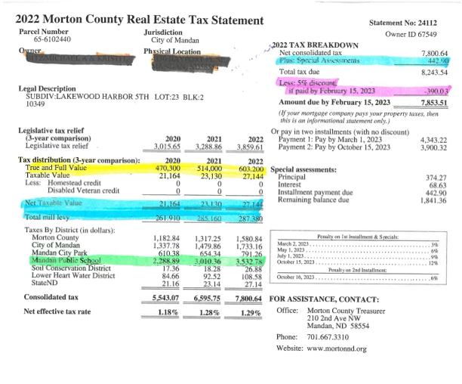
28% Increase in Property Value
54% Increase in Dollars Collected
Notes:
This is an actual tax statement.
You can see it shows the last 3 years of taxes. The yellow highlight is the true and full value of the property. You can see the value of the value of the home decreased by over $15,600 one year.
Above the pink is the taxable value. The assessed value is not included on these statements
The pink is the total school levy by all the taxing districts (school, city, county, parks, water, & state).
The green is the 5% discount for paying taxes by Feb. 15th
Specails

Slide 20
Types of School District Levies
General Fund—The state assumes a general fund levy of 60 mills. The revenue generate from these 60 mills is deducted from the school’s foundation aid payment. A school board can levy up to 70 mills in the general fund without a vote of the people. Note: Several school districts are unable to levy the full 60 mills because they are limited to a 12% increase per year in revenue.
Miscellaneous Fund Levy – Capped at 12 Mills and can be levied by vote of the school board. This levy consolidated several smaller levies including the technology levy. These dollars are co-mingled in the general fund. These dollars are not limited by the 12% cap.
Special Reserve Fund Levy – Districts can levy up to 3 mills per year in the Special Reserve Fund. By a vote of the school board, these dollars can be transferred into the general fund.
Tuition Levy – Districts can levy mills to cover the cost of tuition (special ed. & high school)

Slide 21
Types of School Levies (Cont.)
Special Assessments Levy--Each school district in this state may establish and maintain a special assessment levy to pay city specials on the property it owns (infrastructure improvements like paved streets, sidewalks, sewer and water improvements, etc…).
Building Fund Levy—This levy is capped at 20 mills. It must be put to a vote of the taxpayers and must be authorized by sixty percent of the voters. Once approved it stays in effect forever.
Sinking and Interest Levy—This levy is used to pay for principal, premium and interest payments the district acquires when constructing, purchasing or remodeling a facility. This levy must be approved by 60% of the taxpayers at a regular or special election. The amount of the levy is dependent upon the number mills needed to pay off bonded indebtedness of the school district. A school district is required to levy 110% of the dollars needed to make the principal and interest payment. This is because not all people pay their taxes on time and others pay early and get a discount.

Slide 22
What is a Mill?
Property Taxes are levied by over 2,100 political subdivisions in North Dakota by multiplying the taxable valuation by the mill levy (School Districts, Cities, Counties, Park Districts, Townships, etc…). It is general knowledge that a percent means per 100. A mill simply means per 1000. See below:
Percent (per 100) Mills (per 1000)
1% = .01 1 Mill = .001
10% = .10 10 Mills = .010
100% = 1.00 100 Mills = .100
165% = 1.65 165 Mills = .165
43% = .43 43 Mills = .043
5% = .05 5 Mills = .005
97% = .97 97 Mills = .097

Slide 23
School District Mill Levy Calculation
If a School District’s Taxable Valuations is $15,475,321. its levy and tax collection could look like this:
General Fund 60 Mills (.060) x $15,475,321 = $ 928,519.26
Misc. Fund 5.15 Mills (.00515) x $15,475,321 = $ 79,697.90
Bldg. Fund 10 Mills (.010) x $15,475,321= $ 154,753.21
Sink & Int. Fund 17.5 Mills (.0175) x $15,475,321= $ 270,818.12
Total Levy 92.65 Mills (.09265) x $15,475,321= $1,433,788.49
Notes:
This is a made up school district with a taxable valuation of $15,475,321.
If you take the general fund levy and move the decimal 3 digits to the right and multiply it by the taxable value you will see that the general fund brings in $828,519.26 from local taxpayers.
If you carry this out for each of the levies you will see that in total 92.65 mills will be levied and the local patrons will be responsible for $1,433,788.49 in tax revenue.
Keep in mind that the following year the state will deduct the full $828,519.26 from the district as the districts part to the per pupil guarantee.

Slide 24
Budgeting & Accounting
ND School District Financial Accounting and Reporting Manual
NDCC 15.1-02-08 “The Superintendent of Public Instruction shall implement a uniform system for the accounting, budgeting, and reporting of data for all school Districts in the state and for all Regional Education Associations…”
Notes:
I underline uniform because of the irony. If I sent the same bill to each of your districts, what is the likelihood that they would all be coded the same?

Slide 25
Budgeting & Accounting
Excess General Fund Balance Offset – SUSPENDED for 2 ANOTHER years
  Dollar for Dollar deduct on state payments for any amount of carryover over 35% + $50,000
  Example 1: $800,000 GF Balance on June 30th / $4,500,000 GF Budget = 17.78%
  Example 2: $1,700,000 Ending Fund Balance on June 30th / $4,500,000 GF Budget = 37.78% /
  State deduct of $75,000
  Schools now receive 50% of State Dollars by November 1st – Cashflow not an issue
  General Fund Dollars can be transfer to the special reserve fund or building fund.
  Bond Rating better with higher balance in reserve
Notes:
If your carryover is going to exceed 35%
Transfer money to Building Fund - Building Fund can be created by a majority vote of the board.
To levy money in the building fund requires a vote of the people.
Prepay bills.

Slide 26

Budgeting & Accounting
Negotiations
Role of the Business Manager (Bismarck, Hillsboro, Mandan)
Same Numbers for both sides (Education Association & School Board)
Total Compensation Comparison
“If you are going to make a mistake, give them too much money”
Rodney Mathias - - Contract Language is Forever
Notes:
As business manager you should be a resource for both sides and make sure that both groups are working from the same numbers.
When making comparisons make sure you do not just look at salary. Contributions to benefits like health insurance and teacher retirement can vary greatly from district to district. - - - Always measure total compensation or the total cost to the district for that employee
Each of your schools has a negotiated agreement between the teachers and the school board. I can almost guarantee you that you have some language in the agreement that is problematic for the board or administrators in your schools. Be careful about including poor language in the agreement.
Rodney Mathis, the North Sargent School Board President said it best when he was giving advice to the board negotiators. He said if you are going to make a mistaek, give them too much money. We can fix that next time.

Slide 27

Budgeting & Accounting
The Budget Hearing
https://www.youtube.com/watch?v=E0J09KPCMRc
Use the Hearing as an opportunity to educate
https://archive.org/details/MandanPublicSchoolBoard2021-09-20
Notes:
This fall each of you will be required to have a budget hearing in your district.
I encourage you to use this as an opportunity to educate your patrons and your board about school district finances.
I have a video clip from the Fargo budget hearing a few year back that shows how poorly things can go when you don’t give a presentation first.
I have a link to the Mandan budget hearing presentation that Ryan gave in Sept. of 2019. It helps explain why our levy is where it is.

Slide 28
Current School District Levies
 | Actual Levy | Maximum Levy
General Fund Required | 60.00 Mills | 60.00 Mills
Tuition Levy | 0 | Actual Cost
Special Assessment Levy | 2.26 Mills | Actual Cost + 10%
General Fund Discretionary | 0 | 10 Mills
Miscellaneous Levy | 10.23 Mills | 12 Mills
Specail Reserve | 0 | 3 Mills
Building Fund | 18 Mills | 18 Mills
Sinking & Interest | 39.66 Mills | Actual Cost + 10 %
Required Levies
Discretionary Levies
Voter Approved Levies
Notes:
To help our board I divide the district mill levy into 3 categories.
The blue are required levies
The Yellow are voter approved levies
When we talk about our mill levy, the board only needs to worry about the discretionary levies in green
Even if we get into discussing the 10.23 mills, the impact is so minimal. Cutting 1 mills would save $4.50 per year on a $100,000 of taxable property

Slide 29
Administrative Practices & Procedures
Board Policy
NDSBA Policy Services – Great Resource
https://www.bismarckschools.org/Page/3598
https://www.mandan.k12.nd.us/en-US/school-board-70834dde/board-policies-click-to-view-e8dc3d2
https://www.gfschools.org/domain/1
https://www.fargo.k12.nd.us/Page/122 Administrative Policies
https://www.fargo.k12.nd.us/Page/378
Board Policies
Notes:
Keeping a school districts policy book up to date is difficult.
I suggest that you chunk it out and review different sections each year. In Mandan we have our policy book divided into 7 different chunks. We try to review these over a 7 year period.
NDSBA policy services is a great. All policies are legally reviewed. We use them in Mandan. We also go to the websites and look to see what Fargo, Bismarck, Grand Forks, and Minot are doing in different areas

Slide 30
Administrative Practices & Procedures
Board Meetings & Minutes
  https://www.mandan.k12.nd.us/en-US/school-board-70834dde/agendas-packets-minutes-ba8bdb6c
  Online – All Handouts and financial information is public.
  Cable TV - https://dakotamediaaccess.org/mandan-school-board-videos/
  Consent Agenda – Approve Minutes, Financial Reports, Monthly Bills with one motion. - - - If a board member wishes to have discussion on an item in the consent agenda, they need to request that it be pulled from the consent agenda and added to the regular board agenda.
  Public Participation –A scheduled time for public participation has been placed on the agenda at MPS Board of Education general meetings. The Board desires to hear the viewpoints of citizens throughout the district. Individuals wishing to address the Board are requested to make arrangements with the Board President or the Superintendent prior to the meeting. Comments should be made to the Board and not to individuals in the audience and be related to school operations and programs. The Board will not hear personal complaints against any person connected with the school district. Comments must address topics that are on the agenda. If a citizen would like to add a topic to the school board agenda, arrangements must be made in advance with the Superintendent or School Board President. The Board reserves the right to eliminate or restrict the time allowed for public participation. The Board requests that comments are limited to five (5) minutes or less. Groups of individuals addressing a common concern are asked to designate a spokesperson.”
  “
Notes:
For the most part everything you share with you board members is a public record. TO not share something, you need to qualify for one of the few exemptions in law.
In Mandan, we have paperless board meetings. Each board member has an ipad and we post all documents for the meeting online so any individual in our district can access the same information as our school board members.
All of our board meeting are recorded and shown on cable access tv. I thought I would hate this when I came to Mandan, but it is a good thing. We all behave better when people are watching us.
Consent agenda is for routine motions like approving minutes and financial reports as well as paying bills. If a board member want to discuss something it must be removed from the consent agenda.
Public Participation – This wording is at the bottom of all of our agendas. If you want to speak at a board meeting it needs to be related to the agenda and you need to keep it short. – We never get into a debate. We just thank the individual for their input and move on.

Slide 31
Administrative Practices & Procedures
  Executive Session – Include on Regular agenda / No Minutes / Need to be recorded / cite legal authority for the executive session ie…. “I move we go into Executive Session to discuss negotiation strategy in accordance with NDCC 44-04-19.2” / Limit conversation
  Special Meetings – No Additions to the agenda - - PROPER NOTICE
  Board Retreats – Opportunity to dig deeper into issues and discuss them. No decisions are made at retreats. Minutes are kept. The meeting is open to the public and must be noticed.
  New Board Orientation – Required by law to attend the New School Board Member seminar in October. A local orientation tailored specifically for your district may also be helpful to help new members understand how your board operates.
  Open Records Request - https://attorneygeneral.nd.gov/attorney-generals-office/legal-opinions/opinion-search
  Somebody is Always Watching: https://www.youtube.com/watch?v=SSSBXPda50w

Slide 32
Investments & Insurance
Designated Depositories
ND Fire & Tornado Fund – Building and Personal Property Ins.
ND Insurance Reserve Fund – Vehicles, Liability, Errors and Omissions (Data Breach / Cyber Security)
Notes:
It is a good idea to visit with you board about where they feel comfortable investing money. Is it one bank only or can you shop for the best money market and CD rates?
ND State Fire & Tornado Fund – Building and Personal Property Ins.
ND Ins. Reserve Fund – Vehicles, Liability, Errors and Omissions, Data Breach/Cyber Security

Slide 33
State & Federal Reporting
ND STARS
https://secure.apps.state.nd.us/DPI/Stars/Login.aspx?lo=s
WebGrants
https://grants.nd.gov/index.do
Consolidated Application – requires more precise reporting (Federal Monitoring)
ND Teach – Teacher License Expiration Dates in Software Unlimited
http://www.nd.gov/espb/
Notes:
These website will be important for you
ND STARS is where a majority of school reporting takes place. It is an old and antiquated system and is going to be replaced over the next few years.
The consolidated application is frustrating because in the end your budget needs to match your expenditures to the penny. This is for Title 1, Title IIa, Title IV funds
Webgrants is a new system that the state has moved to over the past year or so to manage discretionary grant.
ND Teach – This is a great way to track teacher license renewals and expiration dates

Slide 34
Human Resources
HR Department – In many Districts the Business Manager is HR
https://www.ndirf.com/reference-section/guides-and-handbooks/
NDIRF
Human Resource Reference Guide for Local Governments in ND (Revised 06/2020)
NDSBA
ND Public School Employers Handbook (2014) - Lot of guidance and samples
Notes:
Human Resources has become a monster.
The ND Insurance Reserve Fund has 2 great resources for schools. If you do one thing when this class gets over – click on the links about and look at the resources that they have available for schools.

Slide 35
Bidding, Purchasing, & Inventories
NDCC 15.1-09-34 - May not enter into a contract involving the expenditure of an aggregate amount greater than $50,000
15.1-09-34. Contracts by school boards - Bids - Penalty.
Except as provided in this section, the board of a school district may not enter a contract involving the expenditure of an aggregate amount greater than fifty thousand dollars unless the school board has given ten days' notice by publication in the official Page No. 9 newspaper of the district, received sealed bids, and accepted the bid of the lowest responsible bidder. This section does not apply to contracts for:
a. The personal services of district employees.
b. Textbooks and reference books.
c. Articles not sold on the open market.
d. Patented, copyrighted, or exclusively sold devices or features required to match articles already in use.
e. Patented, copyrighted, or exclusively sold articles so distinctive that only one brand can be purchased.
f. Building construction projects under chapter 48-01.2.
g. School transportation services purchased under section 15.1-30-11.
h. Vehicle fuel purchased under section 15.1-09-34.1.
i. Heating fuel purchased under section 15.1-09-34.1.
j. The purchase of a used motor vehicle, including a school bus, motorbus, or van, intended primarily for the transportation of students.
k. Cooperative purchases with the office of management and budget under chapter 54-44.4.
l. The purchase of products from prison industries under chapter 12-48.
m. The purchase of products from work activity centers under chapter 25-16.2.
n. Cooperative purchases made pursuant to a joint-powers agreement under chapter 54-40.3.
o. Building materials required for district students enrolled in a course ….for projects sold on the open market
2. For purposes of this section, a "used motor vehicle" means a motor vehicle that has been previously owned or leased and which has an odometer reading in excess of 18,000 miles
3. A board member who participates in a violation of this section is guilty of a class B misdemeanor
Notes:
Schools are required to bis anything that costs over $50,000. The exception to this are listed in law and on this slide.
It is important that you put notice of bidding in your official newspaper.
Generally, need to take the low bid unless there is a valid reason not to accept it.

Slide 36

Bidding, Purchasing, & Inventories
P-Cards or Purchase Orders
ND Educators Service Cooperative
Avera Pace – Group Purchasing
Inventory Appraisal – Valuations Northwest (Boise, ID)
Notes:
Mandan no longer uses Purchase Orders. We put everything on Purchasing Card on P-Cards. Through the ND Office of Management & Budget.
All principals and directors have one. It has a daily limit and a transaction limit that we can adjust ourselves.
We purchase everything with the P-card that we can including fuel, textbooks, supplies, utility bills, etc…
Last year our cash back rebate was over $80,000
Both the ND Educators Service Coop and Avera Pace are group purchasing cooperatives. This is a way to avoid bidding on items. These groups have already done that.
Inventory Appraisal - Mandan used Valuations Northwest out of Boise ID to help us keep our inventory up-to-date for insurance purposes

Slide 37
Support Services & Activities
Child Nutrition
  Direct Certification / Credit Card Payments / Free & Reduced Applications
Transportation
  State Reports / Contracted Service
School Organizations
Activity Accounts / Non-revenue producing activities / Gate Receipts / Concessions
Sports COOPs
How are expenses tracked and divided?
Notes:
Child Nutrition –
Direct Certification if on assistance
Credit Card Payment – Only Check I write – Seerice fee
Free & Reduced Applications
Transportation –
Paid on Riders & Miles
Last spring when school was cancelled (1/4 of the year)
School Organization
Activity accounts – fundraising – get cash deposited
Gate receipts and concessions – put processes in place to prevent fraud
Multiple people counting – controlled access safe – cameras
Sports Coop –
like a marriage – do more than your share
Schools have a $5M budget and they fight over $200 football helmet

Slide 38
School District Elections & Bonding
NDCC 15.1-09-07 through NDCC 15.1-09-26
Appointment to fill a vacancy – process
May partner with County or City to Share Expenses
Be sure to follow timelines published in the NDSBA Bulletin – Mandan Missed Deadline in 2008
Question of Publishing the Minutes – Every two years
Notes:
Board Members Resignation
2 questions:
why do you want to serve
what special qualifications do you have
Election with county
Timeline
Dickinson – Publishing the Miinutes

Slide 39
School District Elections & Bonding
New Law – Canvassing of votes “on the 13th day”
15.1.09-15 School District Election – Declaration of Winner
On the thirteenth day after the election the school board shall meet to canvass the election returns a d shall declare the winner of the election and, in the case of a tie, within three days from the determination of a winner. However, if the election is held under an agreement with a city or county pursuant to sections 15.1-09-22 and 15.1-09-24, the returns must be canvassed and the winner declared as set out in the agreement. The individual receiving the highest number of votes shall be declared elected. The board shall record the results of the election.
Notes:
Must canvas the election 13 days after the election

Slide 40
School District Elections & Bonding
Special Elections
Cannot use District Funds or Public Dollars to advocate for one side or the other – Board Members and School Officials can Share their Opinions
All information shared needs to be factual
Do not have Non-District Residents leading the effort
Use of Social Media???
Focus of Information should be on 4 Questions?
  What is the Need?
  What is the Proposal?
  What is the Cost?
  Why Now?
Notes:
Dave Loyson former supt. In Jamestown & Minot
If you can successfully answer these questions you will pass
Do not use any district funds to promote a yes vote – only facts

Slide 41
School District Elections & Bonding
  Bonding
  Bonds can be sold as a result of an election or can be financed through the District’s Building Fund
  When levying to pay bonds, Districts should levy enough mill to pay 110% of principle, and interest due. (This is because not all people pay their taxes on time and many other pay early and get a 5% discount)
  If you have existing bonded debt, take a look at your interest rates and when the Bonds are callable. It may be wise to refinance the debt.
Notes:
Can sell bonds through an existing building fund
Bismarck is currently building two elementary schools without a vote of the people. They are committing building fund mills to bond repayment for the next 20 years.
With a Sinking & Interest Fund levy you need to levy 110% of the principle and interst payment. This is because of the 5% discount if people pay their taxes early and also because not all people pay their taxes every year.
Interest rates are at historical lows. If your district has outstanding debt, you may want to consider refinancing the debt.

Slide 42
Questions / Comments
Due Date on Assignments – Should be emailed by Sunday, October 29thto Mike.Bitz@msd1.org
Yearly Calendar

