Slide 1

Title Page
Business Manager Workshop
5/5/2022

Slide 2
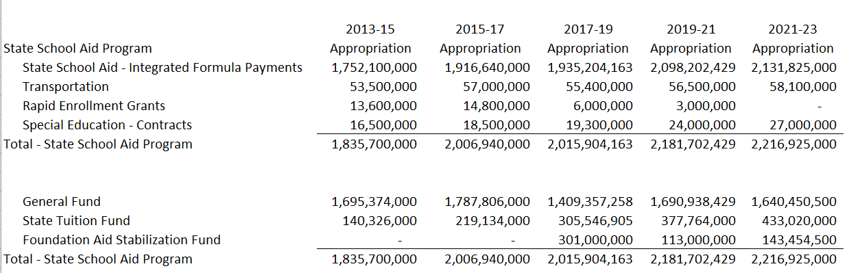
HB 1013

Slide 3
Payment Withholding
HB 1013 gave DPI the authority to reduce Foundation Aid payments for funds required to be paid for school approval during the 2021-2023 biennium
STARS Rewrite (Special Session)
  Payment withheld from Foundation Aid
    Debit Cash
    Debit Expense
      Credit Revenue

Slide 4
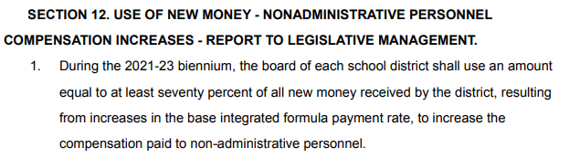
Salary Increases
School District Finance | North Dakota Department of Public Instruction (nd.gov)

Slide 5
HB 1013
Administrative Cost Sharing
  New cooperating districts after June 30, 2022 or special education units are eligible
  Must demonstrate savings by sharing superintendent/special ed administrator and business manager
  Expires June 30, 2024
  Partial salary reimbursement up to a salary of $300,000
  10% if 2 districts cooperate
  15% if 3 districts cooperate
  20% if 4 districts cooperate
  25% if 5 or more districts cooperate
Admin rules have been updated to reflect these changes

Slide 6
HB 1388
Allows school districts to operate virtual schools
Full-time students receive an ADM of one; ADM will be prorated for less than full time
  School will need to submit a calendar for online schools for ADM to be prorated
Students may not open enroll into a virtual school in another district
Districts must enter into a cost-sharing agreement to educate students from another district
  Code Revenue as “Other Local Revenue”

Slide 7
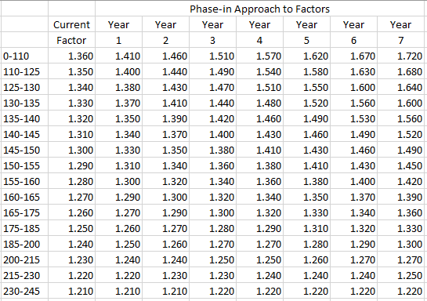
HB 1388
New Weighting Factors

Slide 8
HB 1388
Per Pupil Payment
  2021-22 $10,136
  2022-23 $10,237
No Increases for transition maximum district
  The plan is to be “On the Formula” by 2027-28
New weighting factors for reorganized districts that operate plants at least 19 miles apart for the 2022-23 school year
Elementary districts will have ADM imputed by dividing .60 and will now use the same factors as high school districts

Slide 9
HB 1388
2020 mill levies will be used to calculate in lieu deductions for the 2021-23 biennium
Transition minimum districts will receive a 15% reduction to its transition minimum adjustment (2019 Legislature)
Deductions of property tax will continue to increase to get districts to the 60 mill deduct (2019 Legislature)

Slide 10
Other SFO Bills
HB 1232
  If a school district must cancel class, virtual instruction may be used to account for those hours
DPI communication:
If a policy is not in place and the school must be closed because of weather or other conditions, the school is responsible for making up only those hours and portions of an hour between the time of all hours of classroom instruction for the day if the dismissal will result in the school failing to meet the minimum amount of hours of instruction.
Also, educational leaders must be cognizant of canceling instructional hours and not making them up because of the impact on student learning and teacher contractual days. All schools should make every effort to make up canceled hours of instruction as those hours were approved by public school and governing boards and districts must be good stewards of tax payer dollars.

Slide 11
Other SFO Bills
SB 2165
  Eliminates the ending fund balance offset until July 1, 2023.
  Impact aid will not be included in the ending fund balance offset calculation
SB 2269
  Provides Foundation aid payments to post secondary transitional programs for students that have graduated for students that were on a documented IEP
  The payments will be provided to post secondary schools

Slide 12
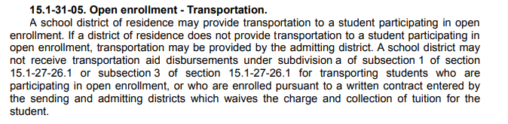
Transportation

Slide 13
Transportation
Reimbursable Miles
  Miles reported for students that are residents of the school district
Non-reimbursable Miles
  Miles added to a route to pick up open enrolled or tuition waived students
Total Miles
  Total transportation miles of the route (Reimbursable + Non- Reimbursable)
  If transporting open enrolled students on the same bus as a resident student, only report the miles the bus would have traveled if not transporting the open enrolled students as reimbursable miles.
    Rides can still be counted for open enrolled and tuition waived transportation

Slide 14
Transportation Funding
Appropriation $58,100,000
  DPI only allowed to spend 50% in year 1 of the biennium
  $29,318,076.87 was needed to fulfill transportation rates
  $268,076.87 was deducted from payments.
Likely to be short again in year 2 of the biennium

Slide 15
Funding Formula
State Formula Aid and Transportation
  The August 1, September 1 payments are based on 10% of estimated entitlement.
  The October payment is based on 20% of estimated entitlement.
  The November 1 payment adjusts payments to 60% of actual entitlement for the school year.
  The December 1 (68%), January 1 (76%), February 1 (84%), March 1 (92%), and
  April 1 (100%) payments are approximately 1/5 of the total remaining entitlement.

Slide 16
Funding Formula Projections
K-12 ADM is projected using the previous year’s fall enrollment
Taxable Valuation for 2022-23 uses 2021 taxable valuation
On time funding is projected using the projected fall enrollment
Nothing is projected for on-time adjustment, however, there will be an adjustment if you received on-time funding the previous year
Other variables are determined using the 2021-22 payment worksheet as of December 2021.

Slide 17
On Time Funding Calculation Example

Slide 18
On Time Funding Calculation Example

Slide 19
On Time Funding Calculation Example

Slide 20
On Time Funding Calculation Example

Slide 21
On Time Funding Example

Slide 22
Transition Payments 2022-23

Slide 23
Transition Payments 2022-23

Slide 24
Mill Levy In Lieu Review
Total In Lieu Revenue = $104,677.77

Slide 25
Property Tax Deduct
2021-22
2022-23

Slide 26
2023-25 Budget
Cost to Continue ($18,000,000)
  Smaller Enrollment increase
  Increases in Property Tax Deduction
  Taxable Valuation Increase
  Transition Minimum Reductions
Changes to the 60 mill deduction have been discussed
How to combat inflation?

