Slide 1
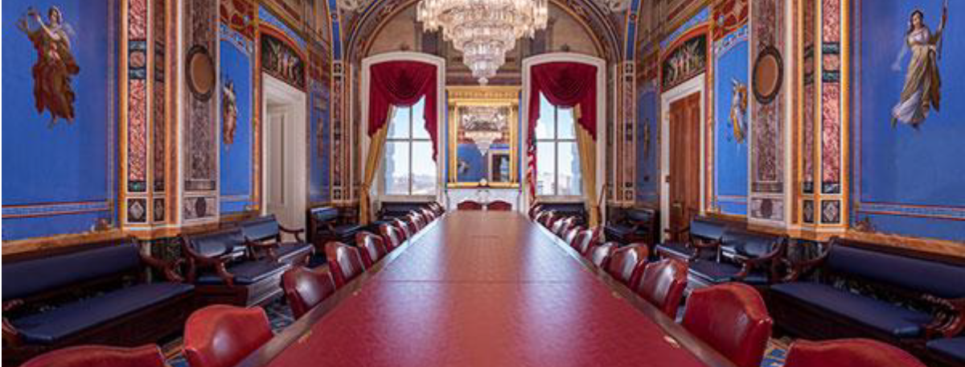
Business Managers May 2022: CNFD Update

Slide 2
Tidbits
Excess Funds: you’re lucky, get your plan in.
SAM unique identifier instead of DUNS number
Apply online: https://apply4schoolmeals.dpi.nd.gov
On-line apps are stored in Primero Edge
You should have a user id and password from doing review forms
Parents are more likely to fill out
Local foods, not just beef.

Slide 3


Slide 4

Meal Pricing for SY 2023
$ $ $ $ $
$ $ $ $
Student Meal Pricing
Adult Meal Pricing
A la Carte Items Pricing

Slide 5

School year 2022-2023
Going back to Eligibilities per Household and collecting Money
  Send out Application for Free or Reduced-Price Meals
  Make Determinations: Free, Reduced or Denied (Paid).
  Verify 3% of applications received by Oct 1, not number of student
  Make sure to update meal counting and claim system
    No tally sheets – unless in a Provision program or CEP
    Do not count second meals
    Do not count adult meals
  Check meal charging policy. Possibly have refunds go to angel fund.

Slide 6
Paid Lunch Equity Tool
Why?
  Historically, prices charged for paid meals have been lower than the cost to produce these meals.
  Therefore, funds that were received from the federal government to produce free and reduced meals often ended up subsidizing the paid meals.
  This is also why we have adult meal pricing rules.
  Prices need to reflect the cost to produce the meal.

Slide 7
PLE Guidance from March 2019
For SY 2019-20, SFAs which, on a weighted average, charged less than the target weighted average price of $3.00 for paid lunches in SY 2018-19 are required to adjust their weighted average lunch price or add non-Federal funds to the non-profit school food service account. The amount per meal increase will be calculated using 2 percent rate increase plus the Consumer Price Index (2.68 percent), totaling 4.68 percent.
It will be interesting to see what CPI percent they say this year. USDA itself said inflation was 8.5% from March 1, 2021 to March 1, 2022.

Slide 8
How to Price Student Meals
7 CFR 210.14(e) Pricing Paid Lunches
  Federal reimbursement for Free meals: $3.73
  Federal reimbursement for Paid meals: $0.42
Target Price for a Paid Student meal: $3.31
  If current Student Paid Price (Average) is less
    Increase price
    Maximum Increase required is $0.10; May increase more than a dime though
    Can round down to the nearest nickel
  If current Student Paid Price (Average) is equal/more than the target:
    Can remain the same
    Look at the budget for Food Service Account
Notes:
https://www.ecfr.gov/current/title-7/subtitle-B/chapter-II/subchapter-A/part-210/subpart-C/section-210.14

Slide 9
Paid Lunch Equity Tool
Data needed to complete the PLE Tool
  The price of paid lunches for October 2010 (SY 2010/2011)
    Different levels of pricing such as elementary, middle and high school.
  The number of paid lunches in each price category.
    If the price of a lunch is the same across all grade levels, only 1 number is needed.
    For multi-priced lunch system, find the number of lunches claimed at each price level.
    Why do you have 2-3 prices?
  The price and number of paid lunches served in October 2019.

Slide 10
Paid Lunch Equity Tool (PLE)
Excel spreadsheet – look for the tabs on the bottom:
  First tab: PLE Guidance. This will have the target price.
  Second tab: Instructions
  9th Tab: SY 2010-2011 price calculator – Base price, all other years depend on this number, it should be the first tab. We have the prices if you don’t.
  3rd Tab: Unrounded Requirement Finder- fills in with 2010-11 average price
  4th Tab: SY 22-23 Price Calculator is filled in
  5th : SY 22-23 Report is filled in.
  This tab says to ‘Please Print and keep in Records’
  Maybe SY 22-23 NonFederal Calculator, then SY 22-23 Split Calculator
  8th Tab: SY 21-22 price calculator, usually doesn’t change anything
  * Not all tabs need to be used or filled out.

Slide 11
PLE Tool Completion
Step 1 – Know your average price charged in October 2010
  We have this information if you do not
Step 2 - Fill in last tab: SY 2010-11 Price calculator
  Do you really need 2-3 prices?
  Remember average 2010-11 price to put in
Step 3 - Fill in 3rd tab: Unrounded Requirement Finder
Step 4 - Fill in next tab: SY 22-23 Price calculator

Slide 12
PLE Tool Completion
SY 22-23 Report is filled in automatically
Don’t want to increase prices?
Maybe need SY 20-21 Non-Federal Calculator
  Money from General Fund or State Match
  Not from a la carte, not from catering.
  Needs to be dedicated money to keep price down.
  Then SY 20-21 Split Calculator
There is an exemption for having a positive balance on December 31, 2021. Hold that thought, might be too good to be true. It’s true but it’s not good.

Slide 13
PLE Rules
We can only make you increase 10 cents per year.
You can increase as much as you want.

Slide 14
Average Prices in North Dakota
Breakfast Lunch
Student Elem $1.69 $2.59
Student Middle $1.74 $2.76
Student High $1.74 $2.77
Student Guest $1.86 $2.92
Adult $2.40 $3.66
Adult Guest $2.48 $3.84

Slide 15
Is $3.31 too high?
Look at invoices.
Compare what you paid for items in any month before March 2022.
See how much the same items cost now. That’s why we gave you SCA.
Remember the 8.5% inflation? That was to March 1.
State Average Price is $2.76 times 1.085 = $2.99
Do you think food prices will go down? How about gas?
There might be some whining. It’s way easier to pay bills when you have enough money. Meals were free for 2.33 SYs plus 2 summers.

Slide 16
Adult Meal Pricing
Adult must pay at least the full price of producing a meal in school.
  Still a great value ☺
  Milk alone at some restaurants is $4.29.
Based on highest student price paid plus federal reimbursement for paid meals plus per meal value of commodities.
Schools that do not have a student meal price use the federal free meal reimbursement as a starting point.
Full price includes federal free rate plus the per meal value of commodities + menu certification incentive + severe need aid

Slide 17
Adult Meal Pricing, with SY 21-22 rates
 | Breakfast – Non Pricing | Breakfast – Pricing School |  | Lunch – Non Pricing | Lunch – Pricing School
Highest Paid Student Price | $0.00 | $_______ (Put your price in) |  | $0.00 | $_______ (Put your price in)
NSLP/SBP Federal Reimbursement | $1.97 | $0.33 |  | $3.73 | $0.42
Value of Commodities | $0.00 | $0.00 |  | $0.3975 | $0.3975 Estimate $0.3960 next year
Total | At least $1.97 | At least $.33 above the student breakfast charge |  | At least $4.13 | At least $ .82 on top of highest student price.
Severe Need | $2.35 with severe need aid. |  |  | $4.15 if the school is severe need | $0.02 more if severe need.

Slide 18
Watch waste
Automatically giving seconds or large portions or extras.
  You worked hard all day, they mostly sat in chairs, maybe had a snack break.
Automatically giving anything they don’t want. Only need 3.
Making students take milk when they don’t want it.
  Make sure water is easy to grab and COLD.
Using individually wrapped everything.
Proteins and other extras on salad bars.
  Make it a choice. Entrée OR ham, cheese, eggs, sunseeds.
Using a whole case, just to finish it.

Slide 19
If we don’t give extras, people will starve.
No, they won’t.
Maybe think about charging the people who want more.
Charge for seconds. Cost plus 10% but just one price.
Cater (sell at a profit) doughnuts or whatever staff are bringing in.
Offer some a la carte items. What are they buying at gas station?
  What about free kids? They would have to pay. Free lunch is just a lunch.
  Maybe have a popular extra item included with the meal once in a while.
  NO charging a la carte. Might want to have parent’s permission first.

Slide 20
Pricing A la Carte
Several Methods:
  Double item cost – round to the nearest quarter.
  Add 30% to food cost – round to nearest nickel.
  Healthy vs Regular food item
    Price Healthier items lower – round down to nearest quarter.
    Price Regular items higher – round up to nearest quarter.
Check Pricing with Non-Program Food Revenue Tool: adjust annually
  Revenue from NP foods > Revenue from program foods
  Cost of NP foods Cost of program foods

Slide 21
2022 Back to School Workshops
Save the Date-
July 26, Tuesday OR July 27, Wednesday
at Fargo Hilton Garden Inn
August 2, Tuesday OR August 3, Wednesday
at Bismarck’s Ramada Inn
August 4, Thursday
at The Grand International Inn in Minot
A block of rooms is reserved at each facility at the state rate.
Please plan to attend one of the workshop dates.
Due to increasing food prices, the registration fee will be $70.

Slide 22

Next Kitchen Counter Conversation
“Top 10 Ways to Get Ready for Next Year”
May 17, 2022
2 p.m. Central Standard Time

Slide 23



Contact us:
Call: 701-328-2294
Email: dpicnfd@nd.gov

Slide 24
Deb Contact info
degeland@nd.gov
701-328-3718
701-391-2884 cell

Slide 25
USDA Nondiscrimination Statement
In accordance with Federal civil rights law and U.S. Department of Agriculture (USDA) civil rights regulations and policies, the USDA, its Agencies, offices, and employees, and institutions participating in or administering USDA programs are prohibited from discriminating based on race, color, national origin, sex, disability, age, or reprisal or retaliation for prior civil rights activity in any program or activity conducted or funded by USDA.
Persons with disabilities who require alternative means of communication for program information (e.g. Braille, large print, audiotape, American Sign Language, etc.), should contact the Agency (State or local) where they applied for benefits. Individuals who are deaf, hard of hearing or have speech disabilities may contact USDA through the Federal Relay Service at (800) 877-8339. Additionally, program information may be made available in languages other than English.
To file a program complaint of discrimination, complete the USDA Program Discrimination Complaint Form, (AD-3027) found online at: http://www.ascr.usda.gov/complaint_filing_cust.html, and at any USDA office, or write a letter addressed to USDA and provide in the letter all of the information requested in the form. To request a copy of the complaint form, call (866) 632-9992. Submit your completed form or letter to USDA by:
(1)mail: U.S. Department of Agriculture Office of the Assistant Secretary for Civil Rights 1400 Independence Avenue, SW Washington, D.C. 20250-9410;
(2) fax: (202) 690-7442; or
(3) email: program.intake@usda.gov.
This institution is an equal opportunity provider.

Slide 26

Time for Questions
or Comments

