Slide 1
School Finance
Business Manager Presentation
Dr. Paul Stremick – Walhalla, ND
Dr. Mike Bitz – Mandan, ND

Slide 2
State Aid Payment Determination
State Payments are determined through a number of different calculations based on the following categories:
  Student Membership
  Other Program Membership
  Formula Adjustments
    Contribution from Other Local Revenue
    Contribution from Property Tax
    Baseline Funding

Slide 3
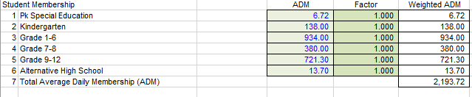
Student Membership

Slide 4
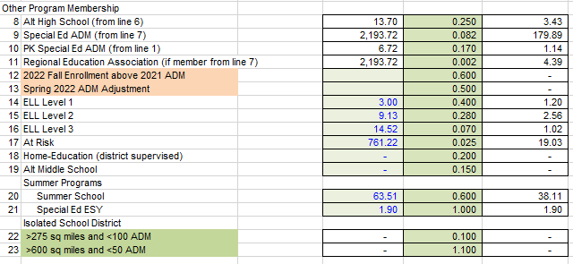
Other Program Membership
After calculating enrollment, the formula goes through a series of equity and adequacy adjustments to provide a base level of financial support.
You add up the total enrollment (Line 7) with all weighted ADM to get a TOTAL WEIGHTED ADM

Slide 5
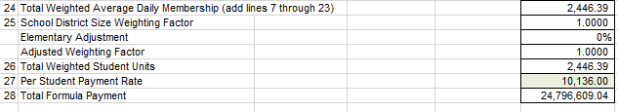
Weighting for School Size
Once you add up Lines 7-23, you have a weighted ADM (2,446.39), but the formula also recognizes that there is a greater efficiency for larger schools. As a result, the formula adds a school size weighting factor that provides an adjustment based on enrollment.
Weighting factors are controlled by policy and any change have a direct result on many students and programs (especially our rural schools).
It is the total weighted ADM that is taken by the per student payment ($10,136 in 2021/2022 and $10,237 in 2022/2023) to get a total formula payment. It is important to understand, however, that the total formula payment (Line 28) is designed to be inclusive of state AND local revenue. A handful of adjustments (i.e. deductions) are still needed so Line 28 is not the amount of funding you receive from the state.

Slide 6
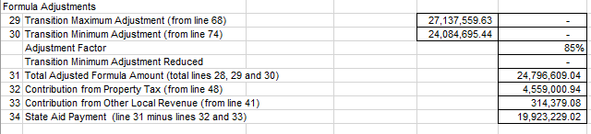
Equity Adjustments
To limit the differences between districts, there are a series of equity adjustments (Contribution from Property Tax and Contribution from Other Local Revenue) that attempt to even the playing field between “wealthy” districts and “poor” districts to ensure that students have similar opportunities.
After these adjustments, you will see in Line 34 the total State Aid Payment. This is the funding you actually receive for foundation aid.

Slide 7
On the Formula vs Off the Formula (Line 29 and Line 30)
94 school districts in North Dakota are currently “off the formula” as transition minimum school districts. Districts that are transition minimum school districts are those that receive more than the formula generates for those districts.
In an attempt to get more districts “on the formula”, the baseline was reset to the 2018/2019 school year for the 2019/2020 school year and beyond. The escalation was amended to be 1% and 5% respectively for the minimum and maximum.
For those 94 school districts, the amount in line 30 will be reduced by 15% for the 2021-22 school year, and will see an additional 15% cut each ensuing year, until all school districts are on the formula by 2027-28.

Slide 8
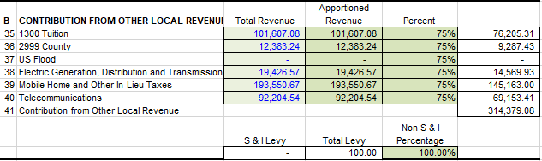
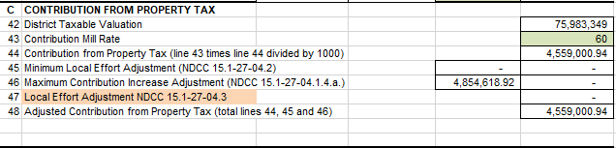
Formula Adjustments

Slide 9
Formula Adjustments

Slide 10
North Dakota
School Fund Formula
Example: Jamestown School District 2021/2022
2021-2022 State Per-Pupil Guarantee $10,136*
*inclusive of state and local revenue
State Assumed Local Contribution (60 Mills) ($ 1,864)
Contribution from Other Local Revenue ($ 129)
Actual State Per-Pupil Payment to Jamestown $ 8,143
------------------------------------------------------------------------------
Since these adjustments generate a different amount of revenue in every ND school district and since each school district enrollment is unique, the actual state per pupil payment is different in every school district and will vary from year to year.

Slide 11
Changes to Funding Formula in the 2021 Legislative Session
  Increases weighting factors for those school districts that are under 245 in ADM.
  Provides a formula for K-6 and K-8 School Districts to use weighting factors. Divide ADM by .6, multiply the weighting factor determined by these numbers by .92.
  Increase per pupil payments $10,136 in 2021/2022 and $10,237 in 2022/2023
  Adjusts Transition Maximum School Districts and increases their payments to get them “on the formula” in 7 years.
  On-Time funding increases by 10% each year of the biennium, 60% for 2021-22 and 70% for 2022-23 payment for new students.
  Adjustments to get all school districts to 60 mill deduction remains in place.

Slide 12
Mill Levies
Fund Group 1 – General Fund
  General Fund Property Tax Levy = 60*-70* mills (limited to 12% increase in dollars each year)
  High School Tuition Levy = amount needed for Tuition
  Miscellaneous Levy = up to 12 mills
  School Safety Plan Levy = voter approved, up to 5 mills (reauthorized every five years)
Fund Group 2 – Special Reserve
  Special Reserve = up to 3 mills (total in fund must not exceed the equivalent of 15 mills)
Fund Group 3 – Capital Projects
  Building Fund Levy = voter approved (cap is 20 mills, or other approved amount)
  Special Assessment Levy – amount needed to make payment
Fund Group 4 – Debt Service
  Sinking & Interest Levy* – voter approved, amount needed to make payment plus 10%
  Judgment Bonding Levy – amount needed to make payment

Slide 13
Question and Answers

